Slide 1




29th Annual Conference on Global Economic Analysis, Kyoto (17-19 June 2026)
Evolution of trade theories and technological change endogeneity in macroeconomic models
Konstantinos Koasidis

Slide 2
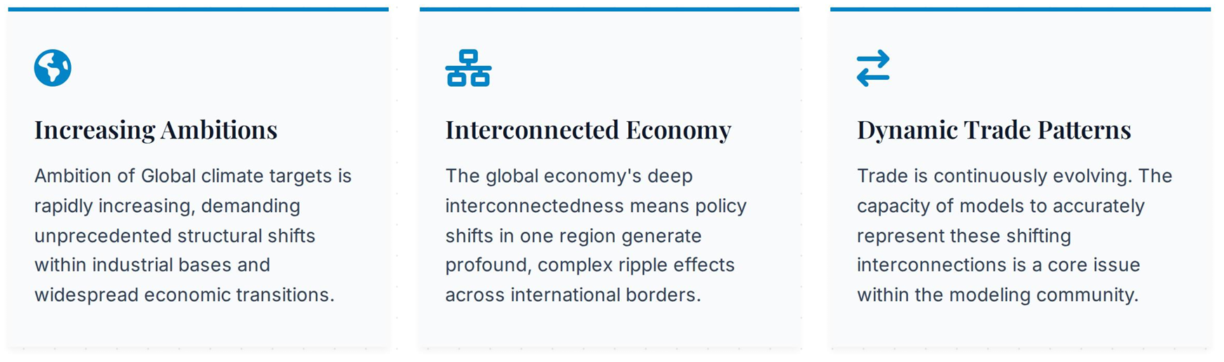


An evolving global landscape
Climate Economy Models: Large-scale macroeconomic and Integrated Assessment Models (IAMs) serve as the analytical bedrock for global climate policy. They are indispensable for precisely mapping transition pathways, policy impacts, and distributional effects across an increasingly complex economy.

Slide 3

The Strategic Importance of Trade
Beyond Simple Assumptions: Modern theory moves beyond traditional Armington assumptions, recognising the economic impact of firm-level productivity and new export varieties.
A Vehicle for Innovation: Trade is recognised as a central driver of embodied technology transfer, foreign direct investment, and vital knowledge spillovers.
Endogenous Technological Change: Understanding the intersection of trade and technology is critical for endogenising innovation and mapping realistic transitions toward a decarbonized economy.

Slide 4
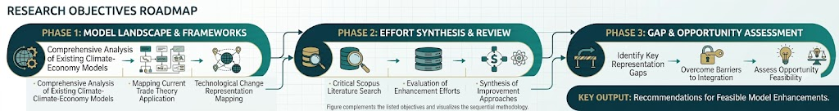
Aim of the study
Three research objectives
O1: Model inventory exploration on trade theory and technological change representation in existing climate-economy models
O2: Systematic literature review (Scopus) on existing efforts towards improving the representation of trade theory and technological change
O3: Identify gaps, barriers and opportunities of potential improvements and assess their feasibility.

Slide 5
Phase I: Model inventory exploration
Model inventories are “accumulation” points of the modelling landscape.
E.g.,
  IAMC wiki (model documentation section)
  IAM PARIS platform
  GTAP inventory
This inventory review aimed at:
  Identify widely used macroeconomic models,
  Document their modelling features,
  Establish a “baseline” on existing capabilities and limitations.

Slide 6
Elicited information
Model type | Principal modelling framework and purpose of the model
Geographic coverage | Spatial resolution of the model
Sectoral coverage | Level of detail of economic activities represented in the model
Trade theory | Theoretical assumptions governing international trade
Technical change | How technical progress is represented and what drives it
# CGEs = 24
# IAMs = 25
# other = 48
# models: 114 – 17 = 97

Slide 7
Trade theories in existing climate-economy models
CGEs predominantly rely on Armington representation of trade,
Many IAMs, macro-econometric, or sectoral models treat trade either more implicitly (e.g., through stylized cost-based mechanisms, fixed exogenous assumptions, econometrically estimated imports/exports, historical trade patterns, global pool based),

Slide 8
Technological change in existing climate-economy models
Technical progress is more pluralistic; there are CGEs and IAMs endogenizing technology/efficiency parameters (LBR- or LBD-driven, or jointly: two factor learning curves); might be sector-focused (e.g. for clean energy); might also be stochastic.

Slide 9
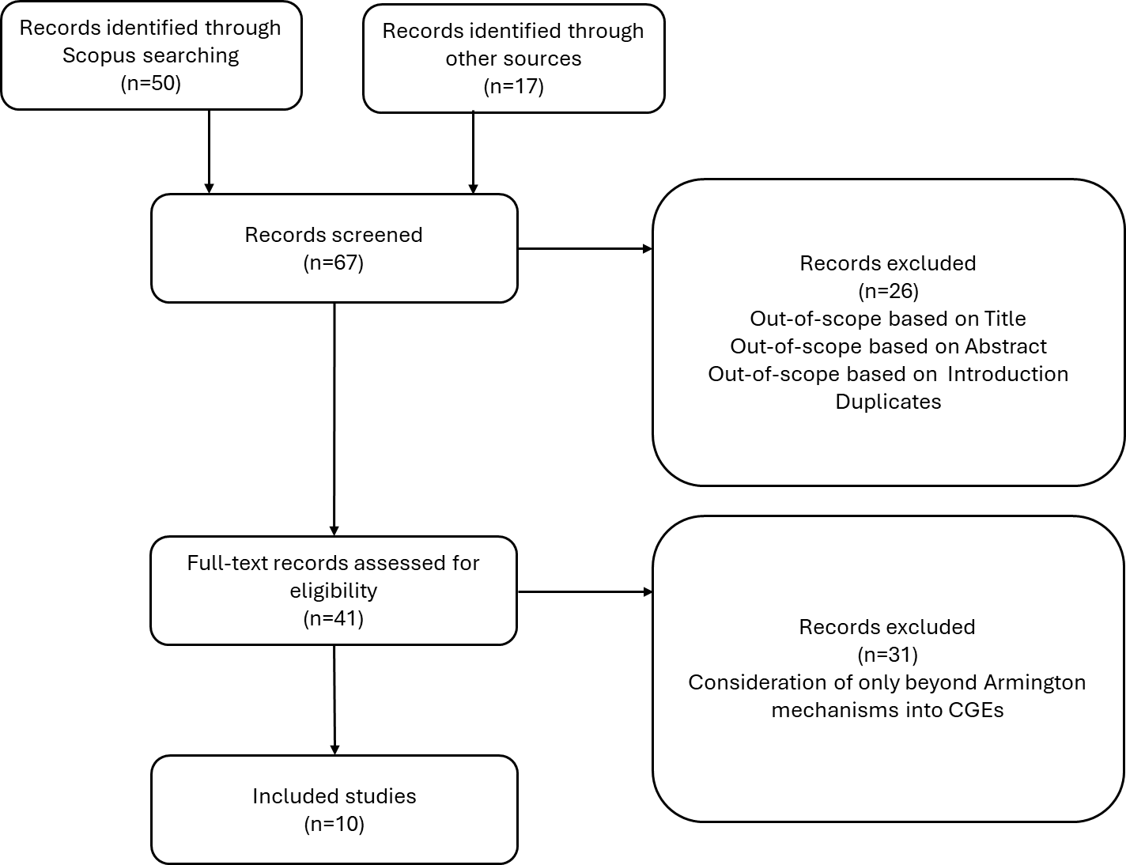

Phase II: Deep dives in the literature
Mini-systematic Literature Review on
“beyond-Armington trade theory”
Mini-systematic Literature Review on
technological change endogenisation

Slide 10
Beyond Armington
Krugman (1980) and Melitz (2003) models have remained at the center of debate.
Krugman model:
  Introduces demand-side variety effects
  Has been criticized over its assumption that all firms are identical in terms of productivity (Bekkers & Francois, 2018)
  One more caveat: varieties are offered to all markets; only trade costs drive consumer preferences (Balistreri et al., 2025)
Melitz model:
  Adds supply-side heterogeneity
  Allows re-allocation of within-sector market shares between less and more productive firms (Dixon et al., 2019)
  Differentiation between fixed and variable costs in bilateral trade allows for more realistic assessments of NTMs (Fugazza & Maur, 2008)

Slide 11
Some interesting cases…
Akgul et al. (2016): incorporates Melitz firm heterogeneity into GTAP (GEMPACK based).
Implementation:
  They define average firm as the firm whose productivity equals the average productivity in the industry.
  GTAP data base issues:
    Love-of-variety: they relax the assumption of composite imports being formed at the border.
    The firm-heterogeneity model requires additional information that is not readily available in the standard GTAP Data Base, such as information on key firm-heterogeneity parameters, fixed set-up costs, and fixed trading costs.
    Shape parameter of Pareto distribution: received externally.
    While it is conventional to use Armington elasticities in traditional models that are based on the Armington assumption, using the same values in a Melitz model could lead to overestimation of trade flows and welfare gains. To this, they use a two-stage estimation method in order to obtain elasticity values that are consistent with the firm-heterogeneity theory.

Slide 12
Some interesting cases… (cont.)
Zhai (2008): incorporates Melitz firm heterogeneity into a CGE with 14 aggregate sectors (calibrated to GTAP Data Base v6.2).
Implementation:
  Assumes no entry/exit of firms. This abstraction is due to the computational difficulties associated with multiple and/or corner equilibria. So, the total mass of potential firms in each sector is fixed and any adjustment in the extensive margin is solely due to the changes in the shares of firms engaged in a specific market. Thus, the model's results may overestimate the changes in the shares of exporting firms following a policy shock and the associated productivity changes, but under-estimate the variety gains brought by new entrant.
  Shape of productivity distribution and fixed and variable trade costs are not available in the Data Base. These parameters are extracted from literature.

Slide 13
Some interesting cases… (cont.)
Bekkers & Francois (2018): incorporates Melitz firm heterogeneity into GTAP (GEMPACK based).
Implementation:
  They use a set of endogenous supply and demand shifters, such that an otherwise conventional Armington model mimics the Melitz model responses.
  To cope with convexity and corner solution issues, two approaches have been adopted:
    Imperfect mobility of production factors,
    Nested import demand with a smaller substitution elasticity between imports and domestic goods, than between imports from different sources
  The framework comes along with a relatively easy calibration, requiring only tariff elasticities, shape parameters of the firm size distribution, and import shares, without needing specific information about the size of fixed trade costs.

Slide 14
Some interesting cases… (cont.)
Other interesting approaches include:
Aguiar et al. (2019):
  Providing a flexible structure combining perfect competition with Armington preferences and monopolistic competition for either Krugman or Melitz (for WTO Global Trade model, GEMPACK-based).
  The switch among the different trade structures is implemented through appropriate changes in the parameters file.
Dixon et al. (2019):
  Converting GTAP into a Melitz-type model.
  The approach leaves unchanged theory and data of standard GTAP.
  Through appropriate closure swaps, they turn on/off the introduction of Melitz for chosen industries.
  No specific data requirements beyond assigning values for Pareto shape parameter and revising Armington elasticities.
Balistreri et al. (2025):
  Presenting the Bilateral Representative Firms (BRF) approach as an opposite to average-firms approach.

Slide 15
Endogenous technical progress
With the rise of endogenous growth theory, modelling has move toward the endogenization of technological change.
Literature draws heavily on Arrow’s (1962) and Romer’s (1990) works, placing learning and knowledge at the center of the growth process.
The recent work of Witajewski-Baltvilks (2025) identifies two dominant trends in endogenizing TC:
  Learning-by-doing mechanisms: producers become more efficient, the more a technology is used,
  R&D investment-based mechanisms: knowledge is treated as a “capital-like” stock that accumulates through “deliberate” activities (such as R&D investments).
A bit more sophisticated variant is the two-factor learning curve, which combines LBD with LBR.
E.g., Klaassen et al. (2005) specify cost as a log-linear function of both cumulative capacity and cumulative R&D investment. In these models, R&D expenditure is aggregated into a stock of “R&D capital,” making it comparable to cumulative capacity as a driver of unit cost reductions.
Witajewski-Baltvilks (2025) notes that such two-factor learning curves address the absence of intentional innovation in pure learning-by-doing models.

Slide 16
Endogenous technical progress (cont.)
Spillover-focused mechanisms are also in the center of debate.
Knowledge created in one sector or region may benefit other sector or regions through channels, e.g. trade.
In modelling terms, these interactions may be captured by letting TC drivers to depend not only on “local” variables, but also on how these variables develop in other regions or sectors.
For inctance, in knowledge stock-based CGE models, this feature can be implemented by letting a sectoral TFP depend on both domestic and foreign knowledge stocks, which can be weighed by trade shares (Fragkos et al. (2017), Parrado & De Cian (2014), Kim & Verdolini (2023)).
E.g. Parrado & De Cian (2014) consider an endogenous relationship between machinery and equipment (M&E) imports, and energy-biased and capital-biased TC.
In the same spirit:
  Robinson et al. (2002) introduce a parameter in the production function as an exponent to the productivity shift parameter. This parameter increases with the trade intensity of the sector.
  Das (2019), in which productivity of primary inputs is affected by technology embodied in traded intermediates.

Slide 17
Endogenous technical progress (cont.)
Spillover-focused mechanisms are also in the center of debate.
Knowledge created in one sector or region may benefit other sector or regions through channels, e.g. trade.
In modelling terms, these interactions may be captured by letting TC drivers to depend not only on “local” variables, but also on how these variables develop in other regions or sectors.
For inctance, in knowledge stock-based CGE models, this feature can be implemented by letting a sectoral TFP depend on both domestic and foreign knowledge stocks, which can be weighed by trade shares (Fragkos et al. (2017), Parrado & De Cian (2014), Kim & Verdolini (2023)).
E.g. Parrado & De Cian (2014) consider an endogenous relationship between machinery and equipment (M&E) imports, and energy-biased and capital-biased TC.
In the same spirit:
  Robinson et al. (2002) introduce a parameter in the production function as an exponent to the productivity shift parameter. This parameter increases with the trade intensity of the sector.
  Das (2019), in which productivity of primary inputs is affected by technology embodied in traded intermediates.

Slide 18
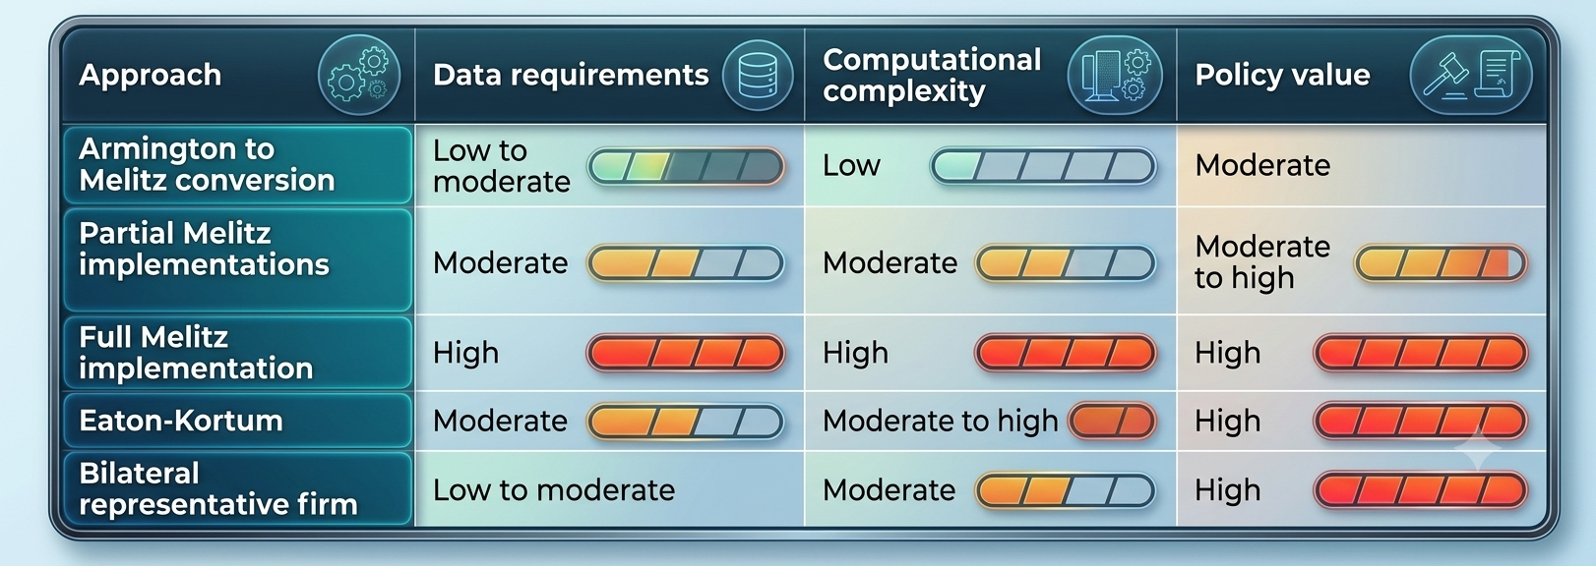
Feasibility Assessment
Own qualitative elaboration, visualised with GEMINI

Slide 19
Thank you!

