Slide 1




Improving Phosphorus and Nitrogen Tracking in a Computable General Equilibrium Model: An Assessment of the Implications of Additive (Quantity Preserving) Production Functions
Elisa Bardazzi, Heleen Bartelings; Wageningen University and Research
Contact: elisa.bardazzi@wur.nl

Slide 2
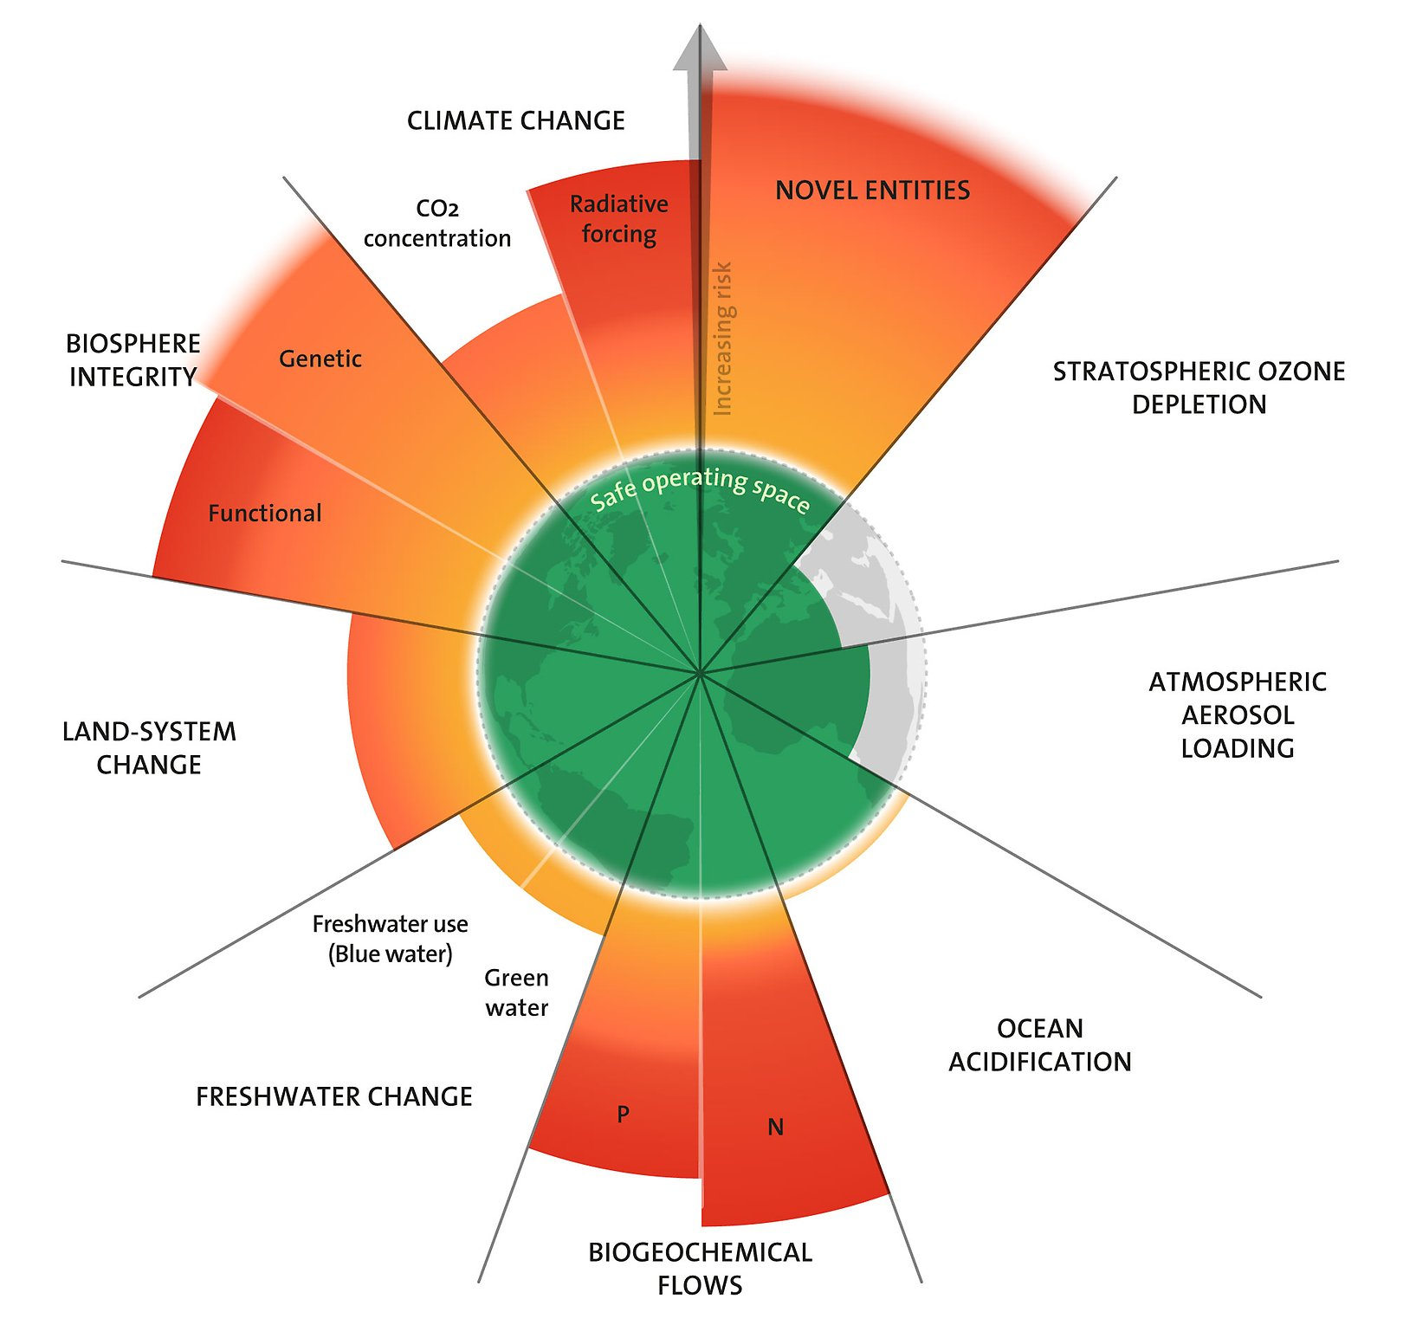
1. Introduction: Research Question Drivers
Nitrogen and Phosphorus Boundary
Food Production and Food Security
Environmental Pressures
Social Pressures
Azote for Stockholm Resilience Centre, based on analysis in Sakschewski and Caesar et al. 2025

Slide 3
1. Introduction: Objectives
A) The inclusion of both organic and non-organic sources of Nitrogen and Phosphorus
B) implementing a quantity preserving (QP) function for nutrient sources

Slide 4
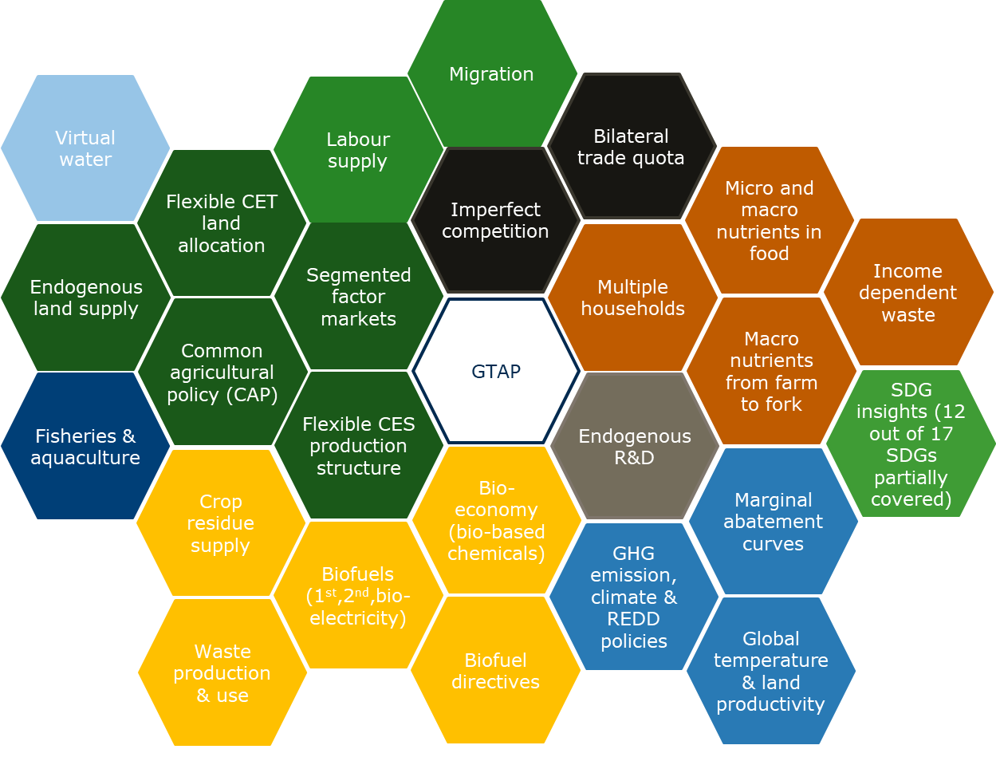
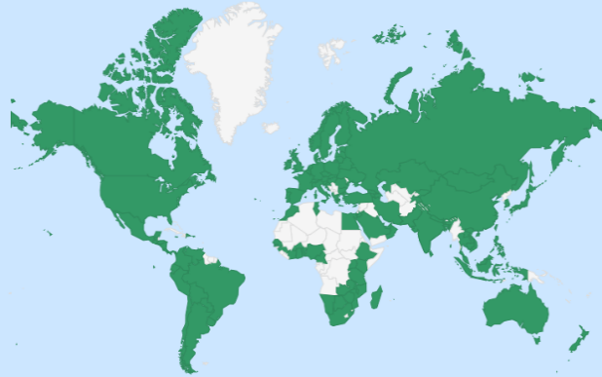
1. Introduction: Methodology – Modular CGE
GTAP model (and data) at the core - shared international starting point for global CGE models
160 regions, >100 sectors, 15 production factors (land, 5 labour types, capital, natural resources (forestry/mining), 3 fossil fuel resources, 4 wild fish stocks)
Extensions
  added as modules
  creating parallel universes of different equations
MAGNET is thus a model platform, not a single model
Notes:
Magnet based on Gtap -> uses data -> build lots of extensions more sectors and production factors then original data, modular setup can turn stuff on or off

Slide 5
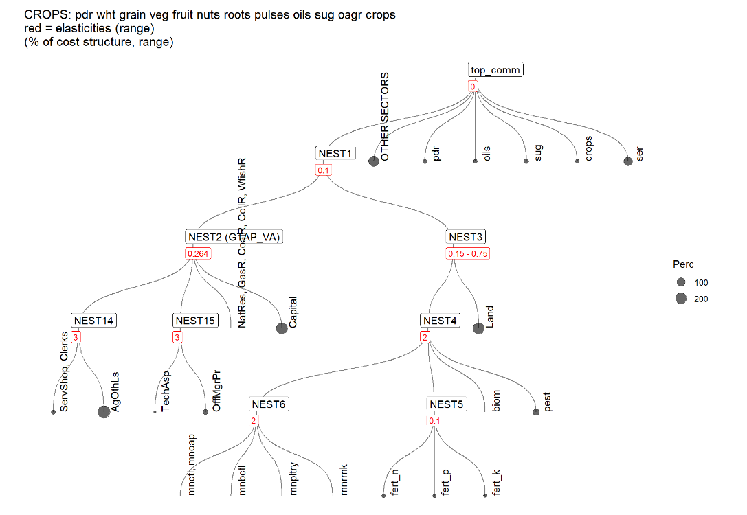

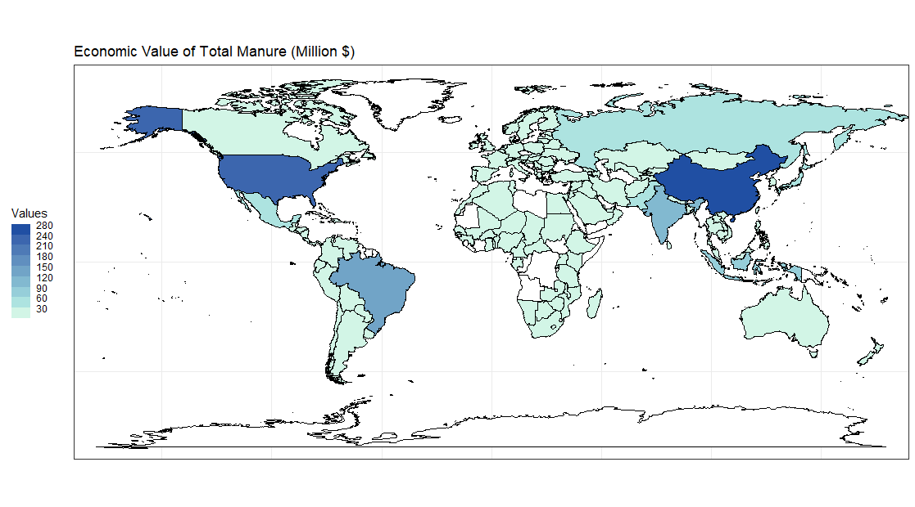
2. Methodology – Organic Fertilisers
Mapping between Data Sources
MAGNET name | OECD Livestock | Brown (2021) Livestock
Dairy | Beef (splitted) | Dairy
Other cattle | Sheep, goats, horses | Sheep, Horses
Beef cattle | Beef (splitted) | Beef, veal
Pigs | Pigs | Hogs
Poultry | Poultry | Chicken, Turkeys
from 1990 to 2021 for 52 countries

Slide 6
2. Methodology – Quantity Preserving Production Function
To introduce preserving additivity of nutrient-based commodities, i.e. the sum of the volumes of the single components adds up to the total volume.
The standard linearised equation applied to each nest of the function is:
Eq. 1 pfa(i,j,r) = ∑ NI(k,j,r)* [pfa(k,j,r) - afa(k,j,r)]
Where pfa is the price of the commodity i produced by sector j in region r by the specific nest, NI is the nest inputs by input commodity k, sector j, and region r (e.g. primary inputs or other intermediates that would act as inputs in the specific nest) and afa is the technological productivity change by commodity i, sector j, region r.
The quantity preserving function is instead:
Eq. 2 pfa(i,j,r) = ∑ NI(k,j,r)* [pfa(k,j,r) * qfa(k,j,r)] - qfa(k,j,r)
Where qfa is the intermediate quantities of commodities asked for production in the nest.

Slide 7
3. Experiment Design – Objectives and Baseline
Baseline Assumptions:
-GDP, population, factor productivity and globalisation from SSP2 (Riahi et al., 2017)
- Labour supply from the Wittgenstein Centre.
-Efficiency of feed use over time, based on IMAGE data (Stehfest et al., 2014)
- Nuclear energy, Grassland use in SSA and biofuels and are assumed to be fixed to 2017.
Two models: Quantity Preserving and Original
Baseline with two models
Introduction of tax on chemical fertilisers with two models

Slide 8
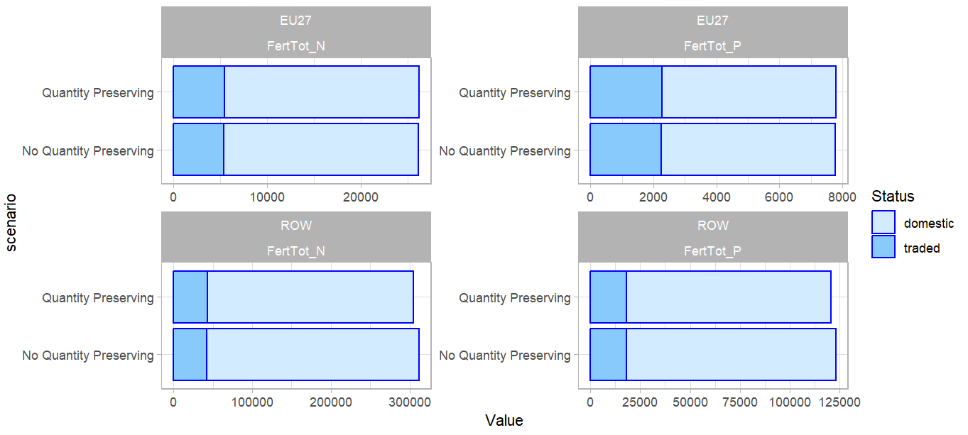
4. Results (I) - Baseline
Domestic and International Nutrient Footprint with and without QP

Slide 9
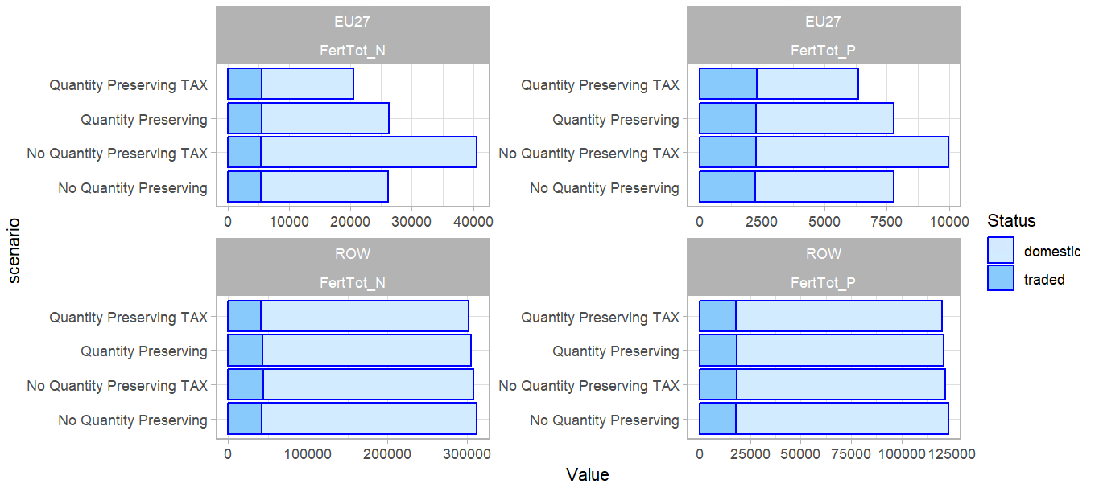
4. Results (II) – Tax Introduction
Domestic and International Nutrient Footprint with and without QP in different scenarios

Slide 10
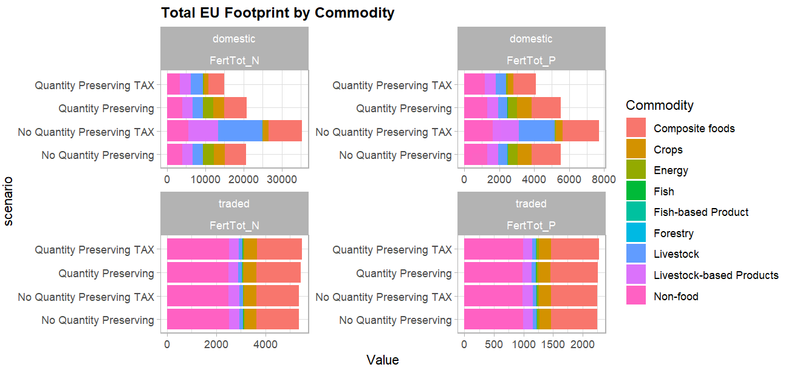
4. Results (III) – Tax Introduction by commodity
Domestic and Imported Eu footprint by scenario.

Slide 11
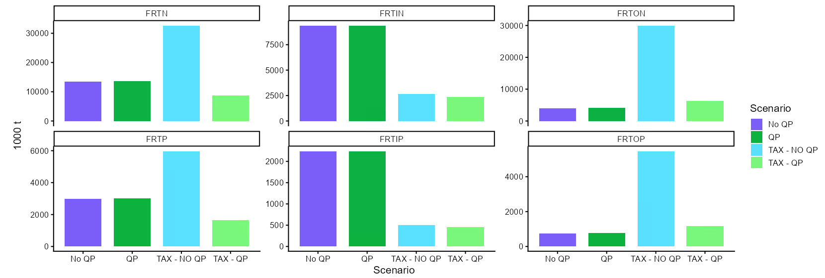
4. Results (IV) – Organic vs chemical impacts
Total, inorganic and organic Nitrogen and Phosphorus use in EU by scenario

Slide 12
5. Conclusions
1) Nitrogen and phosphorus footprints are fundamental to ensure the continuation of the current environmental system, as well as for food production and food security.
2) It shows that the two different types of production structures lead to a significant difference in the results.
3) This choice have significant for both the environment and their repercussions in the political arena.

