Slide 1

Pathways to “High-Performance Sustainability”: Does Organic Farming Close or Widen the Gap?
Omid Zamani, Stefan Frank, Petr Havlik, Jordan Hristov, Sibylle Rouet Pollakis, David Leclere, IIASA
GTAP Conference, Kyoto, June | 2026

Slide 2



Foundations of the EU Organic Sector
Regulatory framework: Regulation (EU) 2018/848, in force since 1 Jan 2022, sets uniform rules on production, labelling
Farm to Fork goal: The European Green Deal sets an aspirational goal of 25% of EU agricultural land under organic farming by 203.
11.1%
18.1M ha
€49.5B
of EU farmland
was organic (2024)
of certified or
converting land
EU organic
retail market
Key Objectives
Evaluate the impacts of achieving the EU's organic farming target.
Compare organic farming with mitigation technology policies.
Assess trade-offs/synergies between policy objectives (environmental performance, emission, and agricultural market).
Is organic farming alone capable of delivering high environmental performance, or does it need to be combined with complementary policies to avoid major trade-offs?
Sources: Eurostat (2024); European Environment Agency (2025); FiBL (2026); Regulation (EU) 2018/848
Notes:
organic sector has grown substantially over the past decade and now represents approximately 11.1% of EU agricultural land, equivalent to around 18.1 million hectares of certified or converting farmland. At the same time, consumer demand has expanded, supporting an organic retail market valued at nearly €50 billion.
This growth is underpinned by a strong regulatory framework. Since 2022, Regulation (EU) 2018/848 has established harmonized rules for organic production, certification, and labeling across the European Union. Building on this foundation, the European Green Deal's Farm-to-Fork Strategy set a highly ambitious objective of increasing the share of organic farmland to 25% by 2030.
While the environmental rationale for organic farming is well established—including lower synthetic input use and potential biodiversity benefits—the implications of achieving such a large-scale transition remain an open policy question.
The objective of this study is therefore to assess the consequences of reaching the EU's 25% organic farming target and to compare this approach with alternative environmental strategies, including biodiversity restoration measures and technological mitigation options. In particular, we examine the trade-offs and synergies between environmental performance, agricultural production, and market outcomes.
Ultimately, the key question is whether expanding organic farming alone can deliver the environmental improvements sought by policymakers, or whether it needs to be combined with complementary measures to achieve sustainability objectives while maintaining agricultural productivity and food affordability."

Slide 3





Scenario Design
Organic at member state
ORG-MS
Fertiliser price shock
FERT
GHG price
GHGPRICE
Organic land reaches 20% of agricultural land in every Member State. Stricter spatial constraint than ORG-EU.
Fertiliser prices increase by 70%, driven by external shocks such as geopolitical conflict or CBAM-related cost increases.
Uniform carbon price of 33 USD/ tCO₂e by 2030 applied to all agricultural emissions at the farm gate.
Organic at EU
ORG-EU
Fertiliser shock + Organic EU
FERT-ORG
GHG price + Organic EU
GHGPRICE-ORG
Organic land reaches 20% of total EU agricultural land, allocated flexibly across Member States. Motivated by the Farm to Fork Strategy.
Combines the FERT fertiliser-price shock with the ORG-EU organic-land target to assess joint effects.
Uniform carbon price of 33 USD/ tCO₂e by 2030 applied to all agricultural emissions at the farm gate, combined with ORG-EU.
Note: ORG-EU and ORG-MS differ in spatial flexibility. Combined scenarios (GHGPRICE-ORG, FERT-ORG) layer policy or market shocks onto the ORG-EU target.

Slide 4
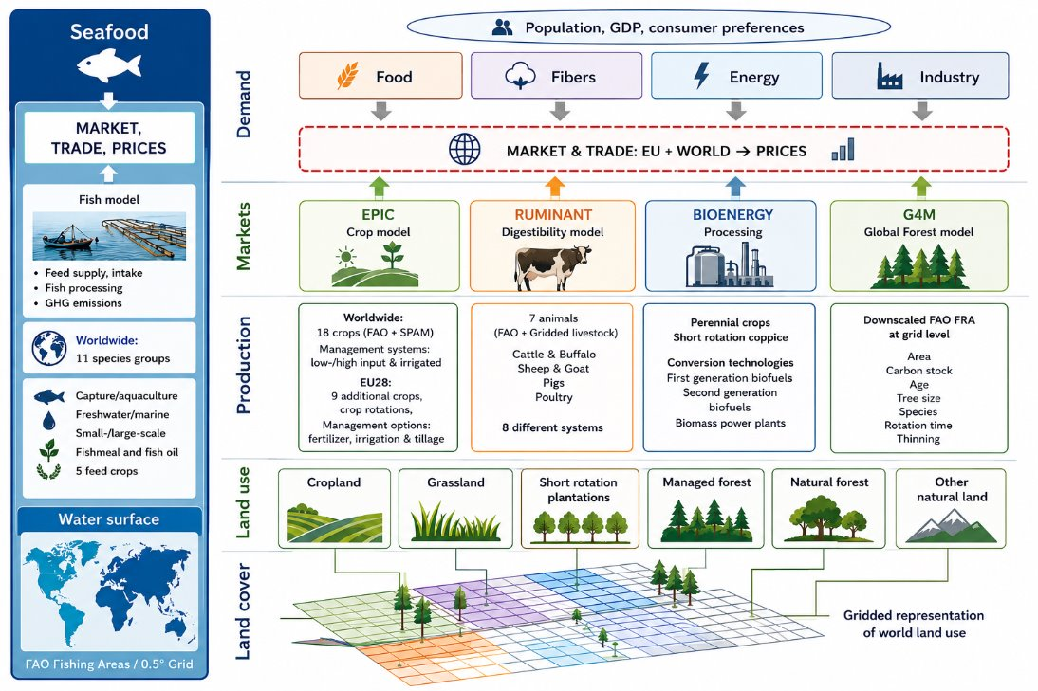
GLOBIOM
Modelling Framework​: Partial Equilibrium Model​, recursive dynamic optimization : 10-year time steps to 2100​
Spatial Representation​: Spatially-Explicit Production Systems​, Endogenous Land-Use Change​, Flexible Regional Aggregation​ 60 Regions​
Sector Coverage​: Crop & Livestock​, Forestry​, Bioenergy​
Integrated Land-Use Perspective​: Biophysical-Economic Coupling​, Integrated AFOLU Representation​, Climate, Land, Water, Bio-Energy Nexus
Notes:
GLOBIOM (Global Biosphere Management Model) is an integrated land-use and economic modeling framework that simulates interactions among agriculture, forestry, bioenergy, fisheries, and trade at the global scale. Using a recursive dynamic optimization approach, it projects developments up to 2100 while capturing regional differences in production systems, land-use change, and market dynamics. By linking biophysical processes with economic drivers, GLOBIOM evaluates how population growth, consumer demand, climate change, and policy decisions influence food production, energy supply, forest resources, water use, and greenhouse gas emissions. This integrated perspective makes it a powerful tool for assessing sustainability trade-offs and supporting long-term land, climate, and resource planning.

Slide 5
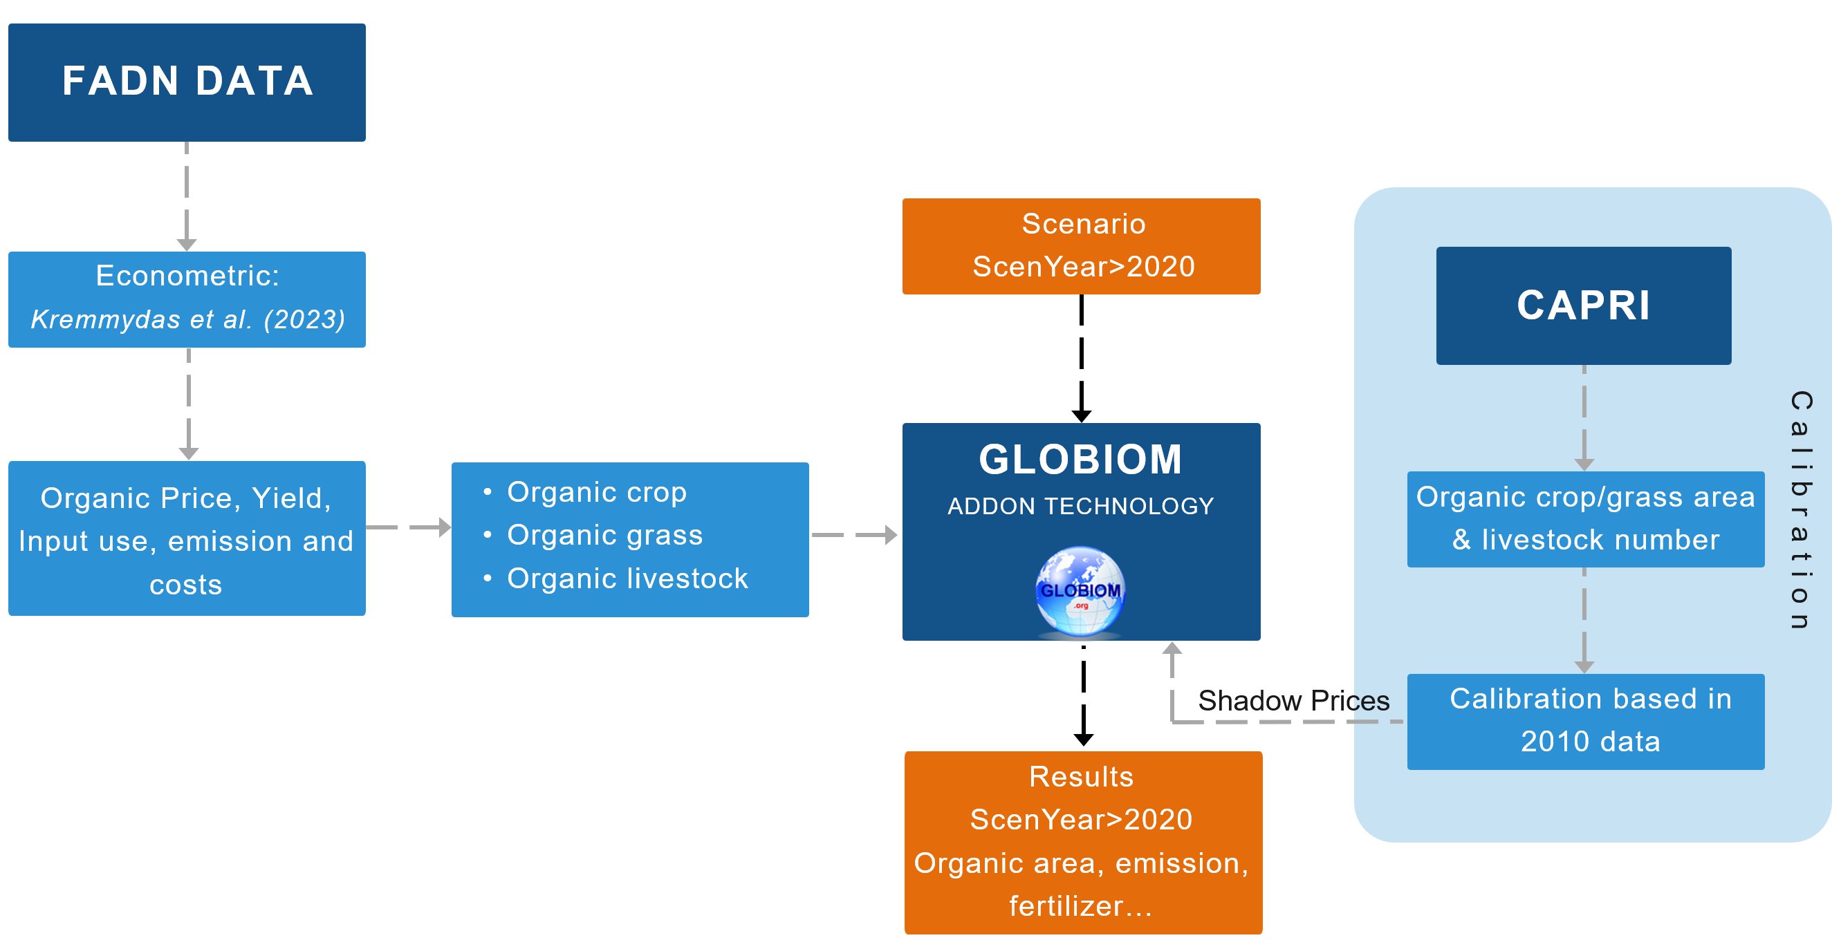
Input Data & Model Setup
The grass cost data are based on the LAMASUS D5.3 Costing Database (Schäfer et al., 2025).
Kremmydas, D., Ciaian, P., & Baldoni, E. (2023). Modeling conversion to organic agriculture with an EU-wide farm model. Bio-Based and Applied Economics, 12 (4), 261–304.
Notes:
I’d explain here where our data comes from and show also some key parameters e.g. organic yields, costs, price premiums and our GHG assumptions across MS for 2010 e.g. % or absolute change compared to conventional (e.g. for key crops)

Slide 6
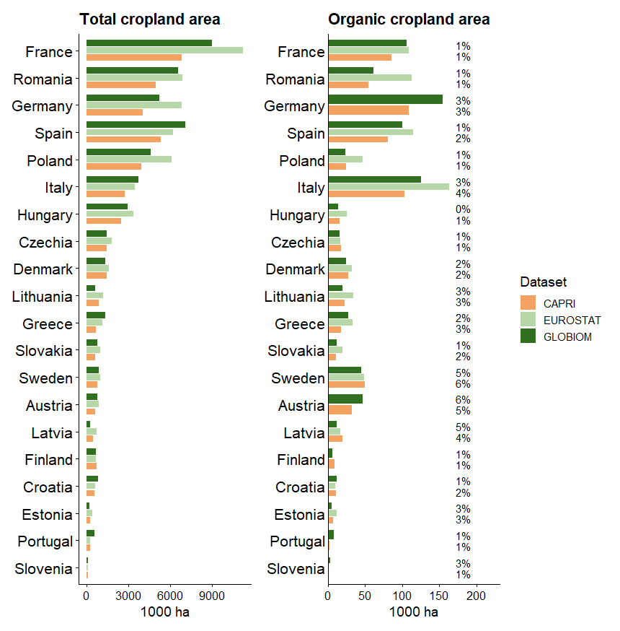
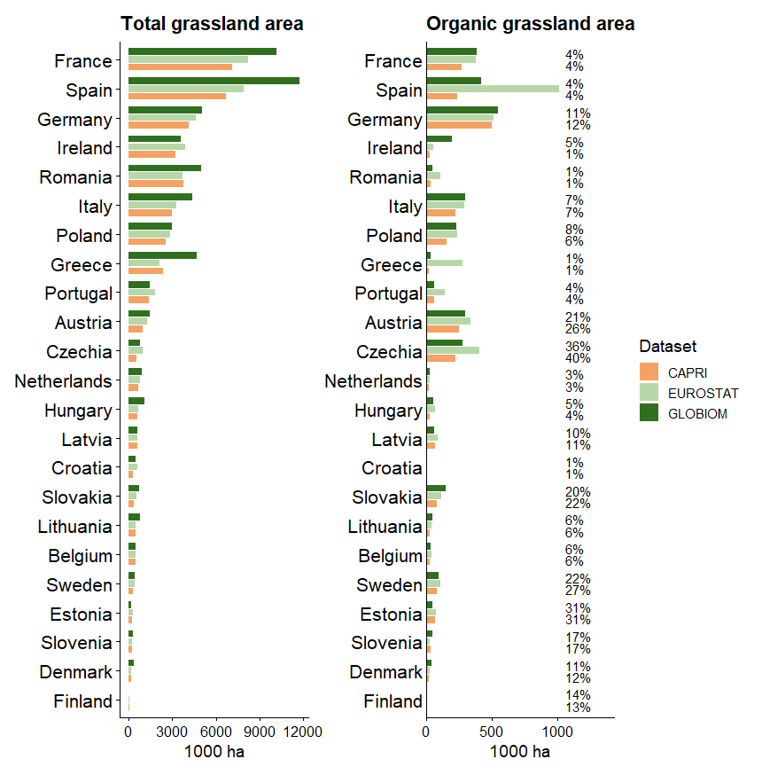
Calibration Validity: Crops (2010)

Slide 7
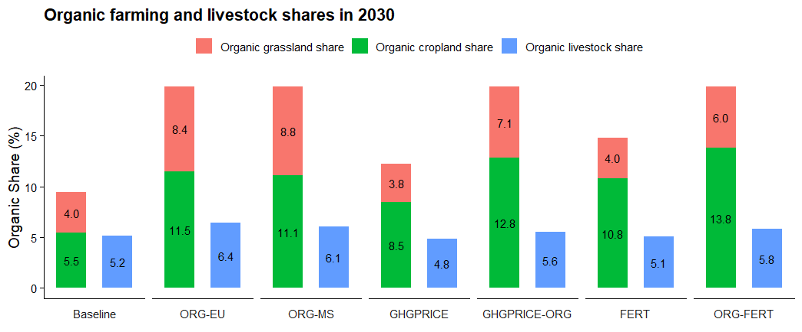
EU Organic Share (2030)
GHG price and fertilizer costs affect organic cropland more → Conventional crops use carbon-intensive inputs.
Notes:
This figure compares the projected share of organic cropland, grassland, and livestock production in the EU by 2030 under different policy and market scenarios. The results show that policies promoting organic farming (ORG-EU and ORG-MS) substantially increase organic land use, nearly doubling organic cropland and grassland shares compared to the baseline. Carbon pricing and higher fertilizer costs also drive expansion of organic cropland, as conventional farming relies more heavily on carbon-intensive inputs. The strongest growth occurs when organic promotion is combined with fertilizer cost increases (ORG-FERT), highlighting the complementary role of environmental policies and input price signals. In contrast, organic livestock shares change only modestly across scenarios, suggesting that crop production is more responsive to these policy interventions than livestock systems.

Slide 8
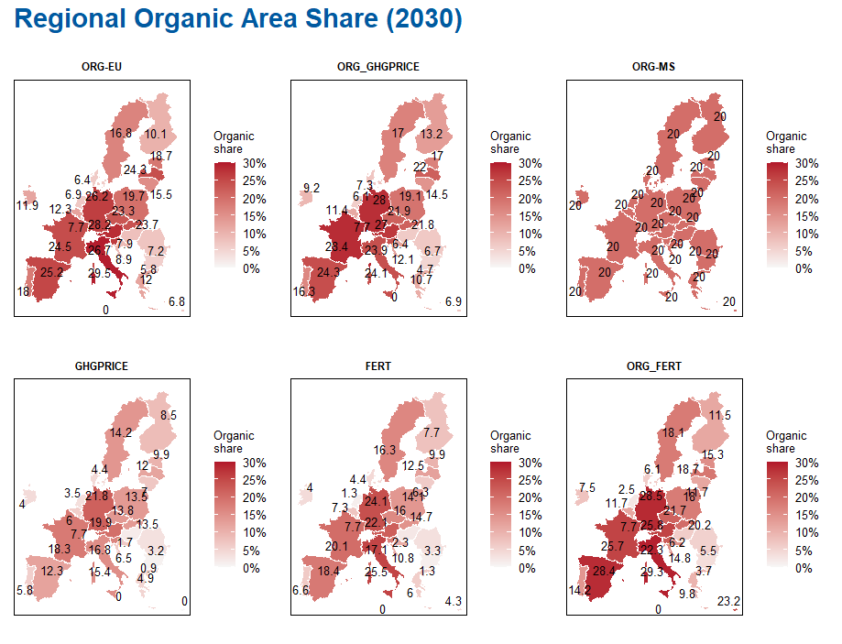

Regional Organic Area (2030)
As we move from Northern to Southern Europe, the yield gap becomes smaller, making organic farming more competitive in terms of production costs.
Organic farming becomes competitive when:
$$Y_{o}=\left(1−g\right)Y_{c}$$
$$GM_{c}=B+GM_{o}$$
Notes:
This figure illustrates the regional distribution of organic agricultural area across Europe in 2030 under different policy and market scenarios. The results reveal significant spatial variation, with Southern and Western European countries generally achieving higher organic shares than Northern and Eastern regions. This pattern reflects a smaller yield gap between organic and conventional farming in southern climates, making organic production more economically competitive. Policy-driven scenarios (ORG-EU and ORG-MS) substantially expand organic area across all member states, while carbon pricing and higher fertilizer costs further increase adoption by reducing the relative advantage of input-intensive conventional systems. The combined scenarios (ORG-FERT and ORG-GHGPRICE) generate the largest organic shares, particularly in countries where organic farming already has favorable production conditions. Overall, the findings highlight that both policy support and market-based environmental incentives can accelerate the transition to organic agriculture, although impacts remain strongly region-specific.

Slide 9
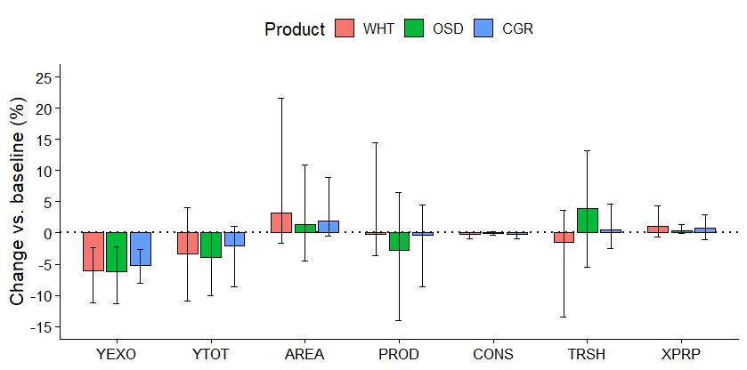
Crop Market Adjustment (2030)
Organic farming reduces yields by ~5–6%.
Land area expands by 1–3% to compensate for lower productivity.
Production impacts are smaller than yield impacts because of land-use adjustment.
Trade becomes an important adjustment mechanism, especially for oilseeds. Crop prices rise slightly due to tighter supply conditions.
Notes:
This figure shows how crop markets adjust to the expansion of organic farming in the EU by 2030. Although organic production is associated with lower yields (around 5–6% below conventional systems), the overall impact on crop production is moderated by market responses. Farmers expand cultivated land by 1–3% to compensate for lower productivity, limiting declines in total output. The reduction in yields is therefore larger than the reduction in production, demonstrating the importance of land-use adaptation. Trade also plays a key balancing role, particularly for oilseeds, where imports increase to offset supply constraints. As a result, consumption remains largely unchanged, while crop prices rise only modestly due to slightly tighter market conditions. Overall, the findings suggest that agricultural markets can absorb a substantial expansion of organic farming through a combination of land-use changes, trade adjustments, and moderate price responses.

Slide 10
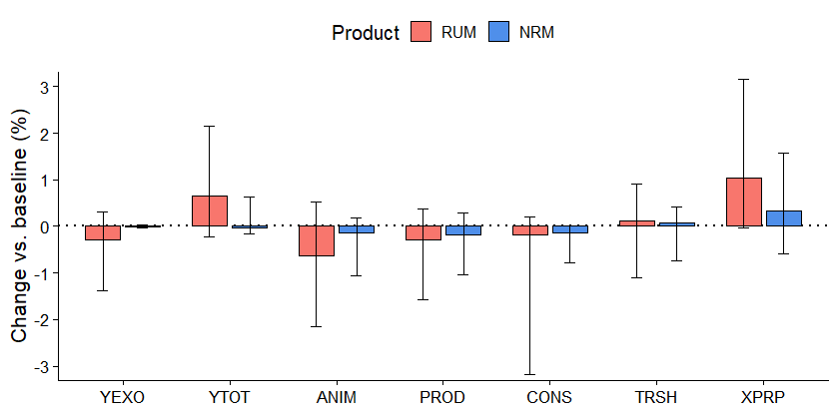
Livestock Market Adjustment (2030)
Livestock impacts are much smaller than crop impacts. Animal inventories decline only slightly (<1%).
Production remains close to baseline levels.
Consumption decreases marginally, especially for ruminant products.
Prices increase modestly, with stronger effects for ruminants.
Notes:
This figure shows that the expansion of organic farming has relatively limited effects on livestock markets compared with crop markets. Animal inventories decline only marginally—generally by less than 1%—resulting in production levels that remain close to the baseline. The modest reduction in livestock output is accompanied by small decreases in consumption, particularly for ruminant products, reflecting slightly higher production costs and market adjustments. Trade plays a balancing role, helping to offset domestic supply changes and maintain market stability. As a result, livestock prices increase only moderately, with somewhat stronger price effects observed for ruminant products than for non-ruminants. Overall, the results indicate that the livestock sector is able to adapt to higher organic shares with minimal disruption to production, consumption, and trade patterns.

Slide 11
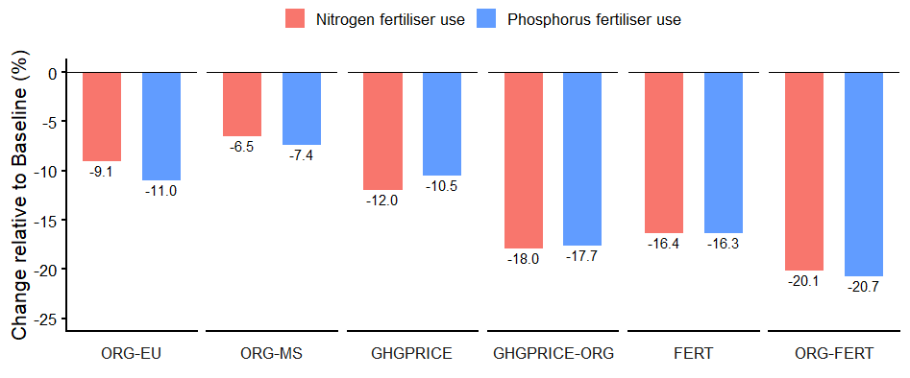
EU Fertilizer Use (2030)
If the policy objective is nutrient reduction → directly targeting fertiliser use may be more cost-effective.
Notes:
This figure compares changes in EU nitrogen and phosphorus fertilizer use across different policy scenarios in 2030. All scenarios lead to reductions in fertilizer application relative to the baseline, reflecting either the expansion of organic farming or policies that increase the cost of carbon-intensive agricultural inputs. Organic farming policies alone reduce fertilizer use by around 7–11%, while carbon pricing and fertilizer cost measures achieve larger reductions of approximately 10–18%. The strongest effect occurs when organic expansion is combined with higher fertilizer costs (ORG-FERT), resulting in fertilizer use declines of about 20% for both nitrogen and phosphorus. These results suggest that while expanding organic agriculture contributes to nutrient-use reductions, policies that directly target fertilizer use or increase the cost of conventional inputs can achieve even greater environmental benefits. Therefore, if the primary policy objective is nutrient reduction, direct fertilizer-focused measures may offer a more cost-effective pathway than relying solely on organic area expansion.

Slide 12
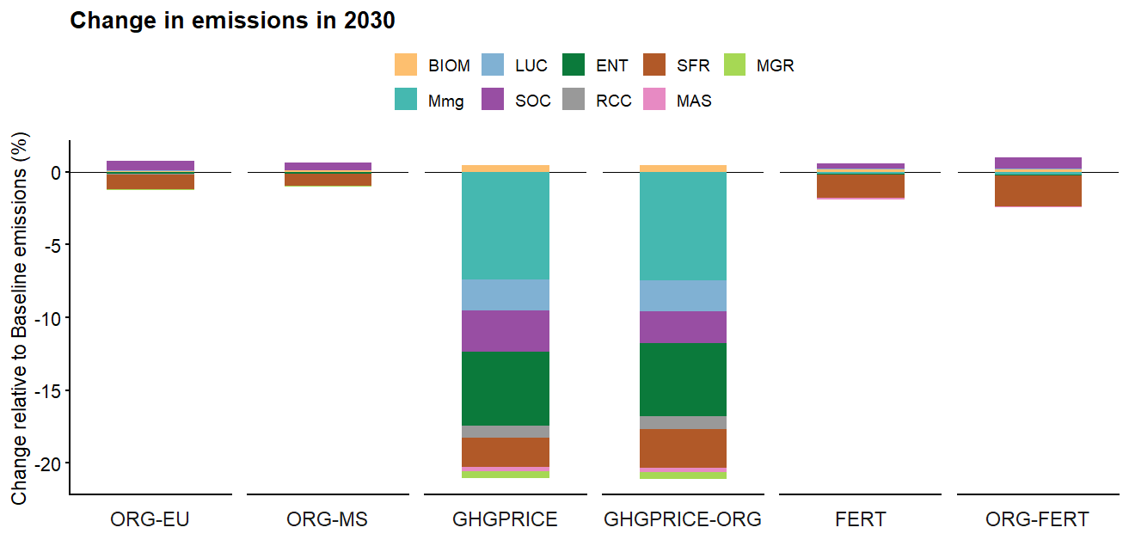
Emission Change (2030)
Carbon pricing achieves the largest emission reductions by triggering structural adjustments across crop and livestock systems, whereas organic expansion and fertiliser policies deliver comparatively modest climate benefits.
Notes:
This figure compares the greenhouse gas emission impacts of different policy scenarios in 2030. The results show that carbon pricing delivers by far the largest emission reductions, lowering agricultural emissions by roughly 20% relative to the baseline. These reductions arise from broad structural changes across crop and livestock systems, including lower fertilizer use, improved management practices, reduced livestock emissions, and shifts in land use. In contrast, policies focused solely on expanding organic farming (ORG-EU and ORG-MS) produce only modest emission reductions, as lower input use is partly offset by lower yields and land-use adjustments. Fertilizer policies achieve somewhat larger benefits but still fall well short of the reductions achieved through carbon pricing. Combining carbon pricing with organic expansion (GHGPRICE-ORG) provides limited additional mitigation beyond carbon pricing alone, indicating that carbon pricing already captures many of the available emission-reduction opportunities. Overall, the findings suggest that economy-wide carbon incentives are considerably more effective for climate mitigation than policies focused exclusively on organic area expansion or fertilizer reduction.

Slide 13
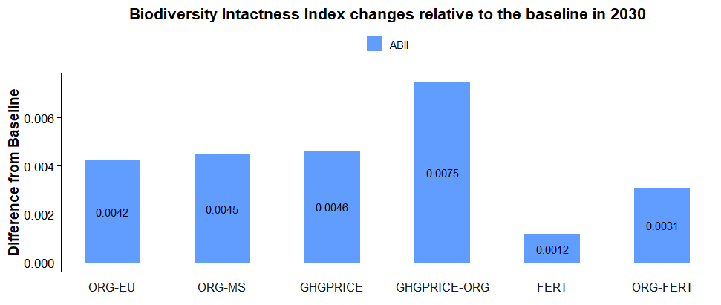
Biodiversity Change (2030)
Fertilizer policies generate modest biodiversity co-benefits, while GHG pricing delivers larger biodiversity gains by reducing overall agricultural intensity and livestock-linked land pressure.
Notes:
This figure compares the biodiversity impacts of alternative agricultural policy scenarios in 2030 using the Agricultural Biodiversity Index (ABII). All scenarios generate biodiversity improvements relative to the baseline, but the magnitude of gains varies considerably across policy instruments. Organic farming expansion delivers moderate biodiversity benefits by reducing input intensity and increasing the share of environmentally friendly production systems. Fertilizer reduction policies produce smaller improvements, indicating that nutrient management alone has a limited effect on broader biodiversity outcomes. The largest gains are achieved under carbon pricing, particularly when combined with organic expansion (GHGPRICE-ORG), reflecting reductions in agricultural intensification, lower livestock-related land pressure, and more extensive land-use adjustments. These results suggest that policies targeting the underlying drivers of land-use change and agricultural emissions can generate greater biodiversity benefits than measures focused solely on organic area expansion or fertilizer use.

Slide 14
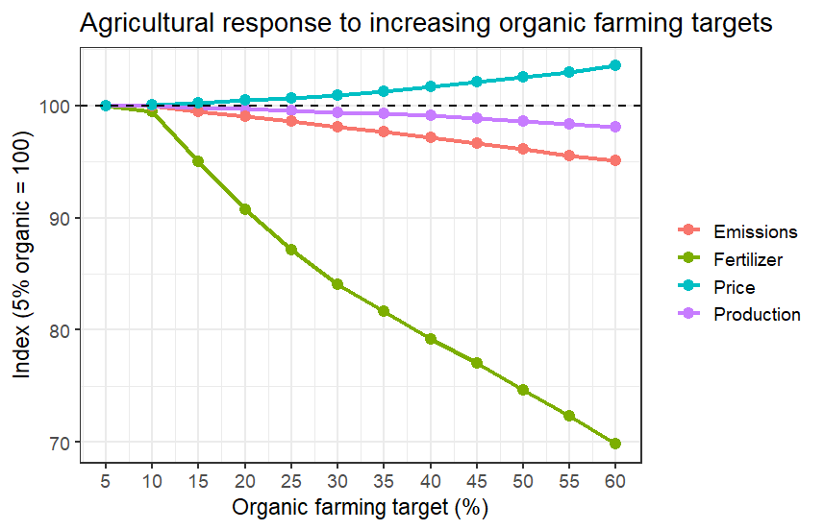
Sensitivity Analysis
Raising the organic farming target from 5% to 60% leads to a moderate reduction in agricultural greenhouse gas emissions.
Increased organic production is associated with higher agricultural prices.
The results suggest that expanding organic farming can deliver reductions in input use and emissions, although these environmental gains come at the cost of higher food prices.
Notes:
The findings indicate that ambitious organic farming targets can contribute to environmental objectives, particularly through reductions in synthetic fertilizer use and associated emissions. However, the environmental benefits are moderate relative to the magnitude of the required structural change, while price impacts become increasingly noticeable at higher target levels. This highlights the importance of complementing organic expansion with additional mitigation measures and productivity improvements to balance environmental performance, food production, and consumer costs.

Slide 15
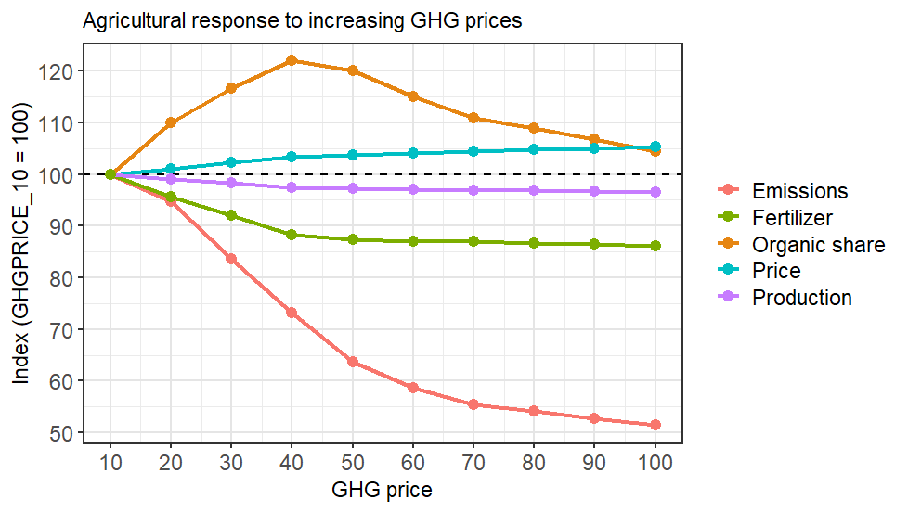
Sensitivity Analysis
The system has already captured the "easy" emission reductions by 40.
Beyond that point, producers respond by:
reducing livestock numbers, improving efficiency,
shifting toward less emission-intensive conventional systems,
rather than continuing to convert to organic production.
Notes:
This sensitivity analysis examines how the agricultural sector responds to progressively higher greenhouse gas prices. The results show that increasing carbon prices initially encourage a rapid expansion of organic farming, with organic shares peaking around a carbon price of 40 before stabilizing or slightly declining. Beyond this threshold, producers achieve additional emission reductions through alternative adaptation strategies, including reducing livestock numbers, improving production efficiency, lowering fertilizer use, and shifting toward less emission-intensive conventional systems. As a result, emissions continue to fall substantially as carbon prices increase, while fertilizer use declines steadily and production remains relatively stable. Market prices rise only moderately, reflecting the sector’s ability to adapt without major disruptions to output. These findings suggest that organic farming is an important early response to carbon pricing, but deeper decarbonization is ultimately driven by broader structural changes across agricultural production systems rather than continued expansion of organic land alone.

Slide 16
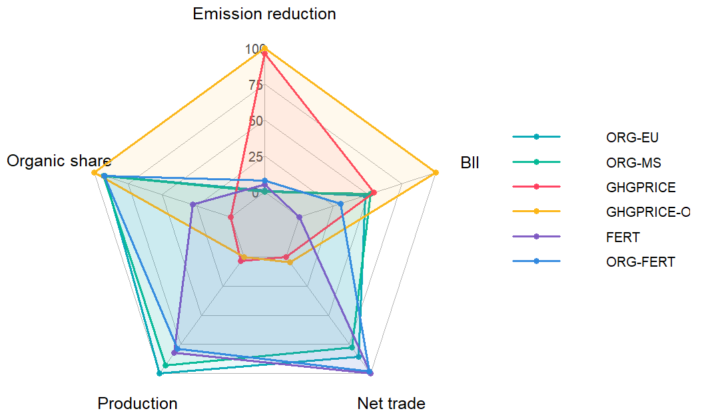
Scenario Trade-offs
Organic scenarios (ORG-EU, ORG-MS) maximize organic land share.
Environmental gains come at the cost of lower production and greater market adjustments.
Trade becomes an important adjustment mechanism under more ambitious environmental policies.
The key policy challenge is balancing climate and biodiversity goals with food production and market stability.
Notes:
This figure synthesizes the key trade-offs across policy scenarios, highlighting how different instruments balance environmental objectives with agricultural production and market outcomes. Organic expansion scenarios (ORG-EU and ORG-MS) are most effective at increasing organic land shares and deliver moderate biodiversity benefits, but they also require larger adjustments in production and trade. Carbon pricing (GHGPRICE) achieves the strongest greenhouse gas emission reductions and substantial biodiversity gains by reducing agricultural intensity and shifting production patterns, although it increases reliance on market adjustments. Combining carbon pricing with organic expansion (GHGPRICE-ORG) generates the most balanced environmental performance, simultaneously delivering high emission reductions, biodiversity improvements, and organic area expansion. Fertilizer policies mainly reduce nutrient use and provide targeted environmental benefits, but have more limited impacts on climate and biodiversity outcomes. Overall, the results demonstrate that no single policy optimizes all objectives; achieving climate, biodiversity, and organic farming targets requires balancing environmental gains against impacts on agricultural production, trade flows, and market stability.

Slide 17
Summary and Policy Implications
EU-wide targets outperform fragmented national targets.
Flexibility allows expansion where environmental and production benefits are highest.
Organic expansion complements rather than replaces direct climate policy.
Targeted organic growth delivers environmental gains with limited economic disruption. Reducing input-intensive crop–livestock linkages, especially in oilseed and livestock production.
Integrated policy packages provide the strongest balance of sustainability, resilience, and mitigation.
GHG
Pricing
Integrated
Package
EU Organic Target
Environmental Benefit ↑
National Targets
Economic Cost →
Notes:
An EU-level organic farming target is likely to generate stronger synergies than member-state-specific targets, because it allows organic expansion to occur where production and environmental trade-offs are more favorable.
Organic farming expansion delivers smaller emission reductions than direct climate policies, such as greenhouse-gas pricing, but it also causes much lower losses in production and trade.
Targeted organic expansion can achieve with limited economic disruption, while broad greenhouse-gas pricing delivers deeper environmental gains at substantially higher economic cost.
The main environmental gains come from reducing input-intensive crop–livestock linkages, especially in oilseed and livestock production, while keeping overall food availability relatively stable. This points to potential synergies between organic targets, fertilizer efficiency, and food-system resilience.
An EU-level organic farming target is likely to generate stronger synergies than member-state-specific targets, because it allows organic expansion to occur where production and environmental trade-offs are more favorable.
Organic farming expansion delivers smaller emission reductions than direct climate policies, such as greenhouse-gas pricing, but it also causes much lower losses in production and trade.
Targeted organic expansion can achieve with limited economic disruption, while broad greenhouse-gas pricing delivers deeper environmental gains at substantially higher economic cost.
The main environmental gains come from reducing input-intensive crop–livestock linkages, especially in oilseed and livestock production, while keeping overall food availability relatively stable. This points to potential synergies between organic targets, fertilizer efficiency, and food-system resilience.

Slide 18
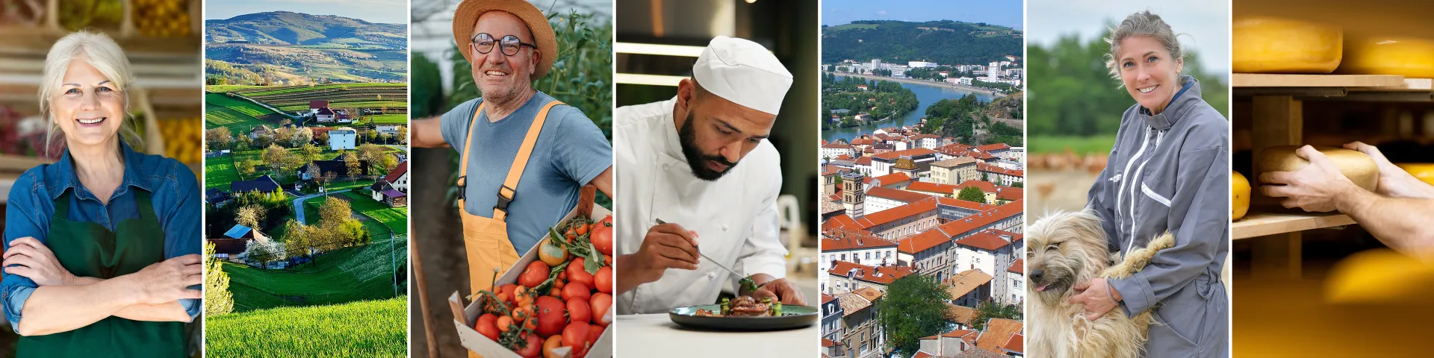
Thank you for you attention!
Omid Zamani zamani@iiasa.ac.at
Sources: European Commission Website

Slide 19
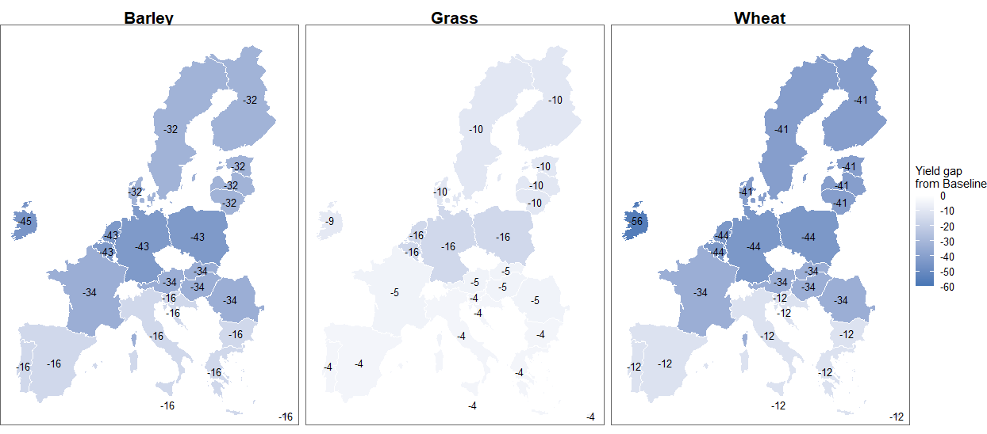
Regional Organic Area (2030)
As we move from Northern to Southern Europe, the yield gap becomes smaller, making organic farming more competitive in terms of production costs.
Organic farming becomes competitive when:
$$Y_{o}=\left(1−g\right)Y_{c}$$
$$GM_{c}=B+GM_{o}$$

Slide 20







Organic Farming Equations: Addon Technology
Organic yield (GRS, LSP, CRP)
Costs (GRS, LSP, CRP)
Price premium (LSP, CRP)
PRODUCTION
$$y_{rj}^{org}=\left(1+δ_{rj}^{y}\right)y_{rj}^{conv}$$
$$c_{rj}^{org}={(1+δ_{rj}^{c})c}_{rj}^{conv}$$
$$p_{rj}^{org}=(1+δ_{rj}^{p})p_{rj}^{conv}$$
ENVIRON.
Crop emissions (− N2O soil sequestration + extra manure emissions)
$e_{rc}^{org}=− e_{rc}^{soil}+e_{rc}^{man}(1+δ_{rc}^{ghg})$
Manure cap (170 kg N / ha)
Organic grassland balance
REGUL. CONST.
$$\sum_{a∈lsp}{\frac{L_{r,a}⋅N_{a}}{0.17}} ≤ A_{r}^{\text{crp}}+A_{r}^{\text{grs}}$$
$$\sum_{r∈EU27}{A_{r}^{\text{grs}}} ≥ \sum_{r∈EU27, a∈lsp}{L_{r,a}⋅γ_{r,a}}$$
Indices: r = region, j = crop, a = animal type; L= animal number, δ = relative deviation organic vs. conventional, $γ$= grazing requirement.

Slide 21
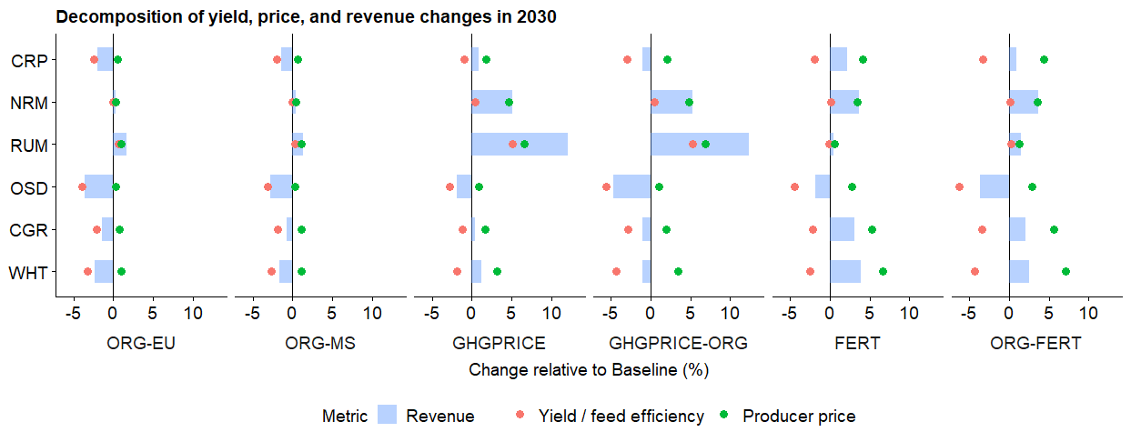
Revenue Change (2030)
A GHG price increases ruminant yield by pushing production toward more efficient animals and higher-productivity systems.

Slide 22
Content
Is the organic farming extension structurally valid?
How is the organic farming setup defined?
What input data is used?
What are the yield, cost, and price gaps?
How are crop emissions calculated?
Is the calibration valid?
Is the prediction valid?
What is the organic area in the baseline?

Slide 23

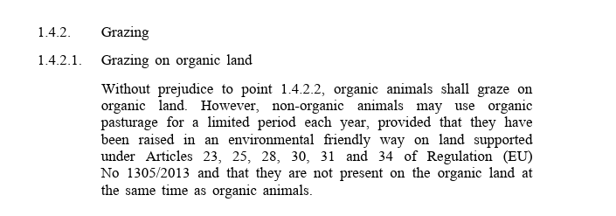
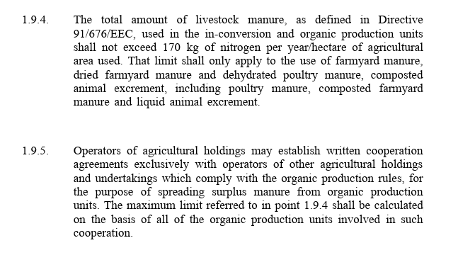
Organic Farming Regulation: Structural Validity
Organic animals → must graze on organic land.
Non-organic animals → can use organic pasture, but only: For a limited time each year, if they are raised in an environmentally friendly way, and never at the same time as organic animals.
Key regulatory provisions
Source: European Commission.
Source: Own based on CAPRI model.

Slide 24
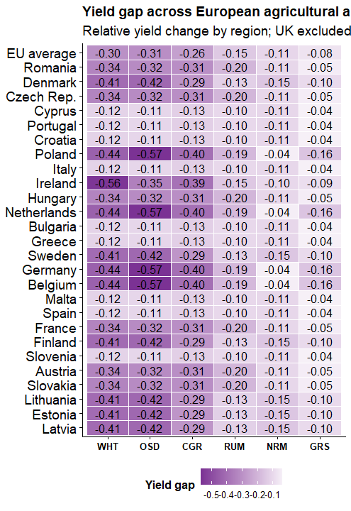
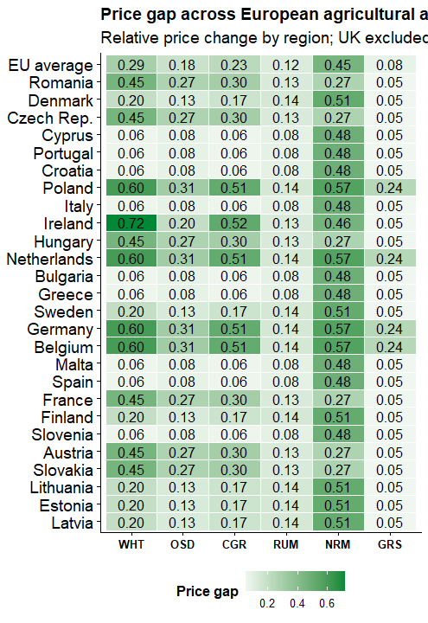
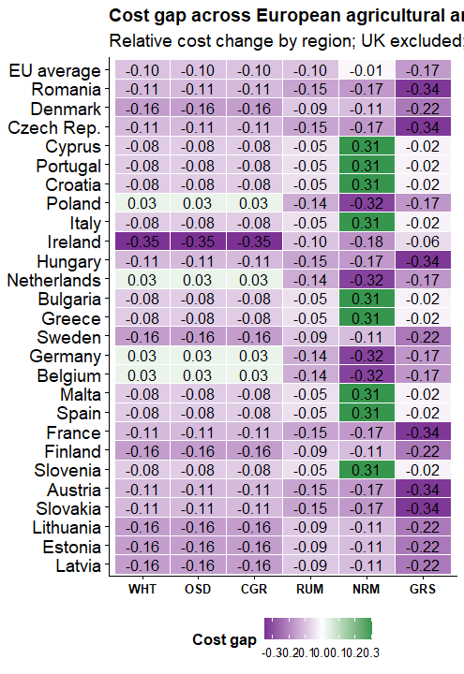
Input Data: Yield, Cost and Price Gaps
  x -
Notes:
conventional production is already relatively “low-input,” switching to organic does not reduce costs dramatically.

Slide 25
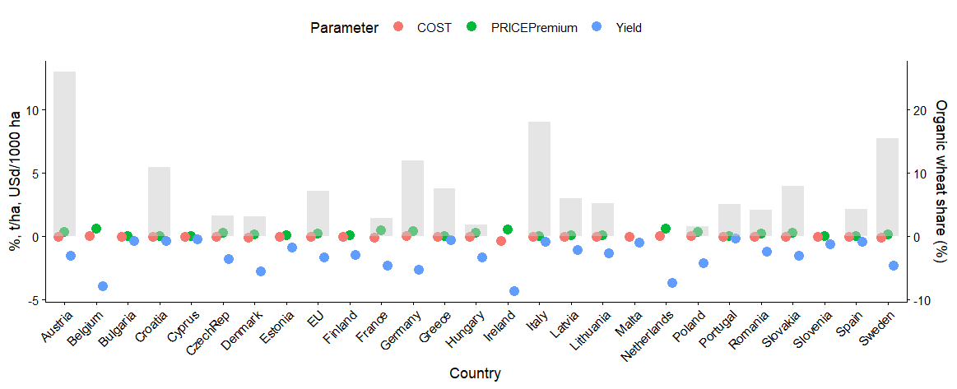
Regional Organic Wheat Parameter (2030)
Notes:
This variation reflects the interaction between economics and policy. Regions with smaller yield penalties, stable premiums, supportive policies, and established organic markets tend to expand organic wheat production more rapidly.

Slide 26
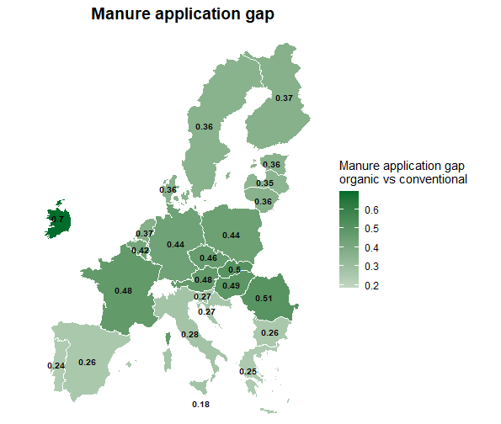
Input Data: Crop Emission
Emissions are estimated from CropSoil_N₂O and Manureapl_N₂O data, adjusted for fertilizer use.
Notes:
The key idea is that organic farming generally reduces synthetic nitrogen fertilizer use, which lowers direct nitrous oxide emissions from soils. However, organic systems often rely more heavily on manure and livestock integration, meaning that part of the emissions reduction can be offset by additional manure-related emissions.

