Slide 1

A cash flow tax to revive investment and raise revenue in Australia
Janine Dixon and Jason Nassios
Centre of Policy Studies, Victoria University
June 18, 2026
GTAP Conference, Kyoto

Slide 2
The problem

Slide 3
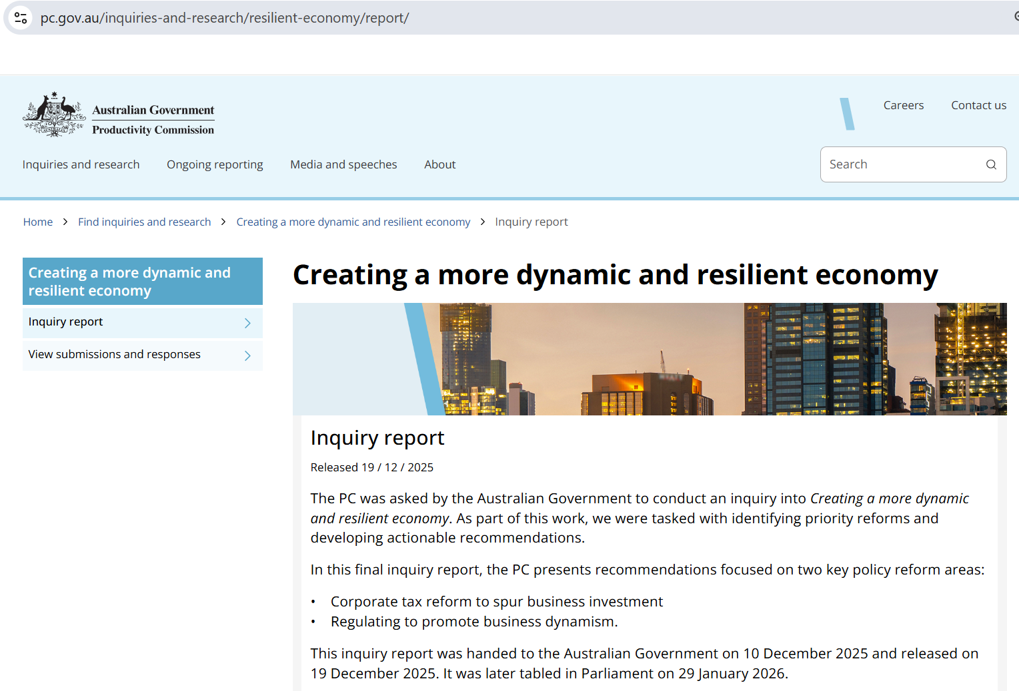
The solution
https://www.pc.gov.au/inquiries-and-research/resilient-economy/report/

Slide 4
Corporate tax reform to spur business investment
Simple cuts to the company tax rate in Australia do spur business investment BUT
  This effect is very muted for local investors due to Australia’s dividend imputation system
  For foreign investors, lower tax rates mean we give up more revenue than we get back
    Overnight windfall gain to existing foreign investors
    Lower tax rate dilutes the advantage enjoyed by domestic investors
Company tax cuts were rejected by the Australian Senate three times between 2016 and 2018 despite heavy lobbying from big business
We needed something different

Slide 5
Cash flow tax
A cash flow tax is levied on income less expenditure, INCLUDING investment expenditure
There are no deductions for depreciation
This does not change the incentive to invest
  An investment that exceeds the hurdle rate of return under no CFT also exceeds it under a CFT
  Proof…

Slide 6
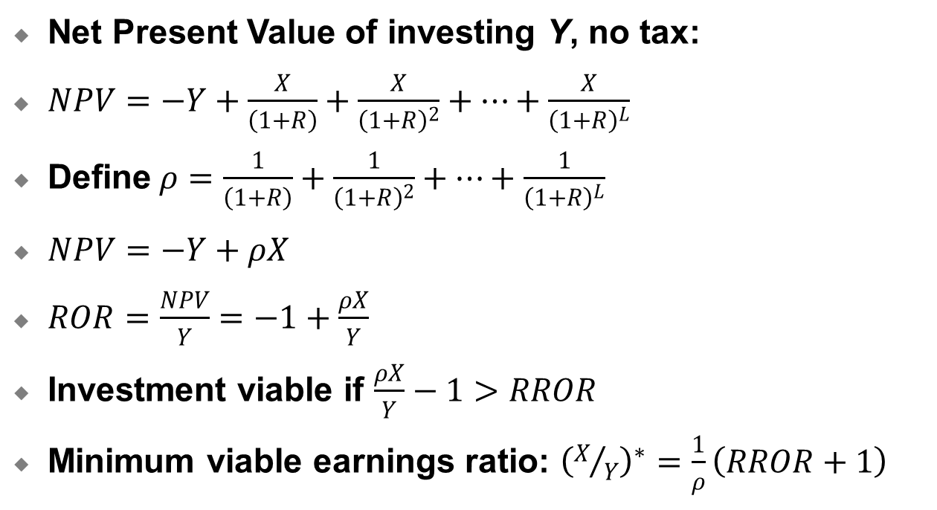
Under no taxes:
Net Present Value of investing Y, no tax:
$NPV=−Y+\frac{X}{\left(1+R\right)}+\frac{X}{{\left(1+R\right)}^{2}}+…+\frac{X}{{\left(1+R\right)}^{L}}$
Define$ρ=\frac{1}{\left(1+R\right)}+\frac{1}{{\left(1+R\right)}^{2}}+…+\frac{1}{{\left(1+R\right)}^{L}}$
$NPV=−Y+ρX$
$ROR=\frac{NPV}{Y}=−1+\frac{ρX}{Y}$
Investment viable if $\frac{ρX}{Y}−1>RROR$
Minimum viable earnings ratio: ${\left(X/Y\right)}^{∗}=\frac{1}{ρ}\left(RROR+1\right)$
ρ = number like 20

Slide 7
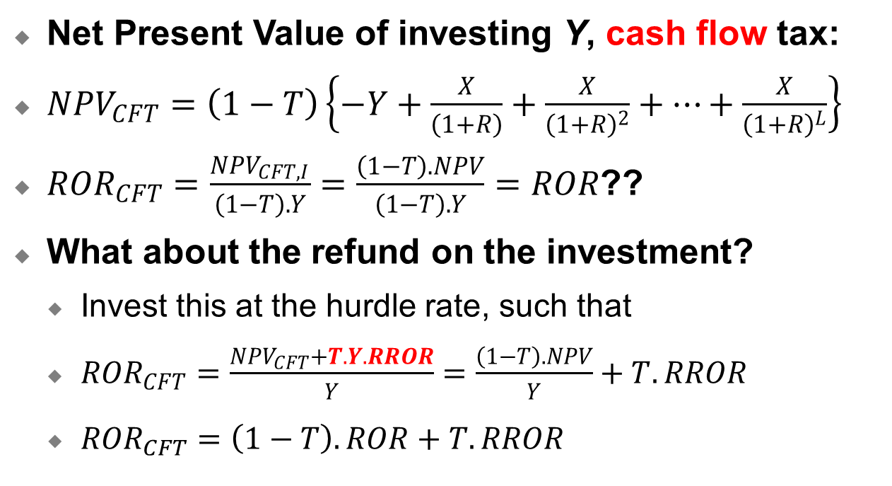
Cash flow tax:
Net Present Value of investing Y, cash flow tax:
${NPV}_{CFT}=\left(1−T\right)\left\{−Y+\frac{X}{\left(1+R\right)}+\frac{X}{{\left(1+R\right)}^{2}}+…+\frac{X}{{\left(1+R\right)}^{L}}\right\}$
${ROR}_{CFT}=\frac{{NPV}_{CFT,I}}{\left(1−T\right).Y}=\frac{\left(1−T\right).NPV}{\left(1−T\right).Y}=ROR$??
What about the refund on the investment?
  Invest this at the hurdle rate, such that
  ${ROR}_{CFT}=\frac{{NPV}_{CFT}+T.Y.RROR}{Y}=\frac{\left(1−T\right).NPV}{Y}+T.RROR$
  ${ROR}_{CFT}=\left(1−T\right).ROR+T.RROR$

Slide 8
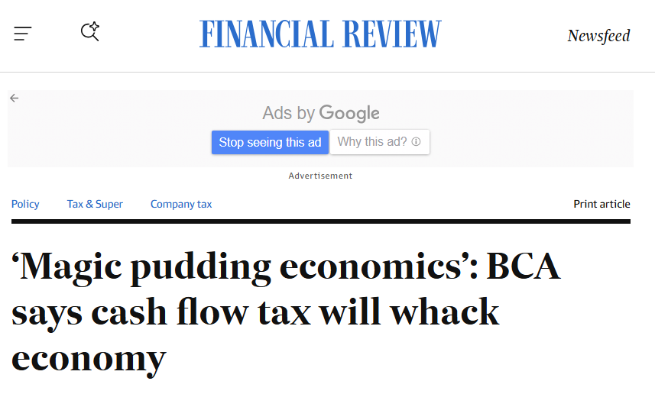
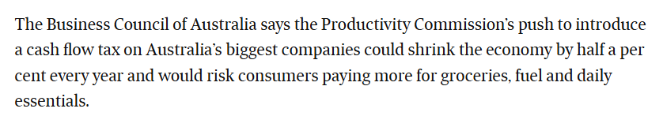
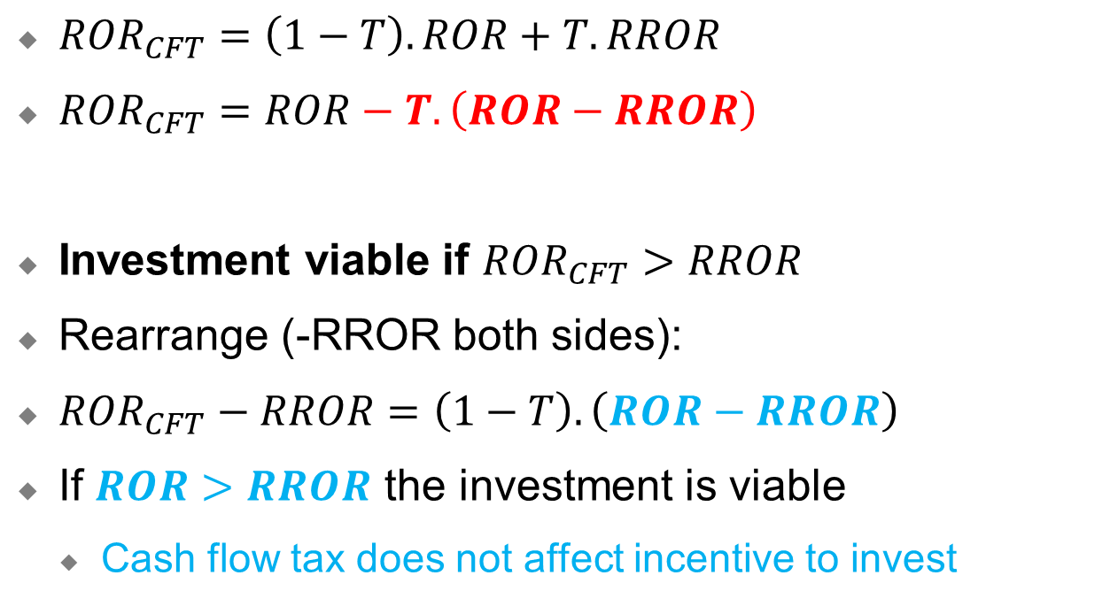
Cash flow tax (cont):
${ROR}_{CFT}=\left(1−T\right).ROR+T.RROR$
${ROR}_{CFT}=ROR−T.\left(ROR−RROR\right)$
Investment viable if ${ROR}_{CFT}>RROR$
Rearrange (-RROR both sides):
${ROR}_{CFT}−RROR=\left(1−T\right).\left(ROR−RROR\right)$
If $ROR>RROR$ the investment is viable
  Cash flow tax does not affect incentive to invest

Slide 9
RoR with and without 10% CFT

Slide 10
Contrast: RoR with and without ordinary Company tax

Slide 11
Implementation
Introducing a CFT:
Option 1:
  Allow deduction of investment
  Disallow deduction of depreciation on all capital stocks including investment made prior to CFT introduction
  “Not fair” to business
Option 2:
  Allow deduction of investment
  Allow deduction of depreciation on investment made prior to CFT introduction
  Up front investment deductions are costly to government
  Simulation: CFT phased in over 5 years

Slide 12
VURMTAX Simulation results
VURMTAX
Recursive Dynamic model of the Australian economy
8 states and territories each with own government and taxation system
1 federal government
91 industries
91 industry investors
1 representative household per region
Experiments also included cuts to ordinary company tax rates for companies of different sizes, which created threshold effects
Core Scenario: ordinary company tax cuts (threshold effects ignored)
Core + CFT
Core + CFT + Threshold effects
Core + Phased CFT
Solved in GEMPACK using Runge-Kutta method

Slide 13
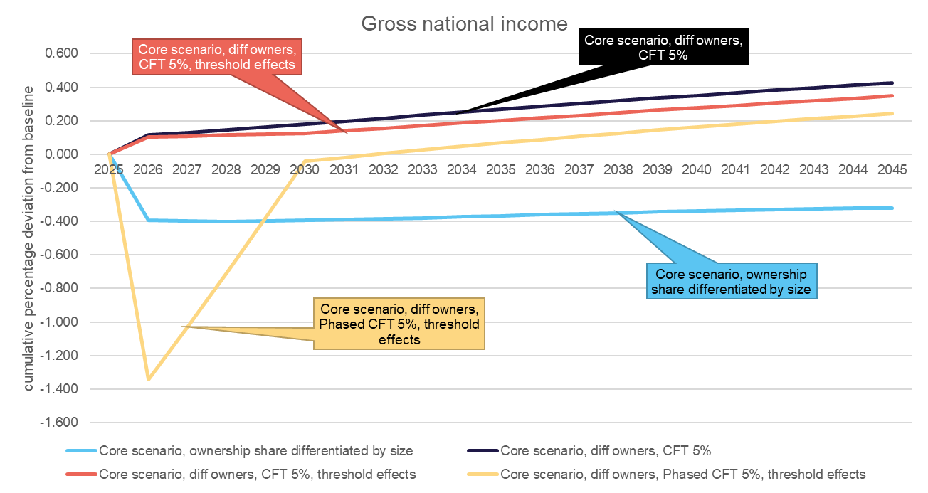
Gross National Income: measure of economic welfare

Slide 14
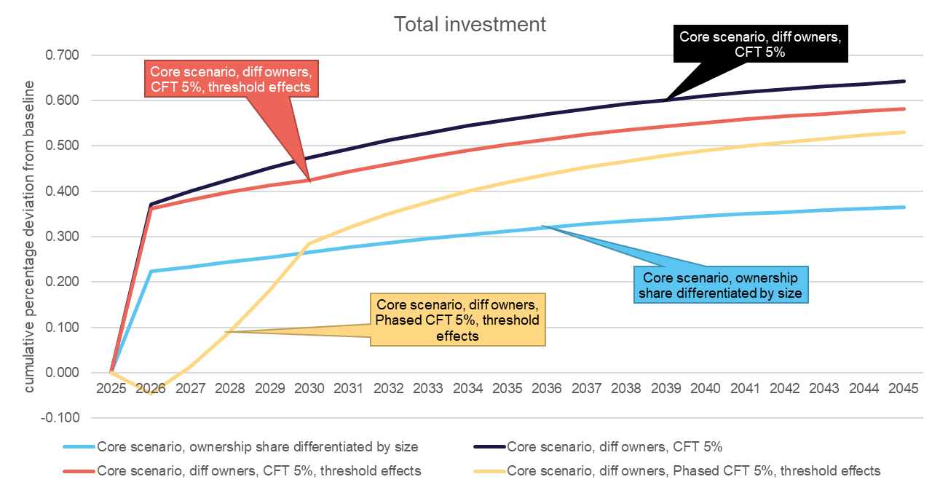
Investment does go up

Slide 15
Was it even a problem?

Slide 16
Was it even a problem?

Slide 17
Concluding remarks
Perceived lack of growth in private business investment in Australia has policy-makers reaching for solutions
Simple company tax cuts are off the agenda (for now)
  Investment goes up but tax revenues and gross national income go down
A cash flow tax raises revenue and stimulates investment
Investment responds to post-tax rates of return. A country that offers strong pre-tax rates of return can afford to have a high company tax rate.

Slide 18
Thank you
Janine.Dixon@vu.edu.au
Jason.Nassios@vu.edu.au

