Slide 1


Commonalities and differences in national pathways toward net-zero emissions
29th Annual Conference on Global Economic Analysis
Anuj Pathak*, Saritha Sudharmma Vishwanathan, Shinichiro Fujimori, Roberto Schaeffer and others
*Email: pathak.anuj.84h@st.kyoto-u.ac.jp
2026/06/19

Slide 2
Background
National scenario overview
Research gap
Objective

Slide 3


National scenario overview
Climate goals and national scenarios
Global temperature goal
1.5 °C, 2 °C
The Paris Agreement and global temperature goals
National net-zero target or long-term strategies (LTS)
National scenarios: inform, track and reflect overall policy direction of national mitigation pathways for achieving global climate goals.
National scenarios
Country A
Country B
Country C

Slide 4
National scenario overview
Past studies on national scenarios
Study type | Objective | Examples
1. Single model, single country | Developed for domestic policy analysis, provides important insights into national decarbonization strategies. | (Oshiro & Fujimori, 2024), (Duan et al., 2021), (Adun et al., 2024)
2. Multiple models, single country (Coordinated MIPs) | Focused on single countries quantifying inter-model uncertainty and establishing robust mitigation pathways. | (Sugiyama et al., 2024), (Lugovoy et al., 2018), (Browning et al., 2023), (Cho et al., 2025), (JMIP 2 Part 1, 2025)
3. Single model, multiple countries | Identifying cross-country similarities and differences. | (Millot et al., 2020), (Starke et al., 2024)
4. Multiple models, multiple countries | Identifying robust national mitigation pathways for globally consistent national scenarios. | (Schaeffer et al., 2020), (Waisman et al., 2019), (Reedman et al., 2018)
Limitations: Some studies do not capture inter-model uncertainties and others represent a limited share of global emissions.

Slide 5
Research gap and objective
While national scenario studies are gaining focus, they are disaggregated due to
  Economic structures
  Modelling capacity
  Data constraints
  Coverage (sectors, technologies, and greenhouse gases (GHGs))
  National policy focus
Objective
Here we use a national scenario database for multiple national net-zero scenarios collected using a common scenario protocol
To illustrate the similarities and differences in climate change mitigation pathways for national net zero targets

Slide 6
Methods
Scenario protocol
National scenario database
Analysis framework

Slide 7
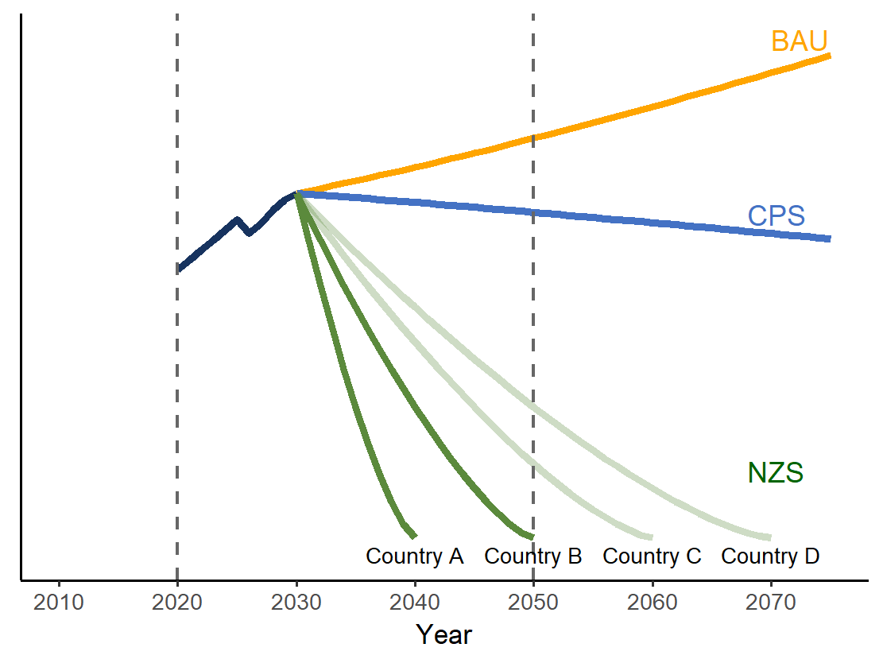
Scenario protocol
The scenario protocol for national scenario contains three types of scenarios:
Time horizon: 2020 to 2050
Scenario | Name | Description
BAU | Business-as-usual | Baseline or business-as-usual pathway assuming policies prior to 2015
CPS | Current policy scenario | Currently implemented policies up to 2030
NZS | Net-zero emissions scenario | Country-specific pathways toward achieving declared net-zero targets
More information on national scenario and protocol:
https://www.iamconsortium.org/scientific-working-groups/national-scenarios/
Fig 1: Illustrative pathways

Slide 8
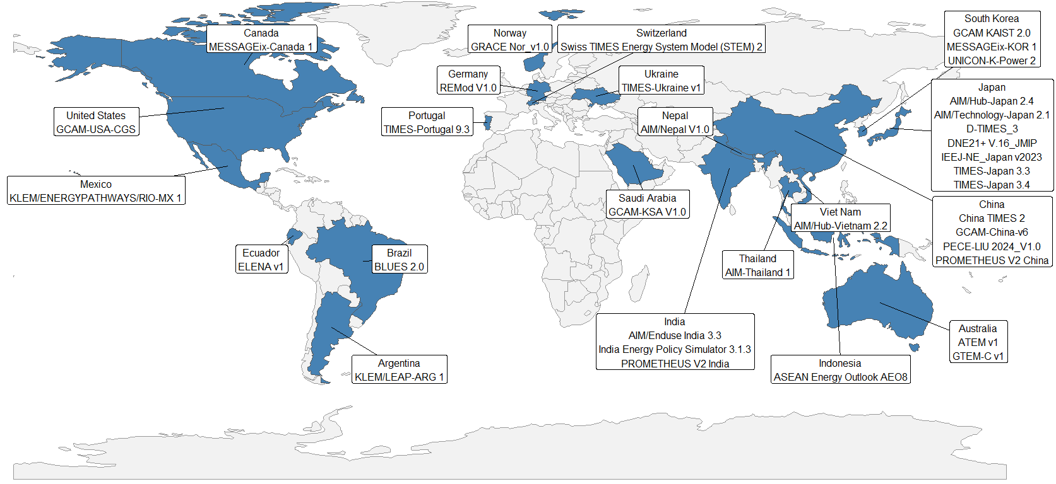
National scenario database
35 national models representing 21 countries were selected from the scenario database for this analysis.

Slide 9
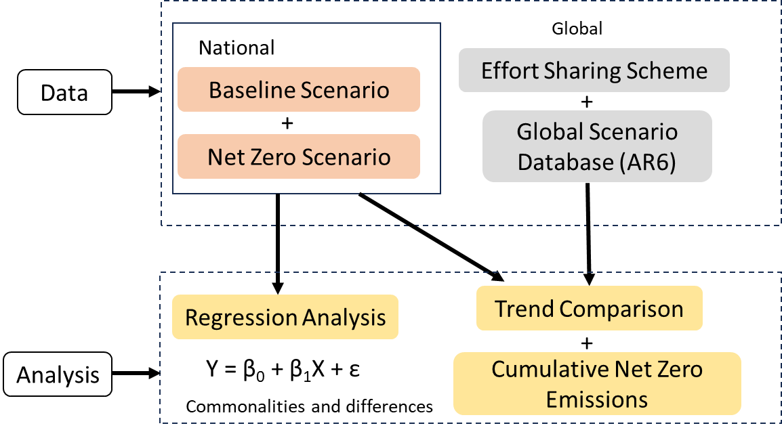
Analysis framework
AP: Ability to pay
ECPC: Equal cumulative per capita emissions
GDR: Greenhouse development rights
GF: Grandfathering
IEPC: Immediate per capita convergence
PCC: Per capita convergence
C1: limit warming to 1.5°C (>50%) with no or limited overshoot
C2: return warming to 1.5°C (>50%) after a high overshoot
C3: limit warming to 2°C (>67%)

Slide 10
Results
Regression analysis of key variables
National vs global/regional scenario trends
National net-zero emissions vs equity principles
National scenario coverage and cumulative share

Slide 11
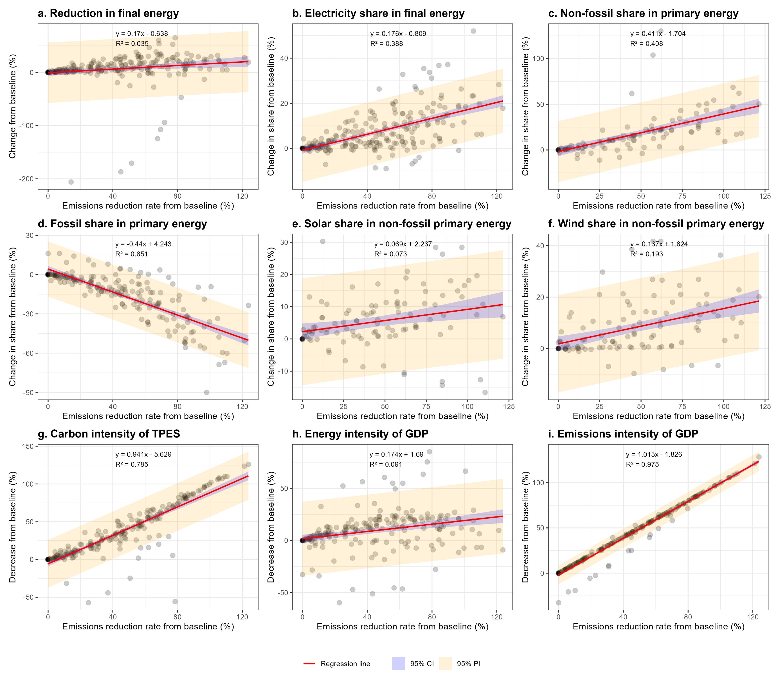
Regression analysis of key variables
Energy demand and supply related variables
Decarbonization of energy supply and electrification are common features of national net-zero pathways.

Slide 12
Regression analysis of key variables
Energy demand and supply related variables
Specific technology choices (wind and solar) are much more heterogeneous, suggesting that countries achieve similar emissions reduction through diverse pathways.

Slide 13
Regression analysis of key variables
Intensity related variables
*
Intensity-related indicators (especially emission intensity of GDP and carbon intensity of TPES*) show the strongest relationships with emissions reduction.
*TPES: Total primary energy supply

Slide 14
Regression analysis of key variables
Regression statistics:
Variable | Slope | Intercept | R² | p-value | N
Reduction in final energy | 0.17** | -0.638 | 0.035 | 0.003 | 238
Electricity share in final energy | 0.176*** | -0.809 | 0.388 | p < 0.001 | 238
Non-fossil share in primary energy | 0.411*** | -1.704 | 0.408 | p < 0.001 | 112
Fossil share in primary energy | -0.44*** | 4.243 | 0.651 | p < 0.001 | 203
Solar share in non-fossil primary energy | 0.069** | 2.237 | 0.073 | p < 0.001 | 112
Wind share in non-fossil primary energy | 0.137*** | 1.824 | 0.193 | p < 0.001 | 112
Carbon Intensity of TPES | 0.941*** | -5.629 | 0.785 | p < 0.001 | 224
Energy Intensity of GDP | 0.174*** | 1.69 | 0.091 | p < 0.001 | 217
Emission Intensity of GDP | 1.013*** | -1.826 | 0.975 | p < 0.001 | 231
Stars indicate statistical significance (*** P<0.001, ** P<0.01, * P<0.05), N is the total number of data points for each regression analysis.

Slide 15
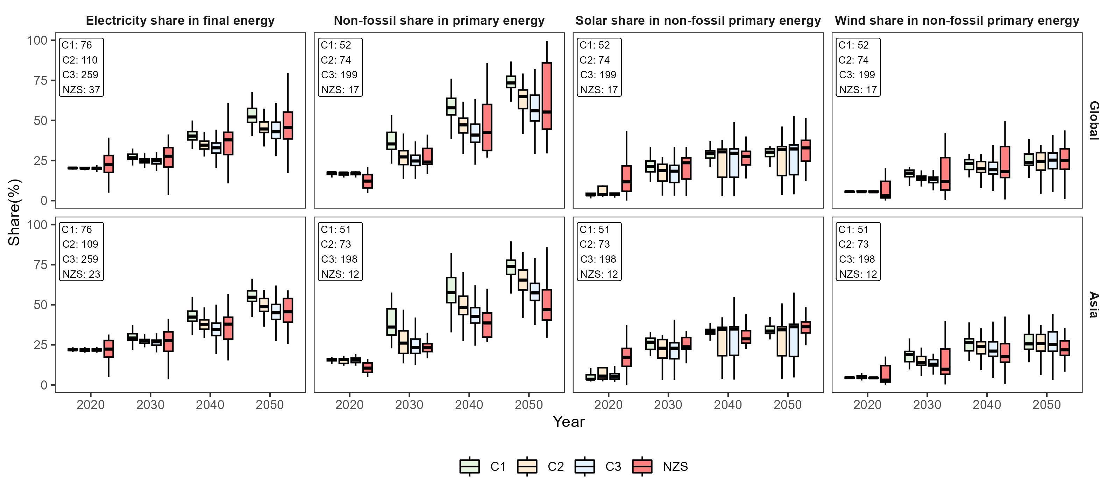
National vs global/regional scenario trends
National scenario trends show greater variability compared to global/regional scenario trends.

Slide 16
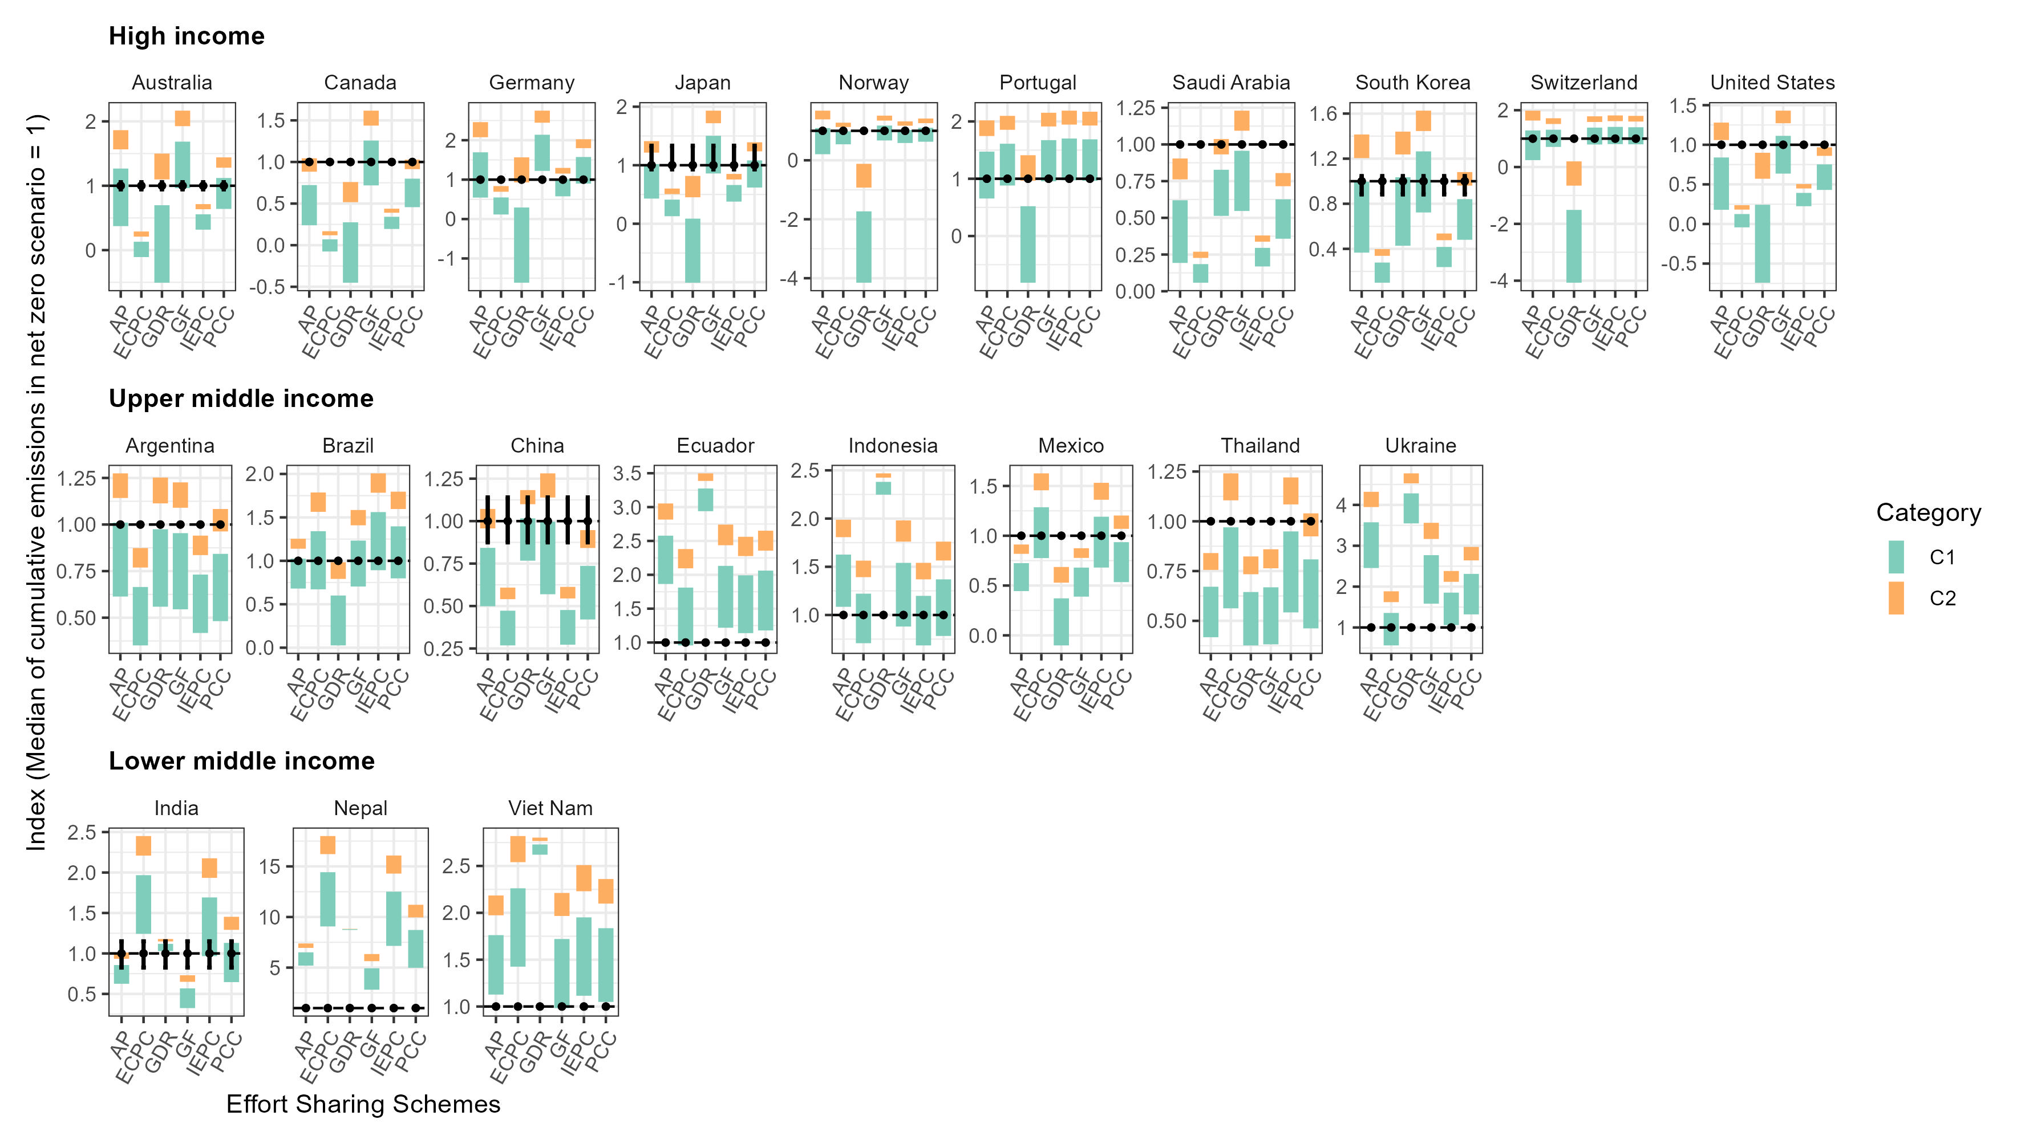
National net-zero emissions vs equity principles
AP: Ability to pay
ECPC: Equal cumulative per capita emissions
GDR: Greenhouse development rights
GF: Grandfathering
IEPC: Immediate per capita convergence
PCC: Per capita convergence
High-income countries frequently exceed carbon budgets consistent with a 1.5 °C goal across multiple effort-sharing approaches, while low-income countries retain substantial unused carbon space.

Slide 17
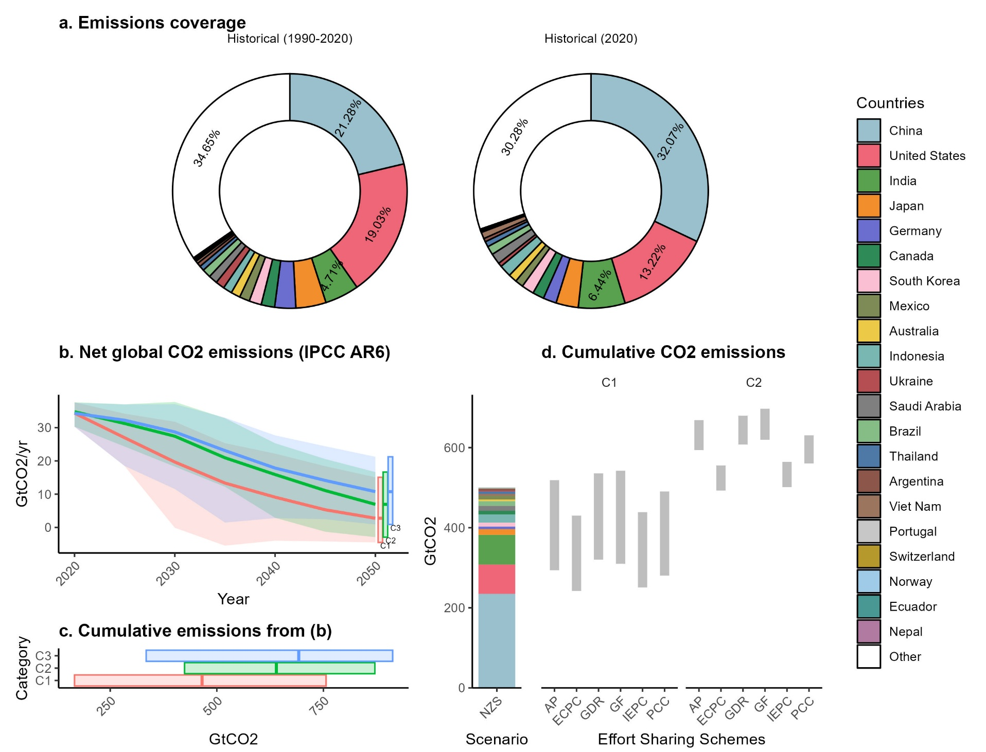
National scenario coverage and cumulative share
Aggregate national net-zero scenarios cover approximately two-thirds of global historical CO2 emissions.
The aggregate national net-zero emissions fall within the range of global carbon budgets consistent with C2 pathways across most effort-sharing approaches, while alignment with C1-consistent budgets depends on the specific allocation principle applied.

Slide 18
Discussions and conclusion
National perspective
Global perspective
Future work

Slide 19
National perspective
Commonalities across national net-zero scenarios
  declining fossil fuel use
  increasing electrification of final energy
  rising shares of non-fossil energy in primary supply
Differences persists in
  composition of non-fossil energy portfolios, i.e., contributions of wind and solar
The identification of commonalities suggests a set of policy directions that are broadly robust, regardless of national context.
Policy design should therefore balance the adoption of these common mitigation pillars with flexibility to accommodate country-specific conditions.

Slide 20
National perspective
From a policy perspective, broad indicators such as emission intensity of GDP may provide a useful measure of overall mitigation progress, but more specific information on supply- and demand-side transformations is required to understand the underlying pathways and technology choices for national net-zero targets.
The observed differences across countries should not be interpreted as inconsistencies but rather as reflections of national circumstances such as resource endowments, economic structure, technology availability, and institutional capacity.
For countries lacking dedicated national scenarios, a pragmatic alternative may be to draw insights from countries with similar economic profiles, population density, and resource characteristics, rather than relying directly on global averages.

Slide 21
Global perspective
The systematic imbalances between carbon budgets consistent with a 1.5 °C goal across multiple effort-sharing approaches highlight the need for enhanced climate ambition, particularly among high-income countries, which may involve
  stronger domestic mitigation efforts
  use of cooperative mechanisms such as international carbon markets under Article 6 of the Paris Agreement.
Aggregating national net-zero scenarios covering approximately two-thirds of global CO2 emissions in 2020 shows that collective outcomes are broadly consistent with pathways allowing temporary overshoot but fall short of robust alignment with a no-overshoot 1.5 °C objective.

Slide 22
Conclusions
Using a common scenario protocol, we identified commonalities and differences in national pathways towards net-zero emissions, and the collective implications on the global temperature goals.
These findings reinforce the importance of developing and expanding national scenario exercises routinely under comparable frameworks.
Limitations and future work:
  Expanding coverage to additional countries
  Including broader technological options such as carbon capture and storage, hydrogen, and carbon dioxide removal
  Systematic vetting of scenarios
  Multi-dimensional feasibility assessments
  Inclusion of socioeconomic heterogeneity and non-CO2 greenhouse gases

Slide 23
Thank you for your attention!
pathak.anuj.84h@st.kyoto-u.ac.jp
vishwanathan.saritha.5t@kyoto-u.ac.jp
fujimori.shinichiro.8a@kyoto-u.ac.jp

