Slide 1
Backcasting and the Global Dietary Shift
Ron Sands
GTAP Conference
17-19 June 2026
Kyoto, Japan

Slide 2
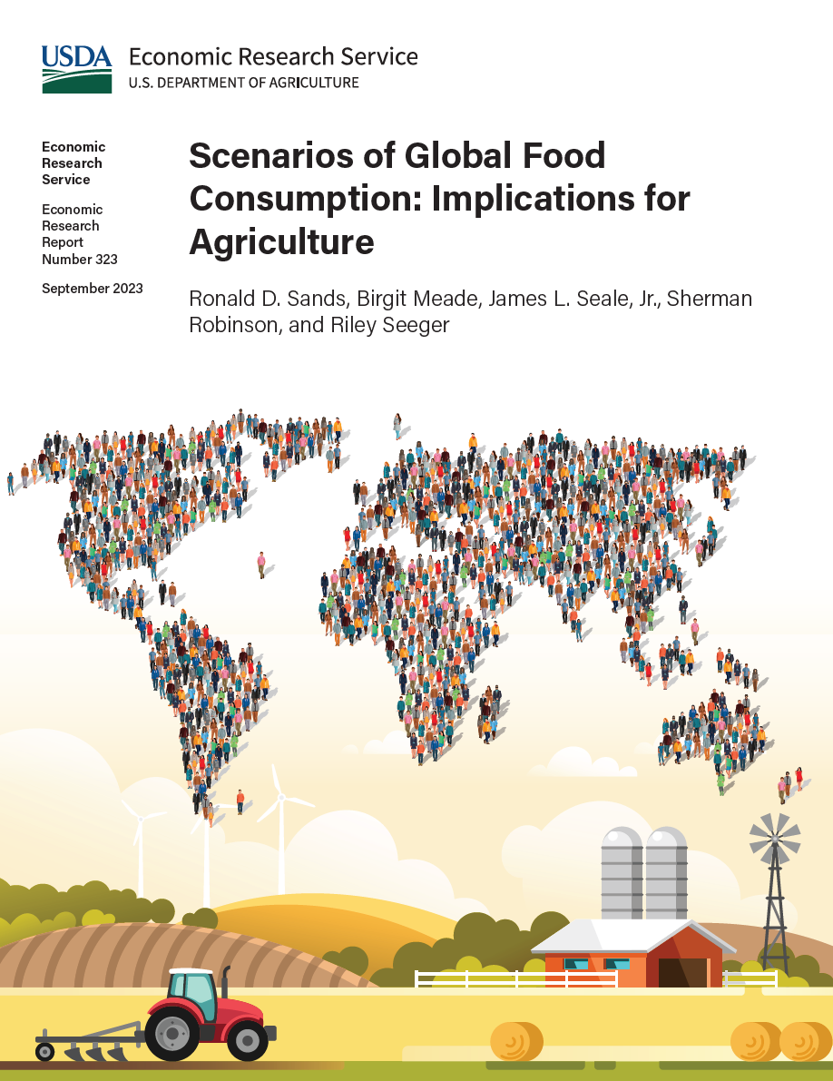
Introduction
It is common practice in CGE modeling to use the most recent GTAP base year.
However, moving the base year back in time can provide insights into model performance over historical years.
This is demonstrated in a 2023 study by USDA’s Economic Research Service, using 2011 as the base year.
Data are available to move the base year back further to 2004.
This presentation describes progress toward a backcasting exercise with 2004 as the base year, and implications for data construction and the consumer demand system.
Notes:
Introduce co-authors
Birgit Meade
Jim Seale
Sherman Robinson
Riley Seeger
Research Questions
1. How do increasing population and income affect global demand for crops and food products through 2050?
2. What is the effect of agricultural productivity growth on food prices and cropland area expansion?
3. How do alternative assumptions about population growth affect the size of the world agricultural system in 2050?

Slide 3
Projections of world food calories and crop calories, 2011–50

Slide 4
World population estimates (United Nations medium growth), 2010–50

Slide 5
1990 and 2019 per capita calories available for consumption (selected countries)

Slide 6
United States
Brazil

Slide 7
China
India

Slide 8
Sequential data construction
Start with a balanced and aggregated GTAP global database (top of diagram)
Integration of food balances
Construct energy technologies (e.g., electricity generation)
Set up the consumer demand system
Use production levels by U.S. State to algebraically downscale U.S. national data
Input-output structure at the national level is retained for each U.S. State
Complexity of model is more easily handled in GAMS/MPSGE than algebraic GAMS

Slide 9
Agricultural production sectors and first-stage mapping for demand system
Group | Subgroup | Product | Grains | Veg. oils | Sugar | Veg. and fruit | Other crops | Animal products | Forest products
Primary agriculture | Crops | Wheat | X
 |  | Paddy rice | X
 |  | Other grains | X
 |  | Oilseeds |  | X
 |  | Sugar (cane and beet) |  |  | X
 |  | Vegetables and fruit |  |  |  | X
 |  | Plant fibers |  |  |  |  | X
 |  | Other crops |  |  |  |  | X
 | Fisheries | Fish |  |  |  |  |  | X
 | Forestry | Forestry |  |  |  |  |  |  | X
 | Ruminant | Cattle and other ruminants |  |  |  |  |  | X
 |  | Raw milk |  |  |  |  |  | X
 |  | Wool |  |  |  |  |  | X
 | Non-ruminant | Other animal products |  |  |  |  |  | X
Food processing |  | Vegetable oils |  | X
 |  | Processed rice | X
 |  | Sugar |  |  | X
 |  | Beverages and tobacco products |  |  |  |  | X
 |  | Other food |  |  |  |  | X
 |  | Meat from cattle and other ruminants |  |  |  |  |  | X
 |  | Dairy products |  |  |  |  |  | X
 |  | Other meat products |  |  |  |  |  | X

Slide 10
Projections of world food calories and crop calories, 2011–50

Slide 11
Discussion
Data construction
  Aggregation of food products from FAO food balance sheets to GTAP production sectors
  Adjustment of GTAP social accounting matrix to replicate per-capita calorie accounting in FAO data
Linear Expenditure System
  Income elasticity for each agricultural product
  Income elasticities fall over time to keep per-capita food consumption in a plausible range
Policy implications
  Global trend toward increasing per-capita calorie consumption in response to income growth
  The trend is strongest with consumption of animal products
  This creates a new baseline for scenarios designed to reduce consumption of animal products and associated greenhouse gas emissions

