Slide 1
Achieving a long-run equilibrium in the dynamic GTAP model
Organised session 21, Trade Projections
2018 GTAP Conference, Cartagena
13-15 June 2018
Paul Gretton
East Asia Bureau of Economic Research, Crawford School and
Centre of European Studies
The Australian National University

Slide 2
Some background
Desire to extend capabilities from comparative static GTAP to dynamic framework to…
  Trace out the time scale of effects of a policy change
  Examine the impact of population, workforce participation and productivity assumptions on global growth and convergence of economies
GDyn appeared a reasonable starting point
  Built on the GTAP model – with long tradition of applications
  Documented – Ianchovichina and Walmsley (2012); Gdyn tablo file
  Accessible public domain, general purpose technology
Paper available at: https://www.gtap.agecon.purdue.edu/resources/res_display.asp?RecordID=5484

Slide 3
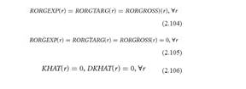
Dynamics introduced in Gdyn architecture
Partial adjustment rules for capital accumulation & rates of return
Full accounting of capital-finance through Regional household wealth, Firm capital accumulation and Global trust
Neo-classical stability conditions for longer-run equilibrium (I&W, pp 68,9)
Presentation focuses on testing for and achieving model stability

Slide 4
Use an aggregated database, test scenario
Database (2011 reference year)
6 regions | 13 industry sectors | 5 primary factor inputs
Australia (AUS) China (CHN) Japan (JPN) United States (USA) European Union (EU28) Rest of the World (ROW) | Grains, Crops, Forestry Livestock, fishing Mining Processed food Textiles and clothing Light manufacturing Heavy manufacturing Utilities Construction Transport and communication Financial services Other services Ownership of dwellings | Land Natural resources Skilled labour Unskilled labour Capital
Test scenario: TIME shocked; Std parameters; Simulation period 100+ years
- Extended to a dynamic baseline & policy simulation

Slide 5
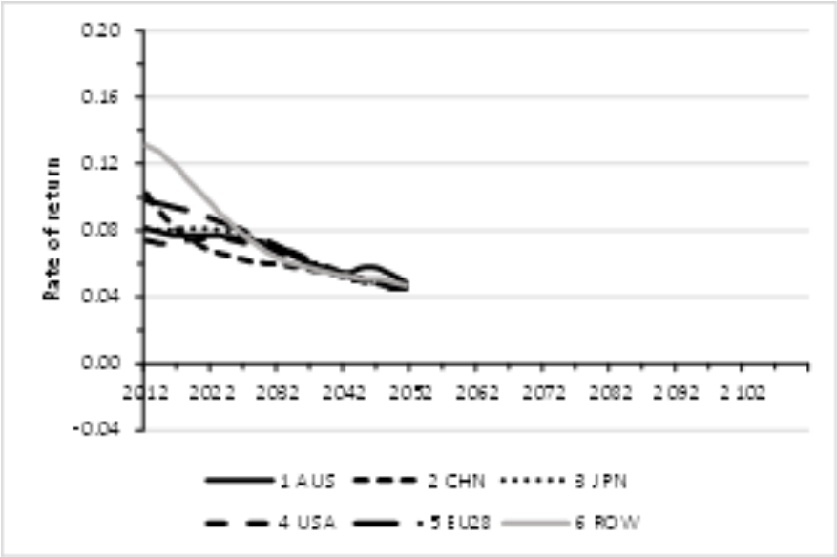
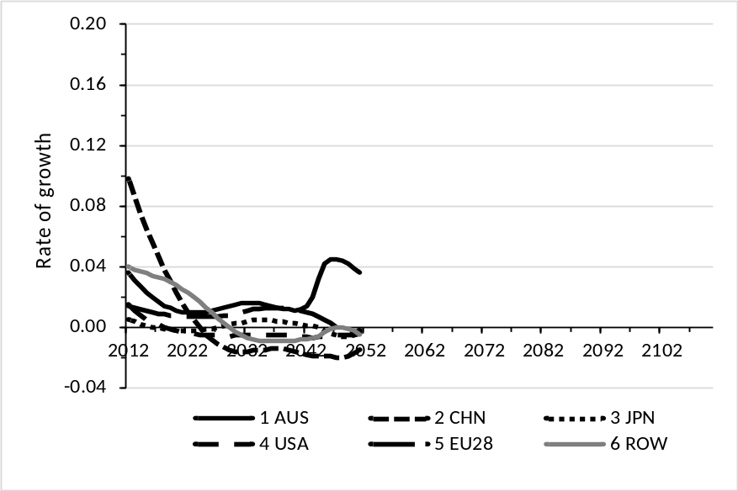
Snag – Stability conditions not satisfied: Evidenced by projections & simulation failure with error
Projected actual rates of return (RORGROSS) trends down (note tendency to depn rate of 0.04) | Price-neutral rate of growth in the capital stock (KHAT) oscillates without converging to zero
Model fails with error in simulation year 41 (that is calendar year 2052)
Error involves data value (ie model coefficient) (ge 0) test failing
Notes:
Projected gross rates of return trend downward
Model fails when: Projected Capital income (Gross rates of return – Depreciation via Equation REGINCEQY) is negative for one region evidenced by projected Income of Global Trust from Firms (YQTFIRM) becoming negative for one region
Model fails when: Projected Income of Global Trust from Firms (YQTFIRM) is negative for one region (because income becomes negative)
Projected income from/of global trust unstable
Capital-finance conditioned by the ad hoc behavioural parameters
RIGWQH(r) # rigidity of allocation of wealth by regional houshold #
RIGWQ_F(r) # rigidity of source of funding of enterprises #;
Model fails when: Projected Income of Global Trust from Firms (YQTFIRM) is negative for one region (because wqtf the equity of the trust in domestic firms biased to negative)

Slide 6
Stability conditions not met partly because no rate of return variable assumed exogenous
There are three concepts of RoR modelled
Actual gross rate of return – RORGROSS (rorga percentage change)
  rorga endogenous; RORGROSS calculated from data
Expected rate of return – RORGEXP (rorge)
  Modelling based on: RORGEXP = RORGROSS * [K(1)/K(0)] ^ -rorgflex that is, if planned capital (K(1) is above base capital, the expected rate of return is lower relative to base rate of return by parameter rorgflex = 10
  Capital adjusts to eliminate errors in expectations over time
  rorge endogenous; RORGEXP updated by rorge
Target rate of return – RORGTARG (rorgt)
  rorgt endogenous in basic model; RORGTARG updated by rorgt
RORGROSS and RORGEXP levels determined by model data/theory
RORGTARG arguably determined outside model – and should be exogenous

Slide 7
An overview of GDyn partial adjustment rules for capital accumulation, rates of return
Financial capital mobile between regions
Capital adjusts via an investment rule to eliminate difference between expected (RORGEXP) and target (RORGTARG) rates of return
  Changes to capital simultaneously influence actual returns (RORGROSS)
Regional expected rates of return (RORGEXP) gradually adjust towards actual rates (RORGROSS) to eliminate errors in expectations
The target rate may be:
  common – assuming elimination of all differences in regional institutions and risk
  region-specific – to allow for differences in regional institutions and risk

Slide 8
Original investment rule eliminates differences in changes, augment to eliminate difference in levels
Equation INVESTMENT # rule for investment # (all,r,REG)
  erg_rorg(r) = LAMBRORG(r) * [rorgt(r) - rorge(r) +
  100.0 * LAMBRORGE(r)*ERRRORGT(r)*time]
  where, ERRRORGT(r) is loge(RORGTARG(r)/RORGEXP(r))
  LAMBRORGE = 0.2 in standard adjustment parameter set
By treating rorgt(r) as exogenous – RORGTARG also exogenous
Capital gradually then adjusts to align the expected with the exogenous target rate of return
  Recall, expected and actual rates of return simultaneously adjust to eliminate errors in expectations
Original
Augmentation

Slide 9
How to make the target rate of return (rorgt| RORGTARG) exogenous
Add a new equation to define the percentage change in the target rate of return by region - rorgt(r) = srorc(r) + srorc_r,
  where
  srorc(r) is a regional shifter on the target rate
  srorc_r is a world average shifter on the target rate
Closing the model
  srorc(r) is naturally exogenous
  Swap sqkworld = srorc_r ;
  where sqkworld is a region-generic shock to capital stock
Swap recognises adjustment costs outside of GDyn diminishing balance theory: retirement of capital before full depreciation, commissioning lags
Specification meets all market clearing and neo-classical stability conditions

Slide 10
A second source of instability remains – to address need to revise capital-finance treatment
In GDyn
  Regional firms’ reproducible fixed capital is modelled as being owned by either: domestic residents, or foreign residents
    Foreign ownership is consolidated into a Global trust
  Regional households’ hold wealth in a two-asset portfolio comprised of:
  (i) portfolio ownership of capital in domestic firms (ii) holdings in the Global trust
Under the original approach
  Funds allocated based on atheoretic resistance parameters
  Projections of firm income turns negative with standard parameters
Difficult to stabilize with ad hoc parameter changes
Better to look to a theoretic approach - choose a CET|CES specification

Slide 11
Matching behavioural parameters in atheoretic and theoretic approaches
Atheoretic funding rigidity parameters of original model | CET|CES theory-based parameters of alternative model
Rigidity of allocation of wealth by regional household (RIGWQH(r)) | Region-specific elasticity of transformation domestic/foreign holdings (CETCF(r))
Rigidity of source of funding of enterprises (RIGWQ_F(r)) | Region-specific elasticity of substitution domestic/foreign capital finance (CESCF(r))

Slide 12
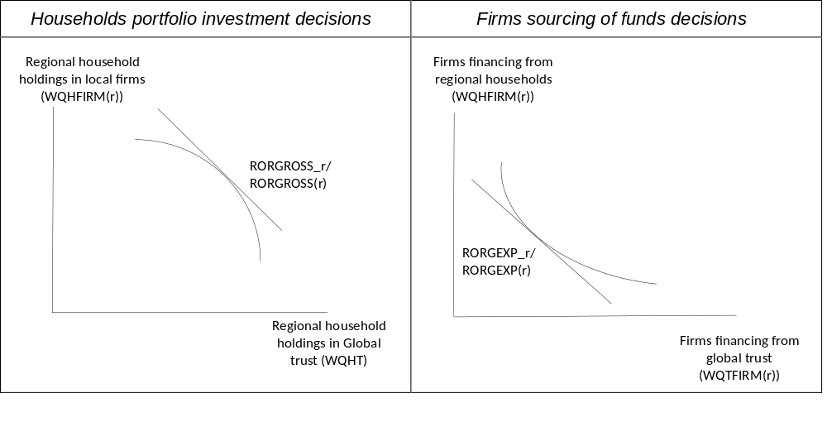
Household and firm optimizing behaviour with a CET|CES approach to modelling capital-finance
Model stable with the CET|CES alternative

Slide 13

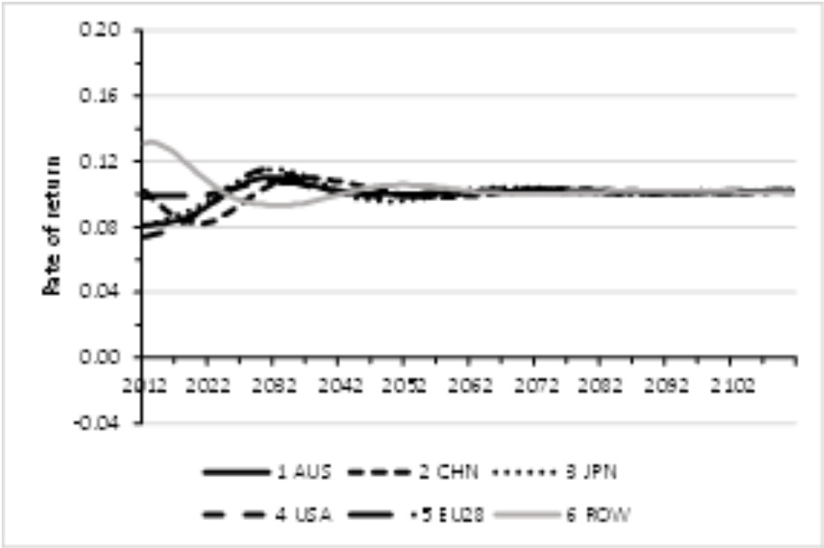
Model stability achieved in GDyn-F for test (with only Time shocked)
GDyn-2012 (from above) | GDyn-F RORGROSS (and RORGEXP) converges to RORGTARG (RORGTARG = 0.104 in database)
Stability conditions not satisfied
All stability conditions satisfied

Slide 14
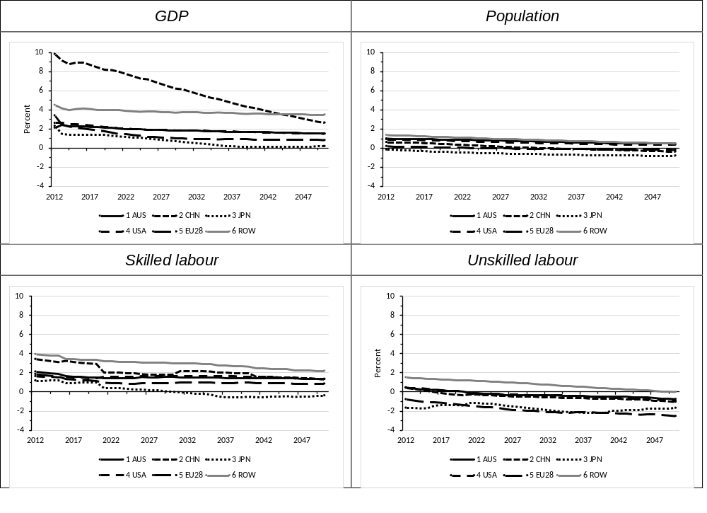
Can apply new theory to project baseline: take GDP, population and labour growth as inputs, 2012 to 2050
Key points
  GDP growth for China high but declining; ROW above average over period
  Population growth low and declining across regions
  Skilled-biased labour input growth projected across regions
  Selection suitable for baseline, others possible
Source: CEPII estimates provided with GDyn_V36, file: Projectionsforthe112_v3.zip downloaded from GTAP webpage 26 June 2016.

Slide 15
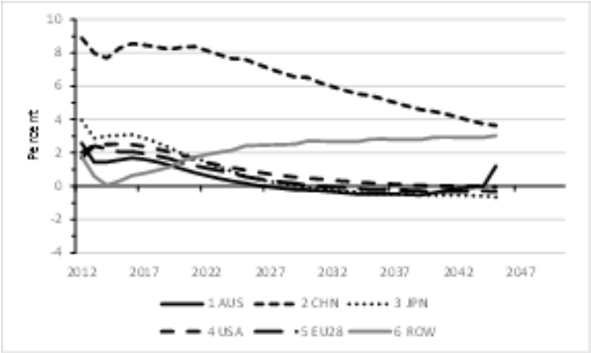
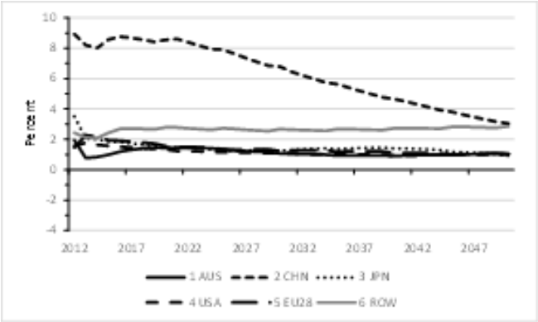
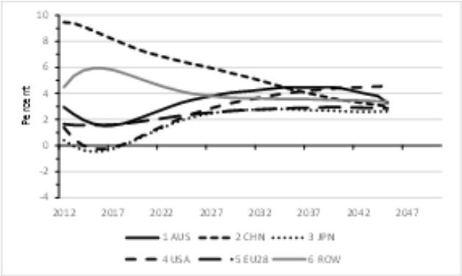
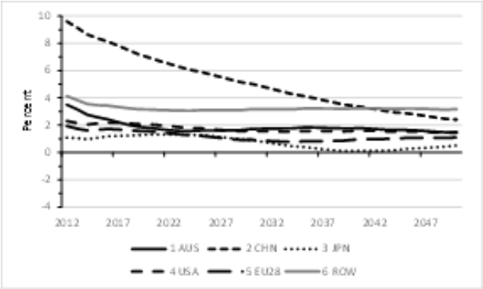
Model primary factor technical change and fixed capital accumulation, 2012 to 2050
GDyn-2012 | GDyn-F
Primary factor technical change in non-accumulable endowments (% change)
Key points GDyn-F
  Tech. change and K growth trace GDP growth across regions
  Effects complementary to skill-biased labour input growth
Key points Gdyn 2012
  Variability out of character with baseline projections
  Model terminates with error
Growth in fixed capital (% change)

Slide 16
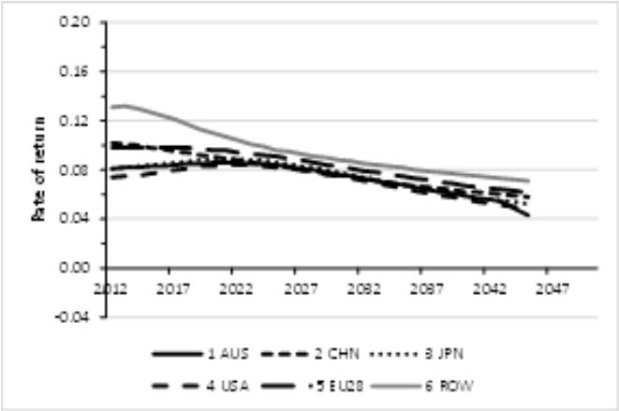
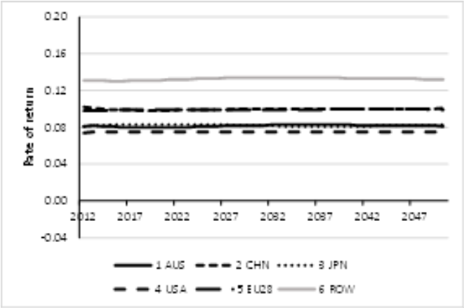
Modelled projections of gross rate of return confirm model stability, 2012 to 2050
GDyn-2012 | GDyn-F
Gross rate of return
Key points GDyn-F
  Regional differences maintained by assumption
  Gross rates of return stable in GDYN-F
Key point Gdyn-2012
  Declining trend projected
  Source of eventual model failure

Slide 17
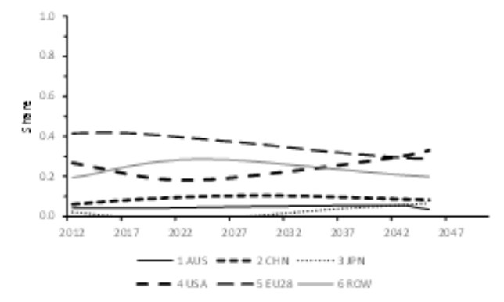
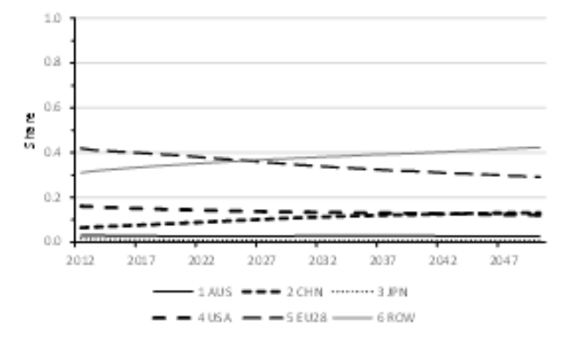
Revised model projections of share of global trust in regional firms also stable, 2012 to 2050
GDyn-2012 | GDyn-F
Share of the global trust in regional firms (Regional shares add to 1)
Key points
  Share of Global trust in regional firms influenced by matching of investment funding requirements to domestic & foreign saving
  Shares projected to:
  - increase for China & ROW - decrease for EU & USA
  - stable/low for AUS, JPN
  Greater variability projected in GDyn-2012

Slide 18
What has been achieved, possibilities for further research
Longer-run neo-classical equilibrium conditions satisfied
Modified Gdyn model suitable for building stable reference case
Some suggestions for further consideration and development
  Modelling of regional household saving behaviour
  Modelling of adjustment costs
  Modelling of labour supply and demand by occupation
  Appropriateness of parameter values
And what about
  Historical validation to help inform productivity and growth assumptions – possible with stable model & data from 2004

