Slide 1
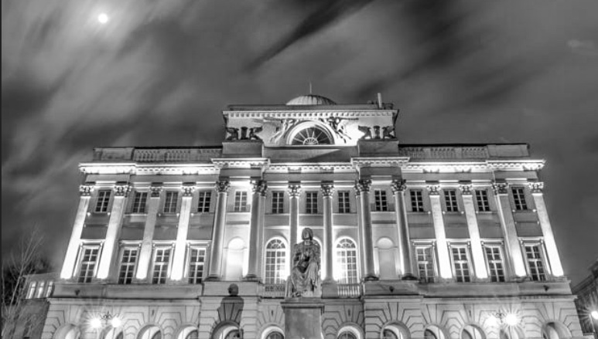

Image: Grzegorz Paskudzki, 500px
Authors (alphabetical order)
Cristian Jara Nercasseau
Maryla Maliszewska
Claudio Montenegro
Israel Osorio Rodarte
Javiera Petersen Muga
Raimundo Smith Mayer
Huanjun Zhang
Gender Disaggregated Labor Database
April 6th, 2020
Notes:
Creative Commons Attribution: https://www.flickr.com/photos/worldbank/15258738635/in/album-72157603688232855/
Font: Andes (presentation might change for pcs without the font installed, such as non-WB computers.)
Color: WB basic branding colors
Slides format is created by Karen

Slide 2
1.
Motivation for constructing a new database
Methodology
Deliverables
2.
3.

Slide 3
1
Motivation

Slide 4
Motivation
Need for a (re)examination of the distributional consequences of international trade beyond macroeconomic indicators
Nevertheless, detailed comparable data for global policy analysis is scarce, particularly for impacts by gender
Objective: Create a comparable micro-based dataset that
  that can inform macro (CGE) models, providing detailed accounts on employment levels by gender, occupation, wage, employment status at a finer level in economic activity.

Slide 5
Future applications within the World Bank
a) Processed “ready-made” statistics,
  To be used in the upcoming World Bank (2020) Trade and Gender Report
  Cross-country stats such as women's labor intensity and gender gap by sector
b) Statistics in flexible format to inform other databases.
To be used as an input to the Global Trade Analysis Project (GTAP) Database
  Disaggregate labor accounts by gender.
c) Added variables to World Bank micro-data surveys
To be used in simulations or generation of statistics
i.e. Impact of trade policy on WB client countries, AfCFTA, CP-TPP, USMCA

Slide 6
2
Methodology

Slide 7
Starting point
The World Bank has harmonized data for 138 countries with broad industry (3 sectors or 10 sectors) and occupation variables that account for 90% of population and GDP

Slide 8
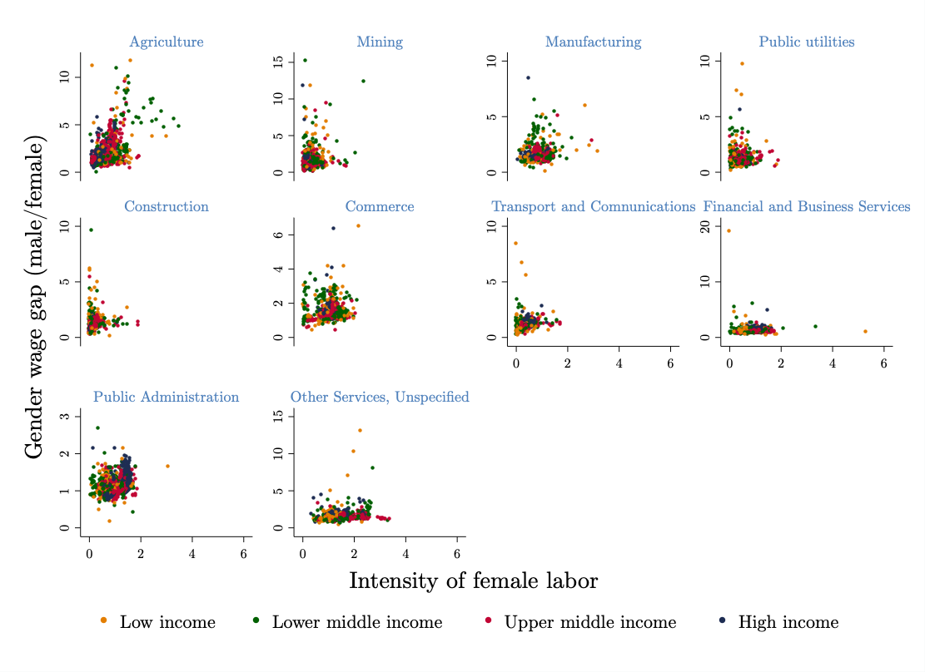
Starting point:
Global
Female labor intensity:
The share of female employment in an
economic activity divided by the share of
female employment in the country
Source: World Bank staff estimates using the International Income Distribution Database
Notes:
Our current data work is to extend the harmonization of microdata to add industry-specific shocks, i.e. within the agriculture and manufacturing sectors

Slide 9
Harmonization Process for the Gender Disaggregated Labor Database
Creates a finer level of disaggregation for “industry” and “occupation” harmonized to international standards.
Recover original industry and occupation variables
Document reason:
a) # of digits is not enough; or
b) Concordance missing
c) Other
No
Global collection of
Household Surveys
Is concordance possible?
ISIC & GTAP (2-digt)
Yes
Meta-data: Collect national classification systems for Industry and Occupation
ISCO 08
Notes:
Recollect meta-data
Using National Systems of Classification for economic activity, educational attainment, and/or occupation classifications.
Prioritize household surveys
Additional surveys to include (Japan, USA, Canada)
Prioritize based on comparability, size of GDP, population, coverage
There are household surveys for 134 countries that potentially could to be harmonized
Processing metadata and computing "industry_gtap" and "intermediate_step" variable
This includes:
Building concordance tables
Defining rules for splitting volumes
Provide metadata, and intermediate step to adjust to researcher needs
Consistency checks throughout the process
Cross-tabulations and construction of dashboard
Dissemination and integration into GTAP database
How to integrate this with existing harmonization workflow maintained by POV GP
Enable World Bank researchers to take advantage of this harmonization

Slide 10
From micro-based statistics to national aggregates matching national accounts (GTAP)
Harmonized micro data
Cleaning Process
Within-country outlier identification
& treatment
Cross-country
outlier identification
& treatment
Working at
micro
level
Working at
aggregate
level
Initial wages & employment
by activity, gender and skill level
Validation
Adjustment of labor value added & employment to ILO, WB, and GTAP
Estimated Aggregated Dataset

Slide 11
Building a Disaggregated Labor Database, limitations
On the microeconomic side, it requires a re-harmonization of industry and occupation data relying on a sub-sample of the World Bank collection of household surveys
The strategy has been to find initial documentation for a cross-section of countries
Finding disaggregated data at industry level in household surveys is not easy, because of:
  Focus. The World Bank efforts to harmonize household survey data are concentrated on collecting data for monitoring “global poverty”. This has created a gap in survey coverage for a. data on high-income countries, and b. an emphasis in poverty, rather than in the production of labor statistics.
  Survey design. Either when the classification system present in the household survey cannot be further disaggregated. Due to sampling, most surveys are not representative at the highest disaggregation level
  Data quality: Even if data can be disaggregated, there are some internal inconsistencies, inherent to data collection in difficult environments and with teams with low-statistical capacity
  Inconsistent meta-data: Comparable international information about national industry and occupation classifications doesn’t exist and country information is not always easily available

Slide 12
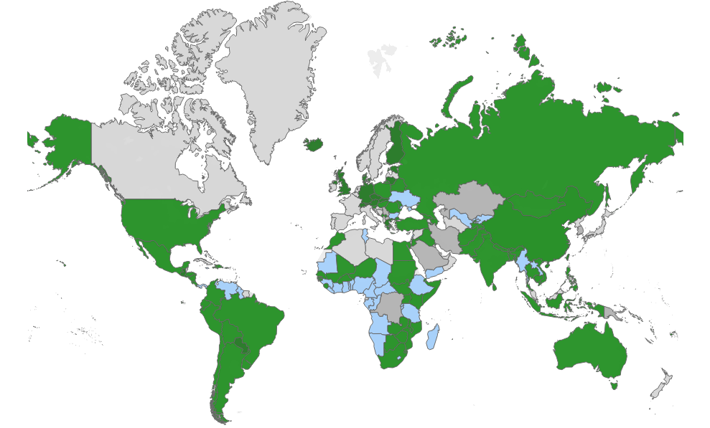
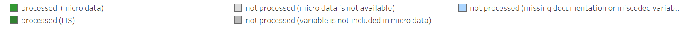
Building a Disaggregated Labor Database, progress on meta-data collection
219 countries-surveys were revised. When possible, information was collected about national industry and occupation classification, including number of digits in the survey
Notes:
Processed (micro-data): World Bank household surveys that were successfully harmonized
Processed (LIS): Relying on the Luxembourg Income Study, micro-based tabulations that were harmonized
Not Processed (micro data not available): Household survey is not accessible to us or not in WB domain.
Not Processed (variable is not included in microdata): There is a household survey in WB domain, but there is no information on economic activity nor occupation.
Not Processed (missing documentation or miscoded variable): These can be considered surveys in the pipeline with missing documentation, concordance table or other element that is preventing the harmonization.

Slide 13
Building a Disaggregated Labor Database, progress on performing conversion
a. ISIC Rev 4 and GTAP v10 codes
Industry | East Asia & Pacific | Europe & Central Asia | Latin America & Caribbean | Middle East & North Africa | North America | South Asia | Sub-Saharan Africa | Total
Harmonized in individual-level format | 11 | 12 | 15 | 7 | 1 | 8 | 22 | 76
Harmonized from Luxembourg Income Study |  | 13 | 2 |  |  |  |  | 15
Not harmonized, concordance missing | 4 | 4 | 3 | 1 |  |  | 12 | 24
Not harmonized, not enough digits | 4 | 11 | 3 | 3 |  |  | 11 | 32
Not harmonized, raw Data before 2000 | 1 |  | 5 |  |  |  |  | 6
Microdata is not available in WB domain | 8 | 8 | 1 | 8 |  |  | 2 | 27
Microdata do not exist (territories/small states) | 7 | 9 | 13 |  | 1 |  |  | 30
Microdata do not contain industry variable | 3 | 2 |  | 2 | 1 |  | 1 | 9
Total | 38 | 59 | 42 | 21 | 3 | 8 | 48 | 219

Slide 14
Building a Disaggregated Labor Database, progress on performing conversion
and/or b. ISCO 08 codes have been processed for:
Industry | East Asia & Pacific | Europe & Central Asia | Latin America & Caribbean | Middle East & North Africa | North America | South Asia | Sub-Saharan Africa | Total
Harmonized in individual-level format | 11 | 7 | 13 | 5 | 1 | 7 | 19 | 63
Harmonized from Luxembourg Income Study |  | 13 | 2 |  |  |  |  | 15
Not harmonized, concordance missing | 4 | 9 | 7 | 2 |  | 1 | 14 | 37
Not harmonized, not enough digits | 3 | 10 | 1 | 4 |  |  | 3 | 21
Not harmonized, raw Data before 2000 | 1 |  | 5 |  |  |  |  | 6
Microdata is not available in WB domain | 8 | 8 | 1 | 8 |  |  | 2 | 27
Microdata do not exist (territories/small states) | 7 | 9 | 13 |  | 1 |  |  | 30
Microdata do not contain industry variable | 4 | 3 |  | 2 | 1 |  | 10 | 20
Total | 38 | 59 | 42 | 21 | 3 | 8 | 48 | 219

Slide 15
An application example for finer level industry
Two prominent options for diversification in Africa are a. Vegetables and Fruits and b. Textiles
Vegetables and fruits have higher value added than traditional agricultural products such as crops, coffee, cocoa
Textiles, on the other hand, have been the base of manufacturing expansion in East Asia
Due to high intensity of female labor and gender wage premia, both sectors can have different implications in job creation, by gender

Slide 16
3
Deliverables

Slide 17
Building a Disaggregated Labor Database, what has been done
The initial deliverables are:
1. Harmonized micro data (household survey)
  with labor module including employment status, labor status, demographic information, wage and income, ISCI Rev 4 (2-4 digit) and GTAP10, ISCO 08 (2-4 digit)
  Only open for the users who have the access to the WB household survey data
2. Harmonization Tool (in Stata)
  Allows user to harmonize a new household survey between national and international classifications. This is critical for future scaling-up this project.
3. Global statistics on wages and employment by economic activity, skill level and gender
  This global statistics match GTAP v10 value-added data
4. Meta-data on national classification systems
5. Document and Visualization – to be released in March 2020*
  World Bank Website
  World Bank Open Data Bank
  World Bank Data Catalog

Slide 18
Dataset: Harmonized micro data for internal use only
The GDLD database complements global and regional harmonization efforts within the World Bank,
  Particularly, economic activities and occupation variables were re-harmonized to match international classifications systems (ISIC Rev 4/ISCO 08)
  Additionally, a proxy variable of “wage per month” was created
  Because it is based on record-level data, the dissemination of the dataset is restricted to only within the WBG. Nevertheless, the underlying code can be shared without restriction
  At the global level, the harmonized micro-database accounts for 71% of GDP and 78% of population

Slide 19
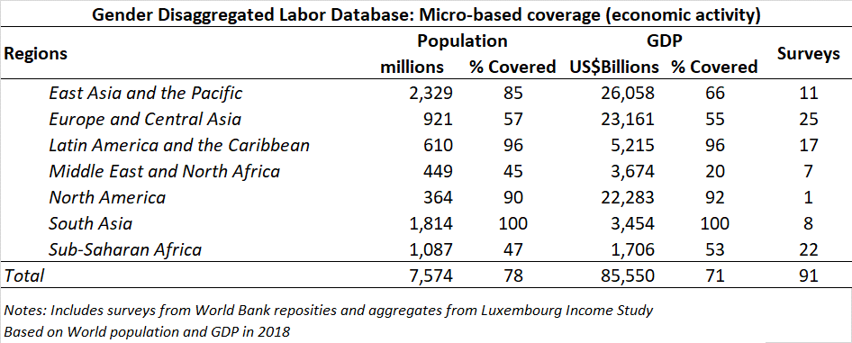
Dataset: Regional coverage of harmonized micro data

Slide 20
Tool: Stata ado-files (re)-run the harmonization
gdld_class
Provides a framework to harmonize national industrial or occupational classifications to their ISIC Rev 4, GTAP v10 or ISCO-08 counterpart
formed by a set of STATA programs that runs on top of individual-level micro data
It helps users to replicate the harmonization done in this project and run their own harmonization based on the local classification information
It is a critical piece in scaling this project and sharing it with units inside and outside the World Bank

Slide 21
Dataset: Estimated wages and employment volume (for CGE modeling)
Estimated statistics based on the harmonized household survey dataset
  It provides the estimated wages and employment volumes disaggregated by economic activity, skill level and gender
    Particularly useful for the GTAP 10 database with 65 sectors and 141 regions
  This database has been adjusted to match macro statistics on labor force and wage bill (available in World Development Indicators and ILOSTAT)
  It includes WB and GTAP regional mappings

Slide 22
Metadata: national classification systems for economic activity and occupation
Metadata collected throughout this project.
It includes information for economic activity and occupation variables present in World Bank household surveys
The metadata was collected from extensive search, including the national statistical offices, survey documents, external websites, and other sources
It helps to identify national classifications used by the surveys, in order to create the harmonization process from local classification to international classifications

Slide 23
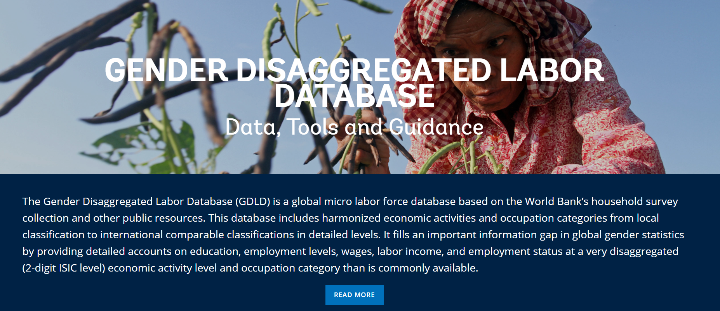
Platform: GDLD Website
GDLD website provides a glance for this project, to download necessary data and files, visualize the database for global comparison, and link to applications such as Trade and Gender Report and AfCFTA project.
  The internal review link is http://datatopicsqa.worldbank.org/gess/
  The final public URL would be http://datatopics.worldbank.org/gdld/

Slide 24
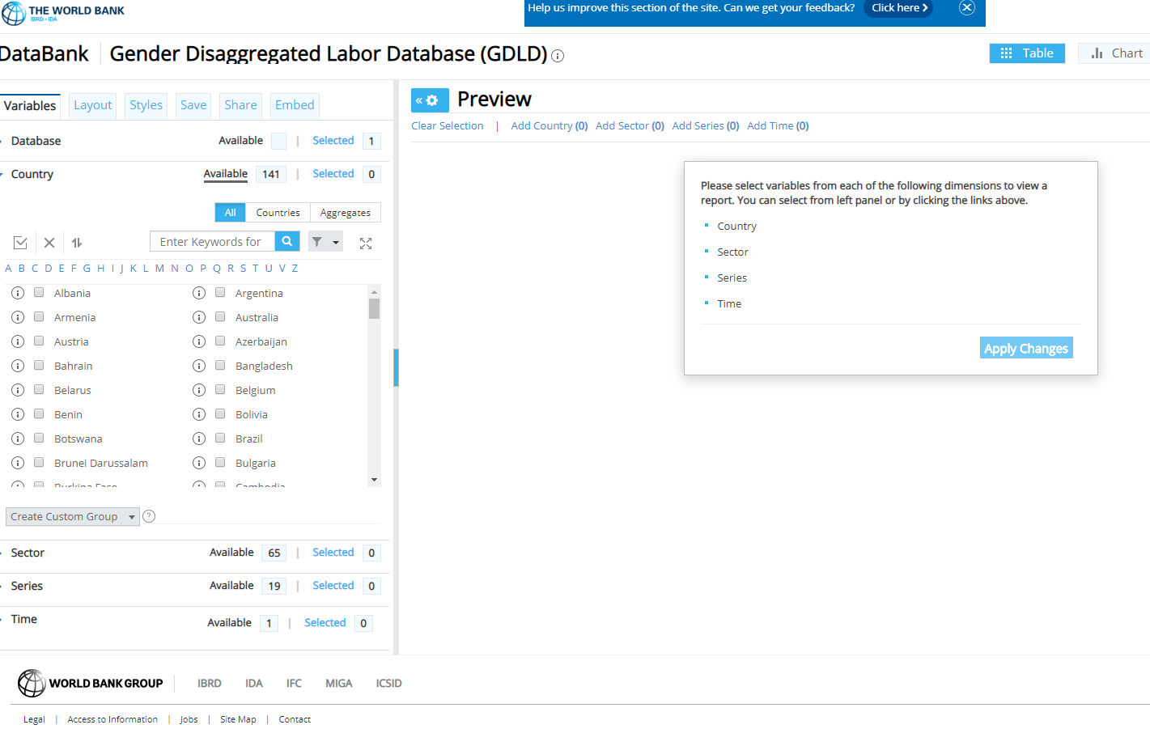
Platform: Data Bank Page
Data Bank page (https://databankqa.worldbank.org/source/gender-disaggregated-labor-database-(gdld)
It is an interactive platform allowing users to select, preview and download necessary summary data. GDLD Data Bank page is 4-dimension for country, sector, series and time. In current stage, it is in internal review status.

Slide 25
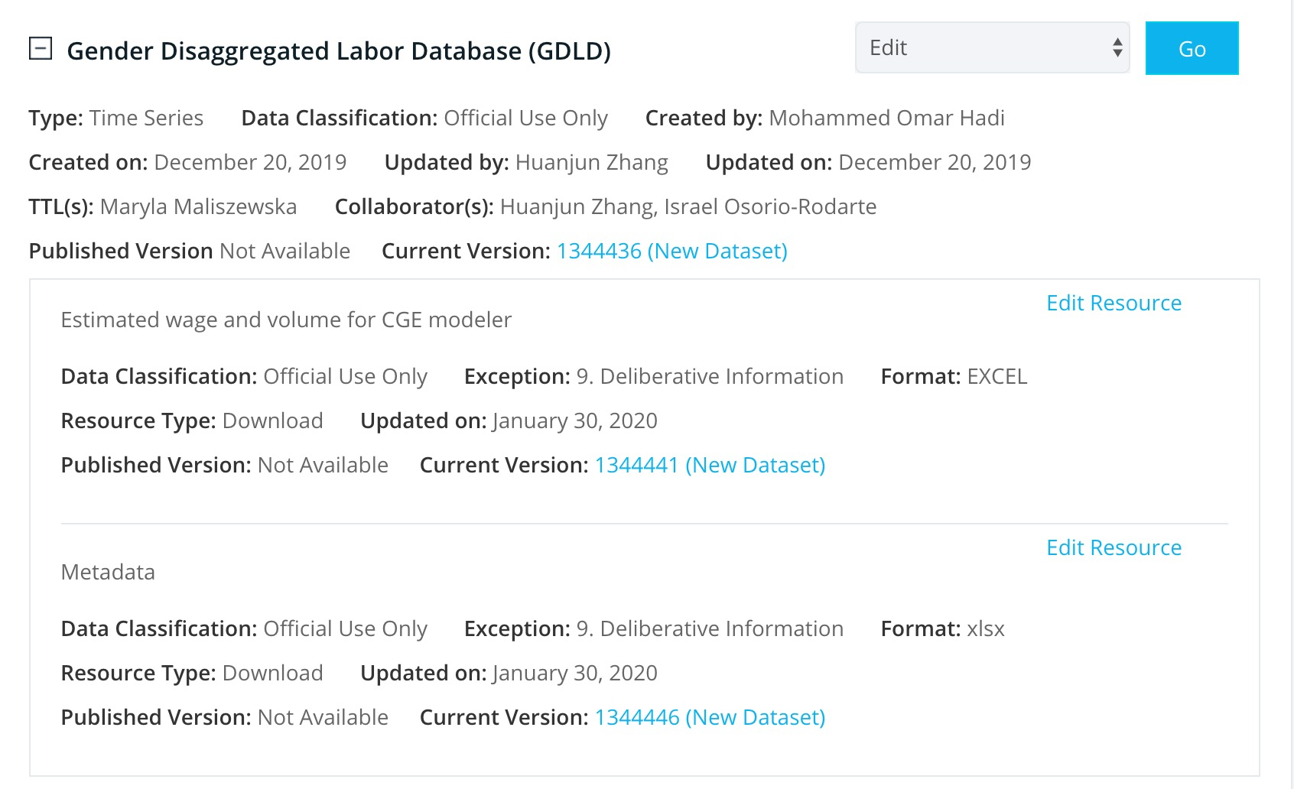
Platform: Data Catalog Page
The Data Catalog page (https://datacatalog.worldbank.org/ddhworkbench/workbench-datasets) is the place to save all materials, which will be shared to public after the review.

