Slide 1

Modelling the Economic Impact of Brexit on Wales
Sangeeta Khorana
Badri Narayanan G
Nicholas Perdikis
10th January 2019
Presentation at GTAP Conference 2020
Welsh Assembly funding gratefully acknowledged

Slide 2
Outline of the talk
Welsh trade profile
Scenarios, data and methodology
Main findings
Policy implications

Slide 3
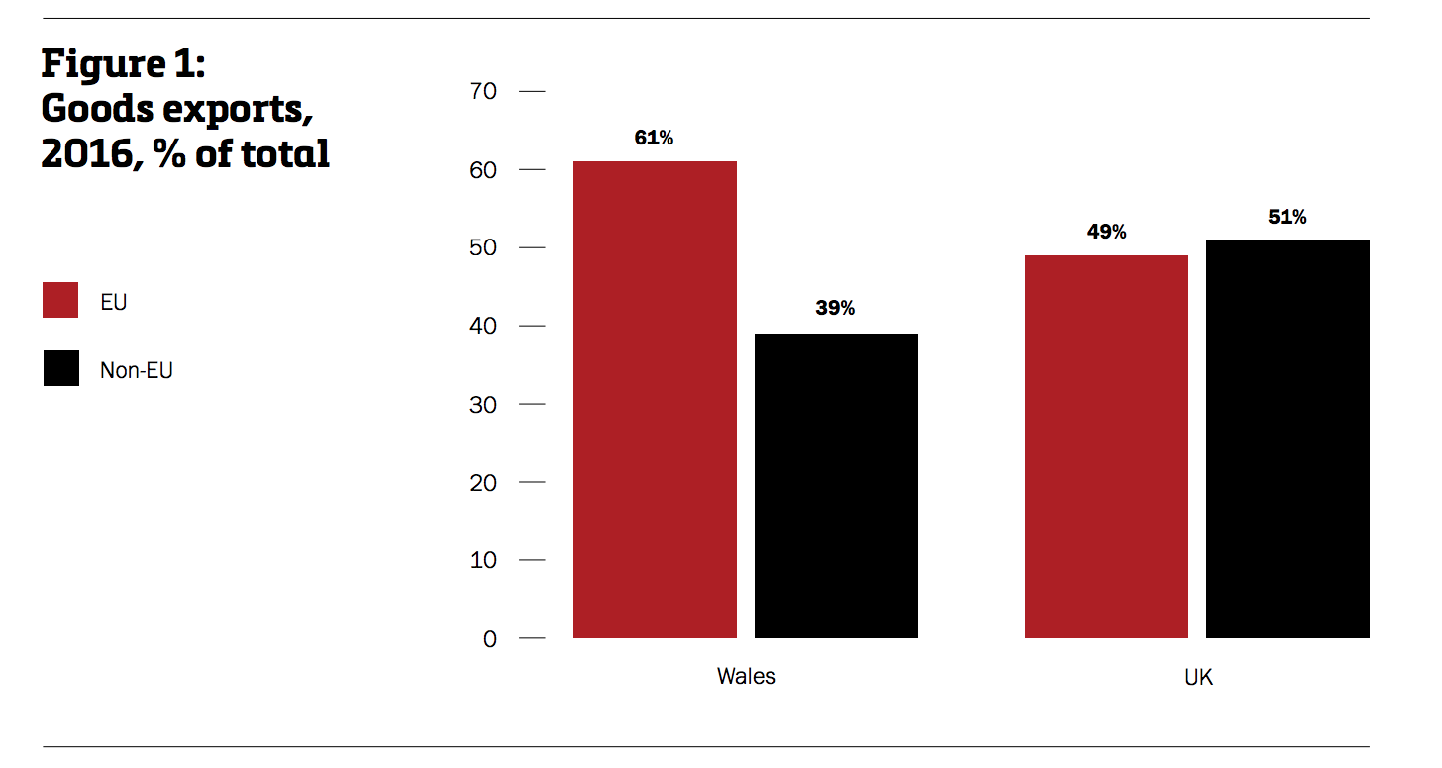
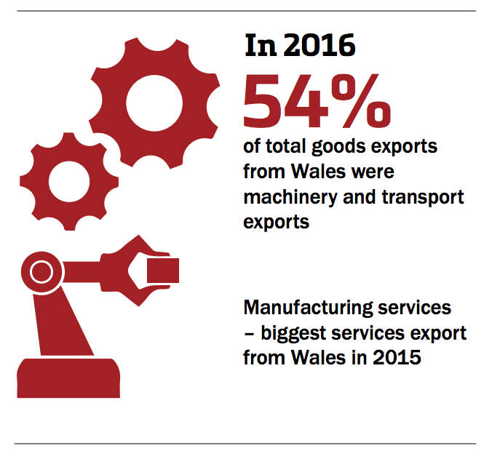
Pattern of trade between Wales-EU

Slide 4
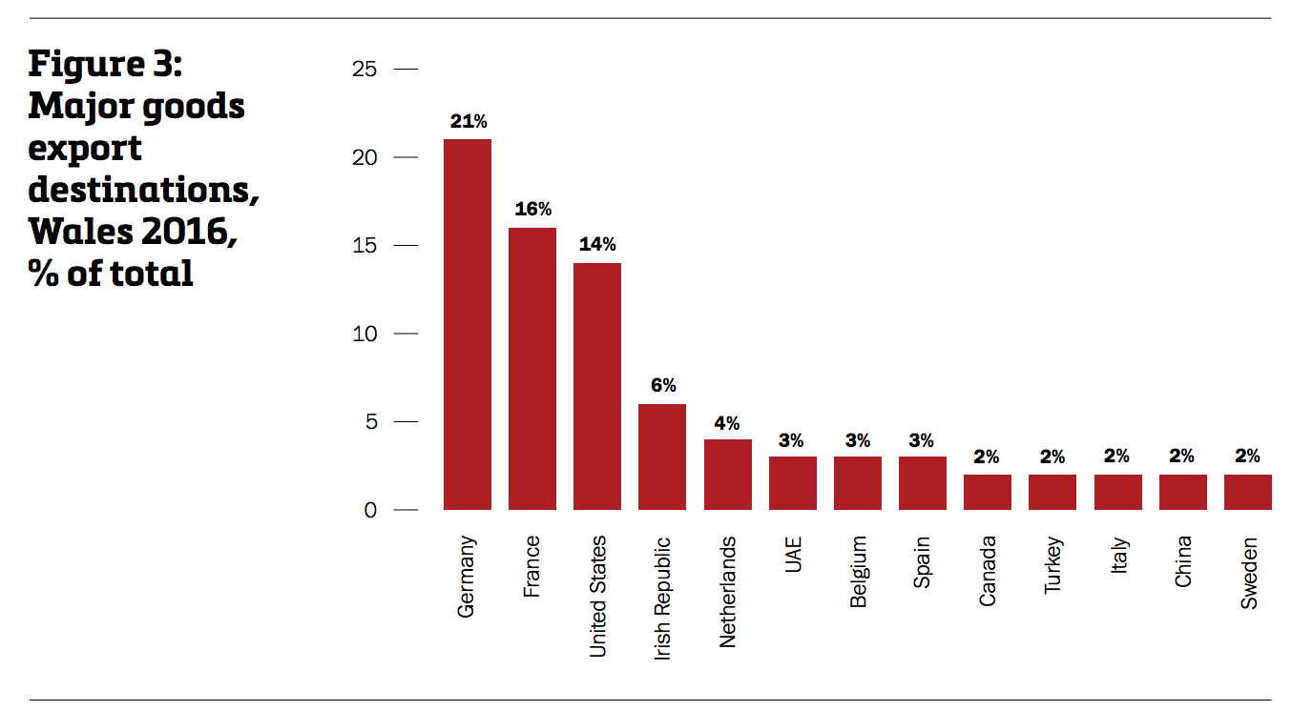

Slide 5
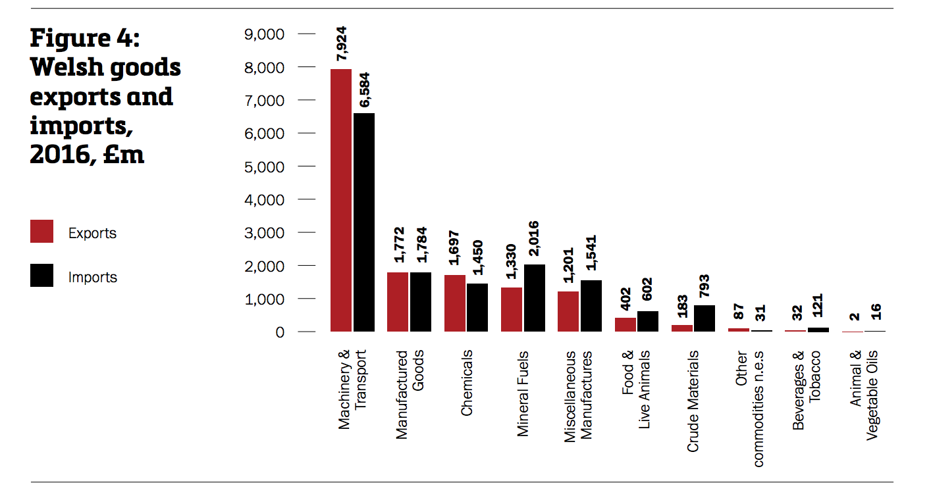

Slide 6
Existing literature
Range of issues, such as immigration and employment (for example see Valverde and Latorre, 2019; Theurer et. 2018; Brakman et al., 2017; Portes, 2017; Hosoe 2017), trade (Ebell and Warren, 2016; HM Treasury, 2016; OECD, 2016; Oxford Economics, 2016; PWC, 2016, 2017; Dhingra et al., 2017; Bank of England, 2018) employment and implications for industrial policy (Bailey et al. 2019) and FDI (Jafari and Britz, 2020; Busch, 2106).

Slide 7
Scenarios simulated
no economic partnership agreement between the UK and EU on 31 December 2020, i.e. trade between the UK and EU and the rest of the world would revert on World Trade Organisation (WTO) basis and default Most Favoured Nation (MFN) tariffs apply.
a limited transition period, i.e. continue the existing arrangement that includes membership of the Customs Union and Single Market, for a limited period after 31 December 2020.

Slide 8
Data and methodology
Dynamic CGE model - Global Trade Analysis Program (GTAP) 9.2 version of Data base
National level trade flows and tariff data for each sector-country pair - UN Comtrade.
Welsh IO table, macro-economic and trade data
SplitReg to disaggregate UK data into Wales and the rest of UK (i.e. Scotland, Northern Ireland, and England)
Regional aggregation includes Wales, Rest of the UK, Rest of the EU, and Rest of the World (RoW)
Definition of sectors and mapping to GTAP 57 commodities

Slide 9
Scenario one
Real GDP by regions
 | % change
Real GDP | -0.6
Exports | -19.7
Imports | -4.9
Unskilled labour | -2.5
Skilled labour | -2.9
Regions | 2020 | 2025 | 2030
RestofUK | -0.41 | -0.44 | -0.48
Wales | -0.50 | -0.55 | -0.59
United States | 0.00 | 0.00 | 0.00
China | -0.02 | -0.02 | -0.02
India | -0.03 | -0.03 | -0.02
Rest of EU | -0.04 | -0.04 | -0.04
RoW | -0.01 | -0.01 | -0.01

Slide 10
Output (% change from baseline)
Long term changes in output in the No-Deal scenario (% change from baseline)

Slide 11
Change in Trade Balance

Slide 12
Employment (%)

Slide 13
FDI and investment (%)

Slide 14
Scenario two (%)
 | 2 year | 3 year | 5 year | 10 year
Real GDP | -0.57 | -0.56 | -0.54 | -0.50
Exports | -19.62 | -19.57 | -19.46 | -19.24
Imports | -4.89 | -4.90 | -4.92 | -4.98
Real Wages
Unskilled labour | -2.47 | -2.46 | -2.46 | -2.45
Skilled labour | -2.75 | -2.75 | -2.74 | -2.71

Slide 15
GDP by regions (%)
 | 2 year | 3 year | 5 year | 10 year
Wales | -0.57 | -0.56 | -0.54 | -0.50
Rest of UK | -0.47 | -0.46 | -0.44 | -0.40
United States | 0.00 | 0.00 | 0.00 | 0.00
China | -0.02 | -0.02 | -0.02 | -0.02
India | -0.02 | -0.02 | -0.03 | -0.03
Rest of EU | -0.04 | -0.04 | -0.04 | -0.04
Rest of the World | -0.01 | -0.01 | -0.01 | -0.01

Slide 16
Trade effect

Slide 17
Impact on output (%)

Slide 18
Employment (%)

Slide 19
FDI and investment (%)

Slide 20
Comparison (2030)
 | No trade relationship | A transition period
 |  | 2-yr | 3-yr | 5-yr | 10-yr
Real GDP | -0.59 | -0.57 | -0.56 | -0.54 | -0.50
Exports | -19.70 | -19.62 | -19.57 | -19.46 | -19.24
Imports | -4.87 | -4.89 | -4.90 | -4.92 | -4.98
Unskilled labour | -2.47 | -2.47 | -2.46 | -2.46 | -2.45
Skilled labour | -2.76 | -2.75 | -2.75 | -2.74 | -2.71

Slide 21

Conclusion and policy implications
Scenario with the UK leaving with no agreement on future partnership presents:
  UK losses range from -0.41% to -0.48%
  Wales from -0.5% to -0.59%
  EU losses are -0.04%
Transition period:
  Losses are lower
  Longer the transition smaller are the losses!
An extended transition is needed to minimise losses

Slide 22
Comments and Questions
skhorana@bournemouth.ac.uk

