Slide 1

JoBs potential of a transition to a Circular economy
Jean Chateau, Eleonora Mavroeidi
Environment and Economy Integration Division
OECD Environment Directorate
GTAP, 17-19 June 2020

Slide 2


Circular economy transition & jobs
Many circular economy (CE) roadmaps emphasize the job potential:
  EU CE Package: 170,000 direct jobs by 2035
  French ‘50 Measures for the CE’: 300,000 jobs
  Finland Roadmap to CE: 75,000 jobs
All previous modelling studies find (small) positive aggregate employment effects
But miss the sectoral and distributional aspects of CE transition
This analysis focuses on the implied structural changes and the subsequent shift of labour across sectors

Slide 3
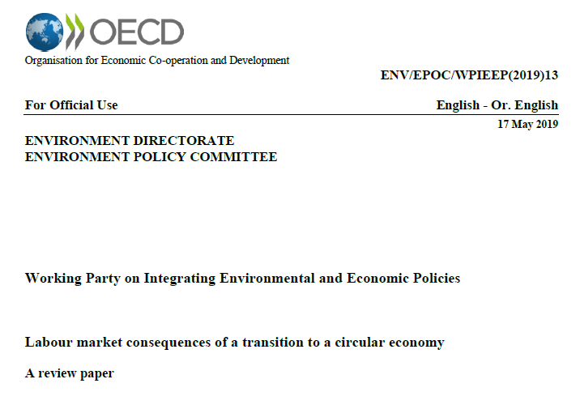
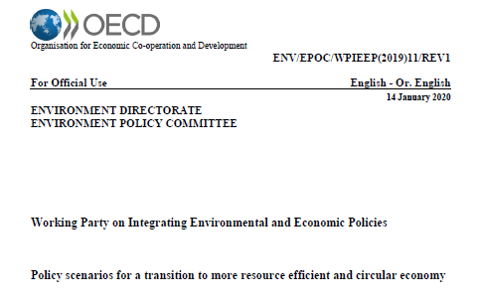



Report builds on previous OECD reports
Current paper builds on:

Slide 4
Mechanisms and drivers of labour implications
Job creation
in sectors that reduce the use of primary materials or support the development of circular business models
Job substitution
whereby one activity replaces another
Job destruction
in sectors characterized by large environmental and materials footprints without direct replacement
Job redefinition
evolution of existing jobs to incorporate resource efficiency and circularity
≠

Slide 5
PART I. Baseline Trends
Notes:
The first section of the paper describes the underlying trends in the absence of RE-CE policies

Slide 6
Projected socio-economic changes by 2040
 | OECD |  | BRIICS |  | Rest of the World |  | WORLD
 | 2017 | 2040 | 2017 | 2040 | 2017 | 2040 | 2017 | 2040
GDP growth ª |  | 1.9% |  | 3.9% |  | 3.7% |  | 3.0%
Employment growth ª |  | 0.3% |  | 0.2% |  | 1.7% |  | 0.8%
Population growth ª |  | 0.4% |  | 0.4% |  | 1.6% |  | 0.9%
Labour productivity growth ª |  | 1.7% |  | 3.1% |  | 1.9% |  | 1.7%
Services share ^{b} | 72% | 74% | 54% | 57% | 49% | 53% | 64% | 66%
Material intensity ^{c} | 0.47 | 0.41 | 1.21 | 0.68 | 0.77 | 0.62 | 0.79 | 0.57
 | OECD |  | BRIICS |  | Rest of the World |  | WORLD
 | 2017 | 2040 | 2017 | 2040 | 2017 | 2040 | 2017 | 2040
GDP growth ª |  | 1.9% |  | 3.9% |  | 3.7% |  | 3.0%
Employment growth ª |  | 0.3% |  | 0.2% |  | 1.7% |  | 0.8%
Population growth ª |  | 0.4% |  | 0.4% |  | 1.6% |  | 0.9%
Labour productivity growth ª |  | 1.7% |  | 3.1% |  | 1.9% |  | 1.7%
 | OECD |  | BRIICS |  | Rest of the World |  | WORLD
 | 2017 | 2040 | 2017 | 2040 | 2017 | 2040 | 2017 | 2040
GDP growth ª |  | 1.9% |  | 3.9% |  | 3.7% |  | 3.0%
 | OECD |  | BRIICS |  | Rest of the World |  | WORLD
 | 2017 | 2040 | 2017 | 2040 | 2017 | 2040 | 2017 | 2040
GDP growth ª |  | 1.9% |  | 3.9% |  | 3.7% |  | 3.0%
Employment growth ª |  | 0.3% |  | 0.2% |  | 1.7% |  | 0.8%
 | OECD |  | BRIICS |  | Rest of the World |  | WORLD
 | 2017 | 2040 | 2017 | 2040 | 2017 | 2040 | 2017 | 2040
GDP growth ª |  | 1.9% |  | 3.9% |  | 3.7% |  | 3.0%
Employment growth ª |  | 0.3% |  | 0.2% |  | 1.7% |  | 0.8%
Population growth ª |  | 0.4% |  | 0.4% |  | 1.6% |  | 0.9%
Average annual growth rate (over the period) (percentages)
Gross value added of services at basic prices in percentage of GDP.
Material uses per unit of real GDP at 2011 PPPs exchange rates.
Baseline projections suggest economic growth accompanied with mild employment growth, increases in labour productivity, and expansion of service sectors

Slide 7
.. will be accompanied by job reallocations across sectors
Percentages of total employment – Average rates over the periods, 2017-2040.
 | Net employment growth | Excess worker reallocation | Job creations | Job destructions | Total job reallocation
OECD | 0.3% | 0.4% | 0.5% | 0.2% | 0.7%
BRIICS | 0.2% | 0.8% | 0.6% | 0.4% | 1.0%
Rest of the world | 1.7% | 0.1% | 1.7% | 0.1% | 1.8%
 | Net employment growth | Excess worker reallocation | Job creations | Job destructions | Total job reallocation
OECD | 0.3%
BRIICS | 0.2%
Rest of the world | 1.7%
Because of structural change there are job reallocations across sectors that are higher than projected changes in total employment
Reallocation of jobs are higher in BRIICS and countries that are in phase of transition towards mature economies
In other developing economies employment growth is the main driver of labour markets dynamics

Slide 8
Jobs destructions in industrial sectors and job creations in services sectors across OECD economies
Percentage changes in 2040 baseline projection relative to 2017 values.

Slide 9
PART II.
Labour implications of policies to promote Resource Efficiency and Circular Economy transition

Slide 10
Material Fiscal Reform (MFR) scenario
Instrument | Description | Global Targets (2040)
Material tax scenario (MTS) | Tax on primary metals and non-metallic minerals | 10 $/t of iron ores 50 $/t of aluminium ores 20 $/t of copper ores 15 $/t of other metals ores 5 $/t of non-metallic minerals
Subsidy to secondary metal production | Production subsidy to secondary metal production | 75% subsidy rate on the purchasing price of the recycling commodity
Subsidy to recycling | Subsidy for recycling input uses | Subsidy on the producer (selling) price of secondary metal - at level that ensures the full package is revenue-neutral.
All these fiscal instruments are implemented from 2018 to gradually reach their target in 2040
Government revenues from the material taxes are used to finance subsides (MFR) or returned as lump sum transfers (MTS)
Material taxes are differentiated across countries to take into account existing royalties and taxes on mining sectors.

Slide 11
Results: boosting resource efficiency and boost employment seems possible
Percentage changes in 2040 compared to baseline
– range across aggregate country groups
Employment
0 to +0.1%
…
GDP
-0.1 to -0.4%
Minerals use
-4 to -12%
Metal use
-17 to -40%

Slide 12
MFR implies small aggregate employment impacts with larger job reallocation
Changes w.r.t baseline in 2040 as % of total employment.
 | Net employment growth | Excess worker reallocation | Job creations | Job destructions | Total job reallocation
OECD | 0.05% | 0.1% | 0.1% | 0.1% | 0.2%
BRIICS | 0.05% | 0.4% | 0.3% | 0.3% | 0.6%
Rest of the world | 0.01% | 0.4% | 0.2% | 0.2% | 0.4%
The impact of material tax policies on total employment is very limited
Labour markets dynamic is characterized by shifts of employment across sectors
MFR implies large labour shifts across sectors for limited impacts on GDP
The policy will result in: 8 million jobs creations, and 6 million jobs destructions globally by 2040

Slide 13
Differences across countries depending on their economic structure
Percentage changes w.r.t baseline in 2040
13

Slide 14
Jobs shift towards less material intensive sectors gradually
Changes w.r.t baseline as a percentage of total baseline employment, 2018-2040

Slide 15
Within OECD additional employment gains captured in labour intensive sectors - services
OECD - Changes w.r.t. baseline in 2040

Slide 16
Partial implementation of MFR yields leakages
Changes w.r.t. baseline in 2040
Importers of raw materials benefit from lower input prices
However, drop in OECD demand for primary metals, negatively affect certain non-OECD economies

Slide 17
Summary
The paper shows that:
The policy implies 8 millions of job creations but also 6 millions of job destructions globally
Although, the net impact on employment is small, some sectors are heavily affected – both in terms of job creations (e.g. secondary materials, recycling, services, utilities) and job destructions (e.g. primary materials, non-metallic materials, construction)
Policy messages:
To maintain public support throughout the transition process towards RE-CE economies, it is important:
To carefully study the sectoral shifts in the labour market
To acknowledge the positive and negative implications that may arise, and
To highlight how additional policies and reforms may mitigate some of these side effects; for example implementing training policies to help workers in material intensive sectors to move to new jobs; investments in R&D to mitigate the cost of substituting primary materials.

Slide 18

Thank you!
Jean.CHATEAU@oecd.org
Eleonora.MAVROEIDI@oecd.org

Slide 19
Mechanisms and drivers of labour implications
Changes in production modes
Changes in demand patterns
Aggregate income and macroeconomic conditions
Trade and competitiveness
≠
Notes:
Different drivers can contribute to these changes:
(i) Firms changing their production modes may require fewer raw materials and more secondary materials and labour demand needs to adjust accordingly.
(ii) Changes in demand patterns can lead to expansion and contraction of industries and their jobs. (e.g. from resource efficient to more circular/recyclable products)
(iii) aggregate income and macroeconomic conditions e.g. aggregate demand and supply
(iv) trade and competitiveness e.g. different policy environment can result in a shift in competitiveness and trade.

Slide 20
BASELINE -Job creations in most sectors across Non-OECD economies
Percentage changes in 2040 baseline projection relative to 2017 values.

Slide 21
MFR - non-OECD benefit from lower material costs
Non –OECD - Global variation in 2040 w.r.t. central baseline scenario

