Slide 1
The impact of multinational and trading enterprises on gender equality
23rd Annual Conference on Global Economic Analysis.
Henri Luomaranta
Statistician
Division on Globalization and
Development Strategies, UNCTAD
henri.luomaranta@un.org
Co-authors:
Fernando Cantu,
Steve MacFeely,
Anu Peltola

Slide 2


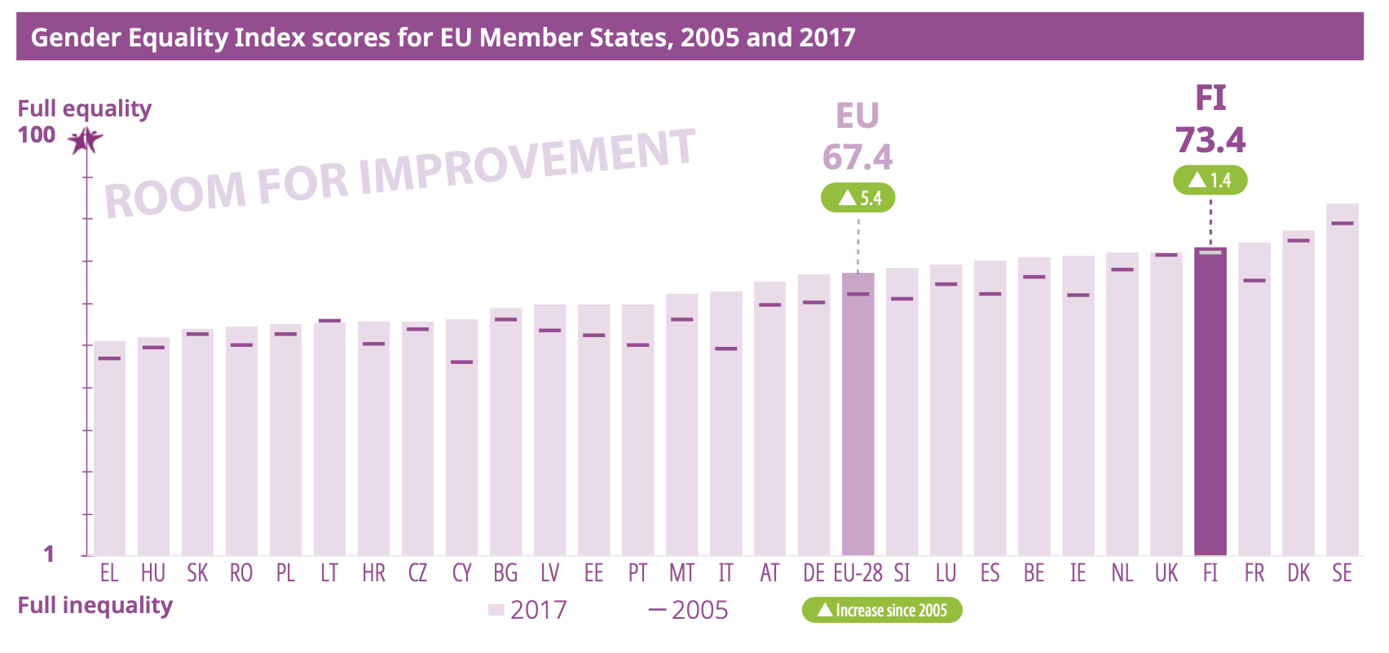
United Nations Statistical Commission
Introduction
Why this study?
  To assess the link between gendered outcomes and the wealth generating apparatus of global economies
    i.e. multinational enterprises and international trade
  To respond to the increasing policy importance of gender equality in trade and the labour market – e.g. WTO, SDGs, EU, Canada
Why Finland?
  High importance placed on gender equality and international trade
  Comprehensive registers on the total population of firms
Purpose of the study
  Propose a blueprint for trade and gender analyses of the labour market in official statistics
  Focus on multinational enterprises and international traders to provide evidence of firm heterogeneity from gender perspective
Source: EIGE, PUBLICATION DATE: 07 October 2019

Slide 3
United Nations Statistical Commission
Roadmap – structure of the study
Literature and motivations – firm heterogeneity and gender outcomes
Operationalize trade and gender analyses
  Highlight data sources in official statistics
  Propose concepts and analytical breakdowns
    i.e. high-paying jobs and skills that benefit from globalisation
Main results – the key role of MNEs and foreign traders in gender participation and pay gap
Next steps – how to develop official statistics to support gender-responsive policy making

Slide 4
United Nations Statistical Commission
Relevant literature
Gender gap shrinking but large in high-paying jobs (Stein, 2017)
High-paying jobs which reward long and unusual hours contribute to gender pay gap (Goldin, 2014)
Heterogeneous firms, not only heterogeneous occupations, play an important role in gender pay gap (e.g. Card et al., 2016; Cardoso et al., 2016; Jewell et al., 2019, Gallen et al., 2019)
  Women work in less productive firms and receive smaller premiums from high-productivity firms
High-skill jobs in trading enterprises in Norway widen the gender gap (Bøler et al., 2018), similar results with Estonian MNEs (Vahter and Masso, 2018)

Slide 5
United Nations Statistical Commission
Motivations
International traders and MNEs highly relevant from the gender perspective – high productivity and international activites are related to gender gap
Industry-level analyses of international trade and gender likely overestimate the role of women in trade,
  Women sort to lower productivity firms within industry and to lower paying occupations in firms
Our framework focuses on these observations

Slide 6
United Nations Statistical Commission
Official statistical sources for gender and trade analyses
Statistical Business Register (SBR)
Firms, activity sectors, ownership links, ultimate controlling institutional unit
Firm
ID
Foreign Affiliate Statistics (FATS)
International Trade in Goods Statistics (ITGS)
Trade volumes, trade partners…
International Trade in Services Statistics (ITS)
Structural Business Statistics (SBS)
Performance indicators (productivity…)
Combined employer-employee data (FOLK)
Workers, occupations, education, earnings..

Slide 7
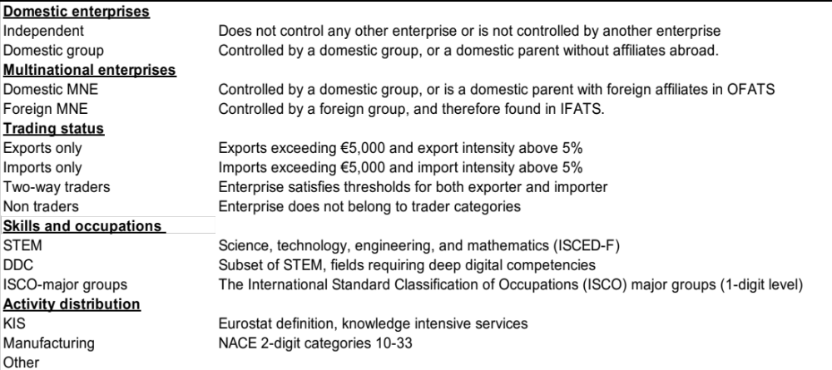
United Nations Statistical Commission
Analytical groupings to operationalize gender and trade analysis

Slide 8
United Nations Statistical Commission
Why these groupings?
High paying occupations and gender gap
  STEM/DDC may benefit from globalisation & job polarization could be related to ICT development (Michaels et al. 2014).
  Gender-occupation sorting
Multinationals & international traders and gender gap
To understand better & inform trade and gender policies of:
  Whether women sort into low productive firms and are underrepresented in MNEs and traders?
  Who benefits from international trade?
  Whether in these firms, women and men sort into different positions and whether the pay gaps are large therein?

Slide 9
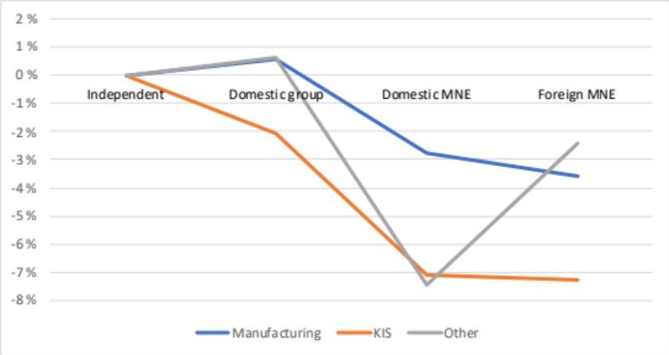
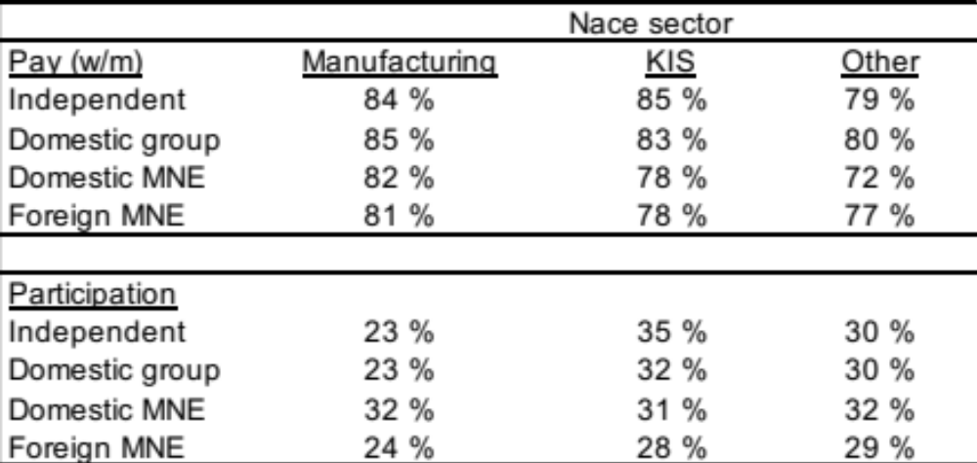
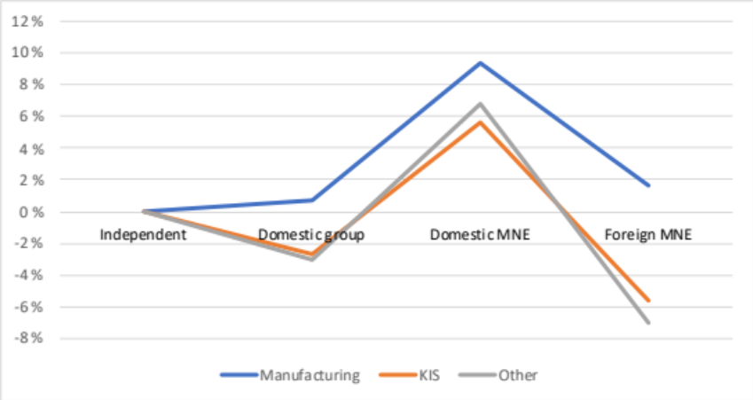
United Nations Statistical Commission
MNES pay well, but
Women’s/men’s salary compared to independent firms, ISCO 1-3
Women’s/men’s participation and pay differences by firm types ISCO 1-3
Difference of women’s share of workforce from independent firms, ISCO 1-3

Slide 10
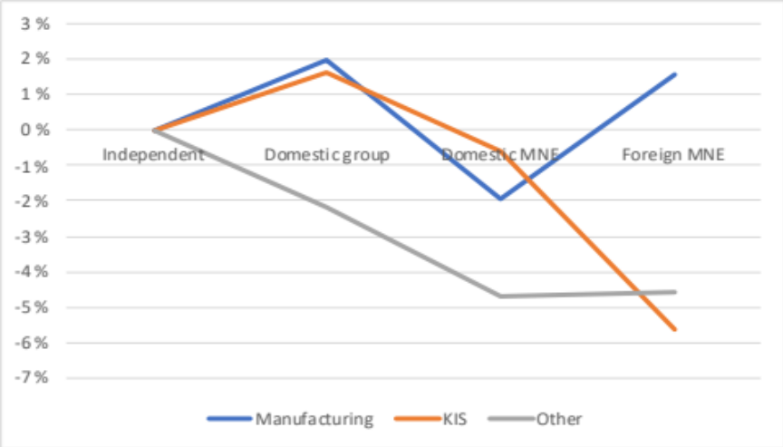

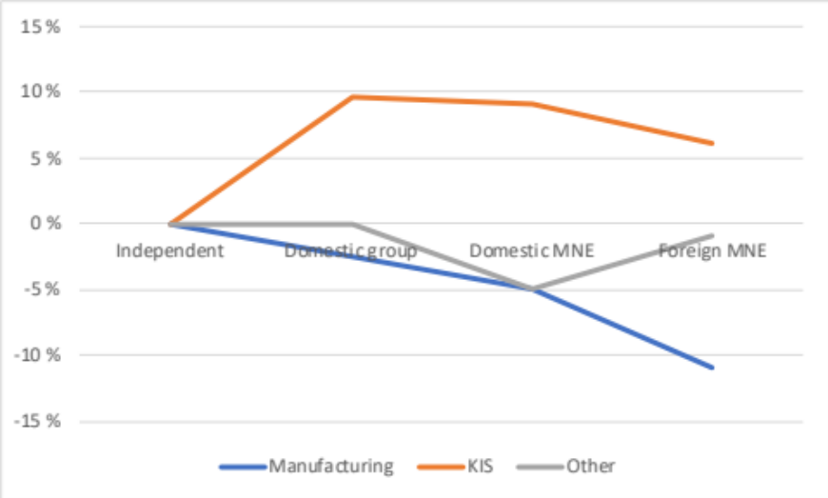
United Nations Statistical Commission
Women’s/men’s average salary compared to independent firms, ISCO 4-5
Women’s/men’s participation and pay differences by firm type, ISCO 4-5
Difference of women’s share of workforce from independent firms, ISCO 4-5

Slide 11
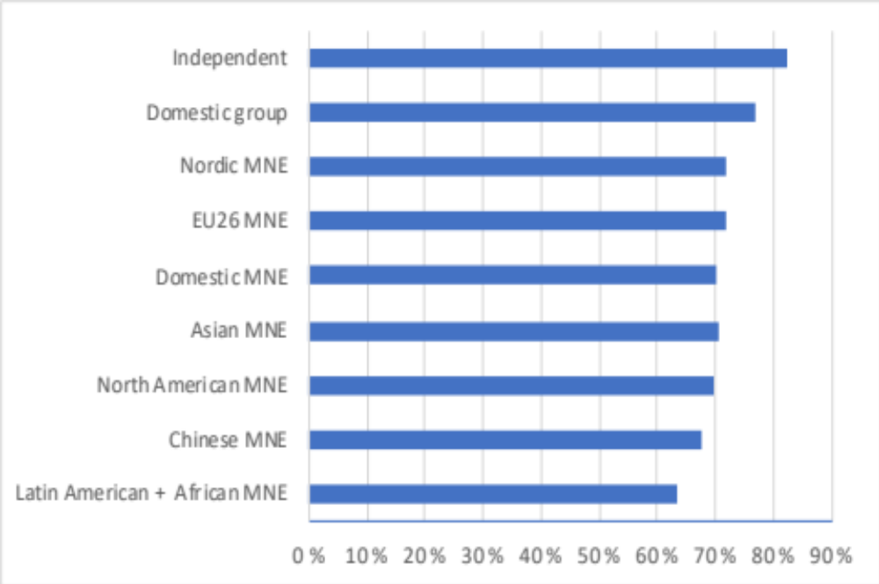
United Nations Statistical Commission
Foreign owned MNEs by country of ownership
Women’s/men’s average salary by ownership structure and country of ownership

Slide 12
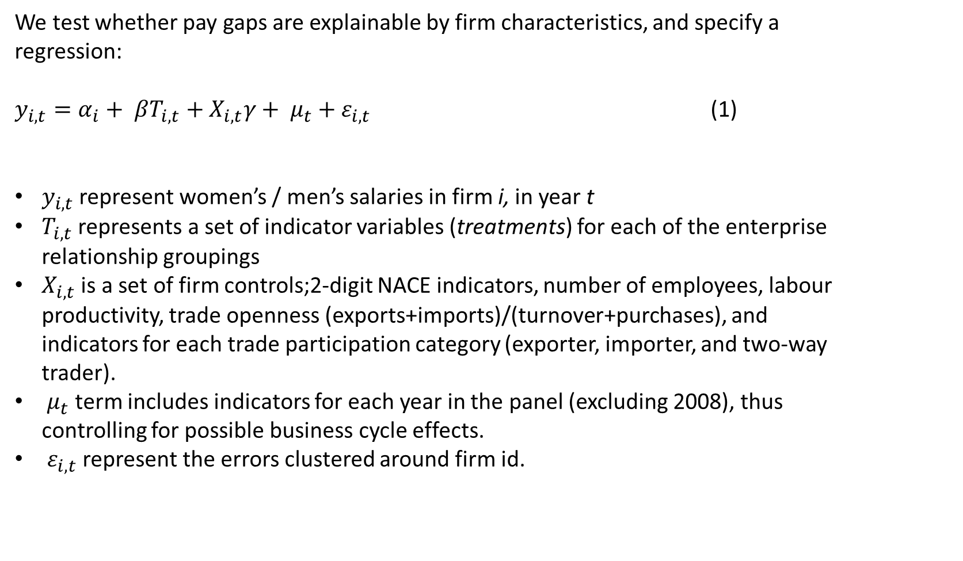
United Nations Statistical Commission
Robustness
We test whether pay gaps are explainable by firm characteristics, and specify a regression:
$y_{i,t}=α_{i}+ βT_{i,t}+X_{i,t}γ+ μ_{t}+ε_{i,t}$ (1)
$y_{i,t}$ represent women’s / men’s salaries in firm i, in year t
$T_{i,t}$ represents a set of indicator variables (treatments) for each of the enterprise relationship groupings
$X_{i,t}$ is a set of firm controls;2-digit NACE indicators, number of employees, labour productivity, trade openness (exports+imports)/(turnover+purchases), and indicators for each trade participation category (exporter, importer, and two-way trader).
$μ_{t}$ term includes indicators for each year in the panel (excluding 2008), thus controlling for possible business cycle effects.
$ε_{i,t}$ represent the errors clustered around firm id.

Slide 13
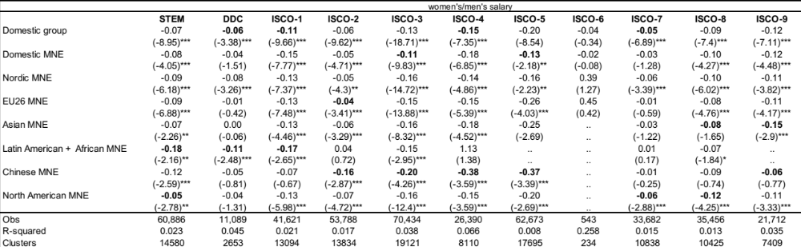
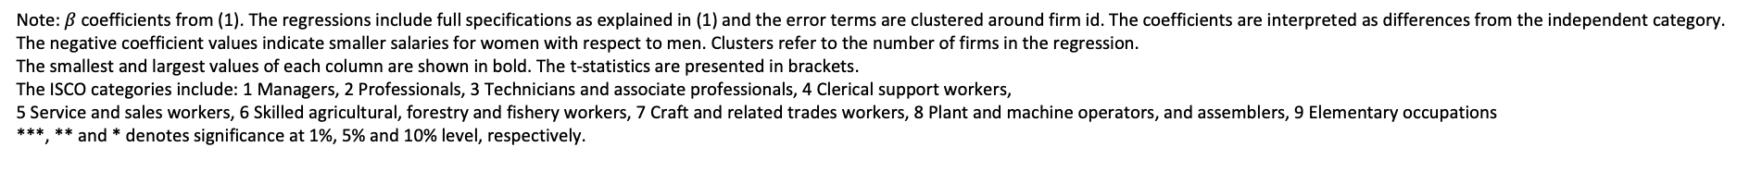
United Nations Statistical Commission
MNEs and salary differences by occupation, regression coefficients
Note: $β$ coefficients from (1). The regressions include full specifications as explained in (1) and the error terms are clustered around firm id. The coefficients are interpreted as differences from the independent category.
The negative coefficient values indicate smaller salaries for women with respect to men. Clusters refer to the number of firms in the regression.
The smallest and largest values of each column are shown in bold. The t-statistics are presented in brackets.
The ISCO categories include: 1 Managers, 2 Professionals, 3 Technicians and associate professionals, 4 Clerical support workers,
5 Service and sales workers, 6 Skilled agricultural, forestry and fishery workers, 7 Craft and related trades workers, 8 Plant and machine operators, and assemblers, 9 Elementary occupations
***, ** and * denotes significance at 1%, 5% and 10% level, respectively.

Slide 14
United Nations Statistical Commission
MNEs pay well, but
Gender pay gaps are larger in:
  MNEs than independent firms
  High-paying occupations (ISCO 1-3)
  Knowledge intensive sector (KIS) and other sectors
Pay gaps persist in support functions (ISCO 4-5) too, where women form a majority
Pay gaps are largest in Latin American & African MNEs and Chinese MNEs active in Finland
Women’s participation rates low across in high-pay professions
– between 23 to 35% – versus 38% in the business sector.
  The largest ”effect” by firm type found in KIS.
Women form a majority in support functions (ISCO 4-5)
  Especially in groups active in KIS – 72-75% of the workforce.

Slide 15
United Nations Statistical Commission
International traders pay well, but
Gender pay gap: two-way traders vs. non-traders
Participation rates: two-way traders vs. non-traders
Within-firm gender pay gap is larger in two-way traders, but not the same across jobs
Women’s participation rates are much lower in two-way traders than in non-traders
Women’s participation rates are lower in high-paying occupations within two-way traders
Women a majority in support functions where gender pay gap is higher in two-way traders

Slide 16
United Nations Statistical Commission
Conclusions and next steps
The business sector
  Low participation rates of women in high-paying occupations – the main reason for gender gap in the business sector
MNEs
  Exacerbate gender gaps because of larger pay gaps in high-paying occupations
  Domestic MNEs hire more women in high-paying occupations than other MNEs
  Country of ownership may have an impact – warrants further research on reasons
International traders
  Exacerbate gender gaps because of women’s lower share in high-paying jobs
  Gender pay gap is smaller (or similar) than in non-traders in managerial and professional occupations, but larger in support functions
We can improve gender balance by advancing women to high-paying occupations in MNEs and foreign traders, but also by paying attention to intra-firm-occupation pay gaps

Slide 17
United Nations Statistical Commission
Conclusions and next steps
We should assess gender gaps by occupation and firm type
  It is the firm hierarchy that reacts to trade policy and guides decisions about distributing the benefits from international trade
It is possible to construct statistics to allow systematic analyses and statistical offices should strive to make the underlying data and related statistics available
Existing macro models may be improved by using these data
Further research should focus on reasons why multinational and international traders generate gendered outcomes, and on improving trade and gender macro-analyses
UNCTAD works with the EU DG Trade, UN Women and UN Regional Commissions in Europe and Africa to improve data availability, develop methodologies and enhance statistical capacity

Slide 18
United Nations Statistical Commission
Thank you!

