Slide 1

Climate Impacts on Agriculture: Searching for Keys under the Streetlight
Thomas Hertel and Cicero Z. de Lima
Center for Global Trade Analysis
Purdue University
Presented at the Conference on Global Economic Analysis, June 2020

Slide 2
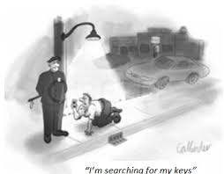
We have been searching for impacts where data & models are best
Majority of work on ag impacts of climate change focuses on yields of staple crops
This is where we have good data and models
Yet these crops make up only 25% of global ag output and land input only accounts for 16% of total costs: .16*.25 = 0.04
So 95% of work is on just 4% of value of ag output!

Slide 3
Overview of Talk
Background and literature review
Economic framework: Explaining output growth
Which inputs are affected by climate change?
Impacts on the rate of productivity growth
Which farm products are affected?
Computational illustrations using the GTAP model
Conclusions

Slide 4
Background and Literature Review
IPCC AR5:
  1782 climate impact on yield estimates
  1165 accounted for by just four crops (maize, rice, soy wheat)
  Insufficient coverage of any of remaining 171 FAO crops to support meta-analysis
Most publications focus on these four major crops:
  In addition, most studies still done in temperate zones: Of 221 studies reviewed by White et al., (2011) only few incorporated key biophysical responses to heat in the tropics
  While critical for caloric intake, these crops play a lesser role in delivering critical micro-nutrients which are at the heart of current nutrition challenges
Almost no attention to other critical aspects of climate change and ag:
  Heat stress on humans and livestock
  Impact on the pace of innovation and hence future productivity growth rates

Slide 5
Decomposition of Growth in the Agricultural Sector
Assuming large # farms, entry/exit and cost minimization, we have CRTS at the industry level yielding:
Determinants of output growth potentially affected by climate
Growth in agr output
Growth in input i augmenting tech change
% change cumulative output
Cost share of
Input i
% change in input i
Total factor productivity growth
(a function of knowledge capital)

Slide 6
Cost shares tell us which inputs are most important
Figure 1. Shares of inputs in total costs for
agriculture, for select regions.
Source: GTAP v.10 data base, Aguiar et al., 2019.
Notes:
This map shows the percentage change in cropland area in each 5 min grid cell (5 min means < 20,000 acres)
1- Total growth in US cropland is projected to be <2% in this scenario which is much lower than production growth.
=> this is mainly due to productivity growth and higher intensification
2- the cropland expansion pattern is not uniform.
3- The map indicates faster growth in marginal land and small growth in current cropland
~transition:
This was about cropland, let’s look at water.

Slide 7
Climate impacts on labor productivity will be key in SSA
Figure 1. Shares of inputs in total costs for
agriculture, for select regions.
Source: GTAP v.10 data base, Aguiar et al., 2019.
Notes:
This map shows the percentage change in cropland area in each 5 min grid cell (5 min means < 20,000 acres)
1- Total growth in US cropland is projected to be <2% in this scenario which is much lower than production growth.
=> this is mainly due to productivity growth and higher intensification
2- the cropland expansion pattern is not uniform.
3- The map indicates faster growth in marginal land and small growth in current cropland
~transition:
This was about cropland, let’s look at water.

Slide 8
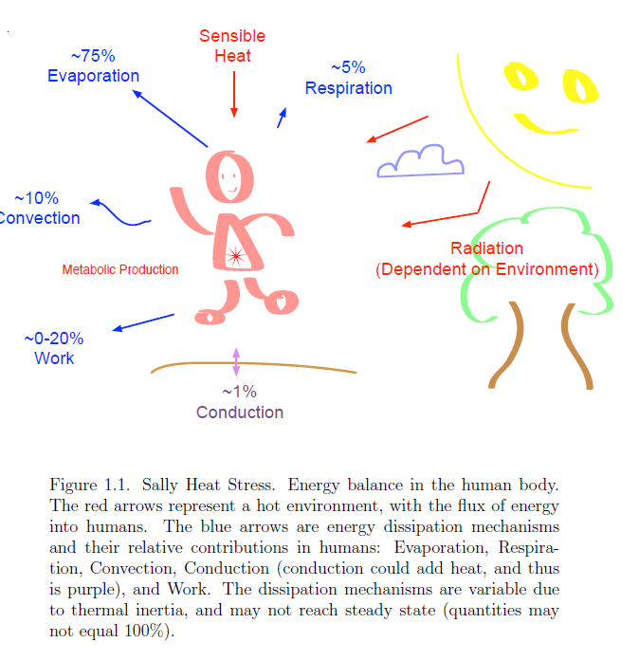


Heat stress arises when humans cannot dissipate internally generated energy; this arises when:
High temperatures
Humid conditions
High solar radiation
Manual labor
This looks a lot like farming in the tropics!
Source: Buzan and Huber, Annual Review of Earth and Planetary Sciences, forthcoming 2020
Notes:
We should show the 3 degrees warming scenario shouldn’t we? That is what is used below.

Slide 9
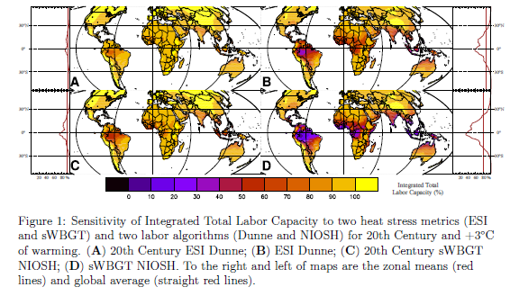
Estimated impacts of climate change on labor capacity in agriculture (two metrics of heat stress and labor impacts)
20th century climate
+3C warming
ESI/Dunne
sWBGT/
NIOSH
Notes:
This map shows the percentage change in cropland area in each 5 min grid cell (5 min means < 20,000 acres)
1- Total growth in US cropland is projected to be <2% in this scenario which is much lower than production growth.
=> this is mainly due to productivity growth and higher intensification
2- the cropland expansion pattern is not uniform.
3- The map indicates faster growth in marginal land and small growth in current cropland
~transition:
This was about cropland, let’s look at water.

Slide 10
What about pesticides and herbicides?
Figure 1. Shares of inputs in total costs for
agriculture, for select regions.
Source: GTAP v.10 data base, Aguiar et al., 2019.
Notes:
This map shows the percentage change in cropland area in each 5 min grid cell (5 min means < 20,000 acres)
1- Total growth in US cropland is projected to be <2% in this scenario which is much lower than production growth.
=> this is mainly due to productivity growth and higher intensification
2- the cropland expansion pattern is not uniform.
3- The map indicates faster growth in marginal land and small growth in current cropland
~transition:
This was about cropland, let’s look at water.

Slide 11
Climate change and intermediate inputs
Climate change can encourage more pests and disease
  Higher temperatures reduce latency period for plant pathogens, speeding up evolution
  Insects thrive in a warming environment
  Diminished frost frequencies expand the range of pests and diseases (e.g., potato blight in Finland; kudzu weed in the US)
Climate change can alter farmer behavior:
  Producers in Kenya increase application of pesticides at the expense of fertilizer and weeding (Jagnani et al.)
  More pesticide use can increase the health burden on labor (Sheahan et al.)

Slide 12
What if climate change affects the productivity of all inputs?
Traditional agronomic approach focuses on output/ha.; yield losses are treated as a perturbation to the productivity of land only:
However, if unchanging application (all) inputs gives under new climate gives rise to lower output, then this is a reduction in total factor productivity
Very different implications for food output and prices

Slide 13
PE Analysis of Climate Impact on Land vs. Total Factor Productivity
PE impact of yield changes altering the productivity of land, as in AgMIP (Robinson et al., 2014)
Aggregate market elasticity: both demand and supply response to price
% change cumulative output
Farm-level price
elasticity of demand
Land ‘disaugmenting’ technical change
Land supply elasticity wrt rents

Slide 14
PE Analysis of Climate Impact on Land vs. Total Factor Productivity
PE impact of TFP changes due to climate impacts (as in Hertel, Burke and Lobell, 2010)
% change cumulative output
Farm level commodity
demand elasticity
Aggregate market elasticity: both demand and supply response to price
Aggregate commodity
supply elasticity wrt price
Chng in Total Factor Productivity
Compare to:
where:

Slide 15
Overview of Talk
Background and literature review
Economic framework: Explaining output growth
Which inputs are affected by climate change?
Impacts on the rate of productivity growth
Which farm products are affected?
Climate impacts on nutritional content of crops
Computational illustrations using the GTAP model
Conclusions

Slide 16
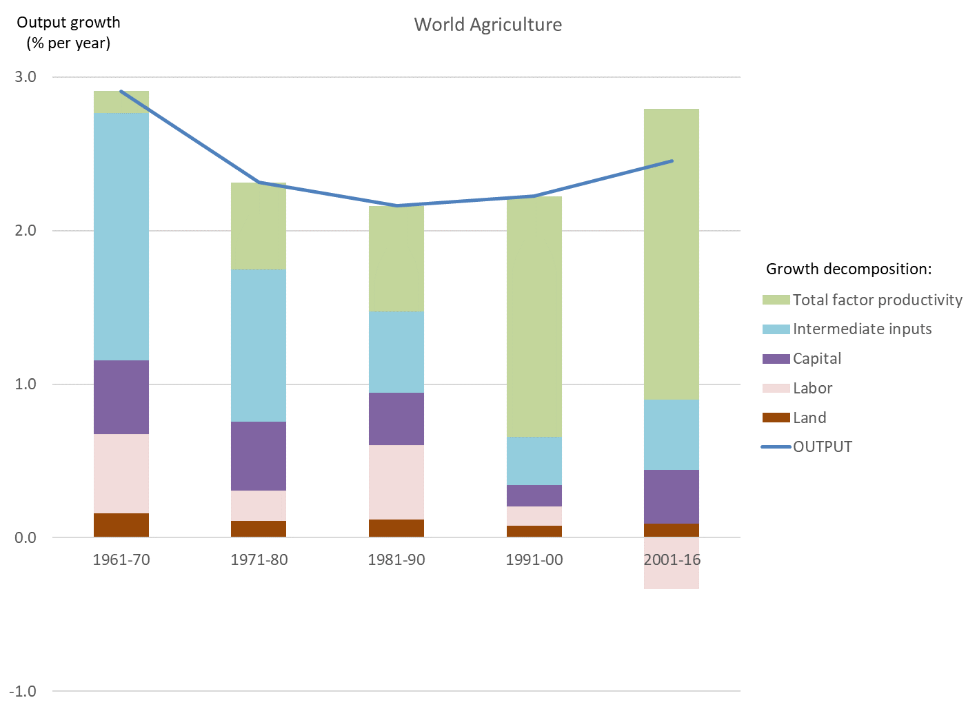
Today agricultural output growth is TFP-driven
Figure 2. Sources of global agricultural output
growth, by decade, 1961-2016.
Source: USDA-ERS (2019).
Notes:
This map shows the percentage change in cropland area in each 5 min grid cell (5 min means < 20,000 acres)
1- Total growth in US cropland is projected to be <2% in this scenario which is much lower than production growth.
=> this is mainly due to productivity growth and higher intensification
2- the cropland expansion pattern is not uniform.
3- The map indicates faster growth in marginal land and small growth in current cropland
~transition:
This was about cropland, let’s look at water.

Slide 17

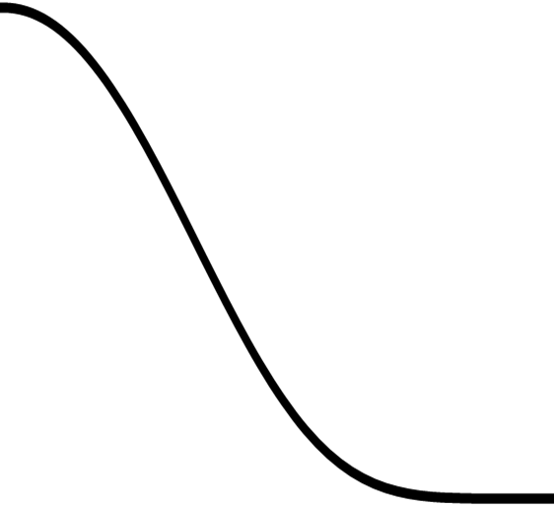
And TFP growth is driven by knowledge capital which has a 50 year life cycle in the United States
Maturity
TFP growth (in %)
Development & Adoption
Obsolescence
Funding & Investment
(Public R&D)
Time

Slide 18
U.S. Farm Productivity and Public R&D spending: Gains from R&D
40% of output in 2001-10
is likely due to
Public R&D after 1980
Public R&D
After 1980
Public R&D Before 1980
Drivers excluding Public R&D
USDA-ERS (2017) Agricultural Productivity in the U.S.
https://www.ers.usda.gov/data-products/agricultural-productivity-in-the-us/

Slide 19
How will the knowledge life cycle and TFP growth be altered by climate change?
More rapid obsolescence
of knowledge capital
Maturity
TFP growth (in %)
Development & Adoption
Obsolescence
Funding & Investment
(Public R&D)
Time
More challenges for scientists seeking to boost TFP

Slide 20
Overview of Talk
Background and literature review
Economic framework: Explaining output growth
Which inputs are affected by climate change?
Impacts on the rate of productivity growth
Which farm products are affected?
Computational illustrations using the GTAP model
Conclusions

Slide 21
Which farm products are affected by climate change?
Staple crops are about one-quarter
of total farm output
Revenue shares weight growth
in individual farm outputs
Figure 3. Share of food product categories in
global agricultural sales.
Source, GTAP 10 data base, Aguiar et al., 2019.
Notes:
This map shows the percentage change in cropland area in each 5 min grid cell (5 min means < 20,000 acres)
1- Total growth in US cropland is projected to be <2% in this scenario which is much lower than production growth.
=> this is mainly due to productivity growth and higher intensification
2- the cropland expansion pattern is not uniform.
3- The map indicates faster growth in marginal land and small growth in current cropland
~transition:
This was about cropland, let’s look at water.

Slide 22
Overview of Talk
Background and literature review
Economic framework: Explaining output growth
Which inputs are affected by climate change?
Impacts on the rate of productivity growth
Which farm products are affected?
Computational illustrations using the GTAP model
Conclusions

Slide 23
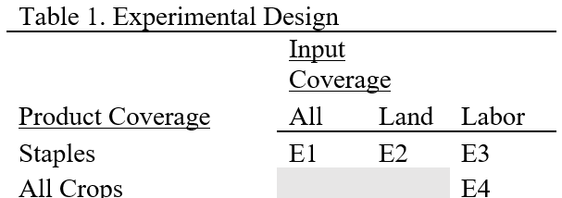
Experimental Design
Contrast partial vs. total factor productivity treatments (E1-E2)
Contrast yield impacts with labor productivity (E3 vs. E1, E2)
Explore implications of extending labor productivity impacts beyond the core staple crops (E4 – E3)

Slide 24
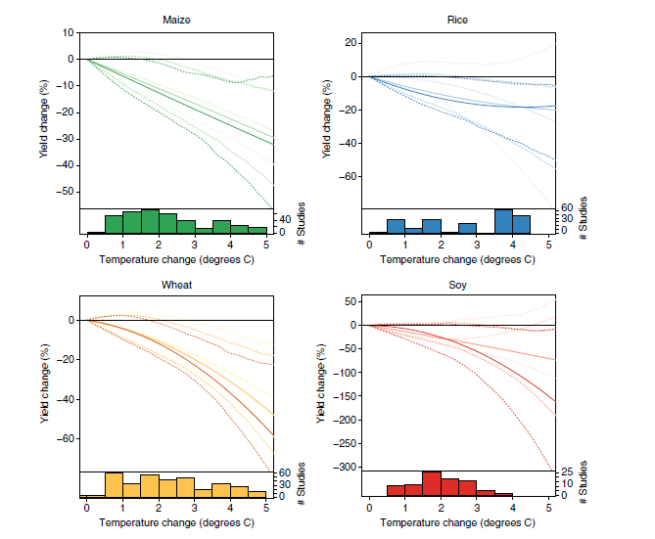
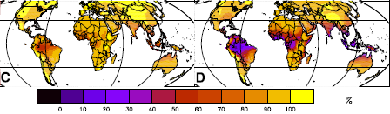
Yield impacts of climate change for staple crops: Meta-analysis of 1,000+ data points reported to the IPCC
Source: Moore et al., ERL, 2017.
Labor capacity reduction:
Risk posed to humans is based on the simplified Wet Bulb Globe Temperature measure computed on a six-hourly basis
Labor capacity is based on NIOSH metric
Source: Lima et al.,
in review

Slide 25
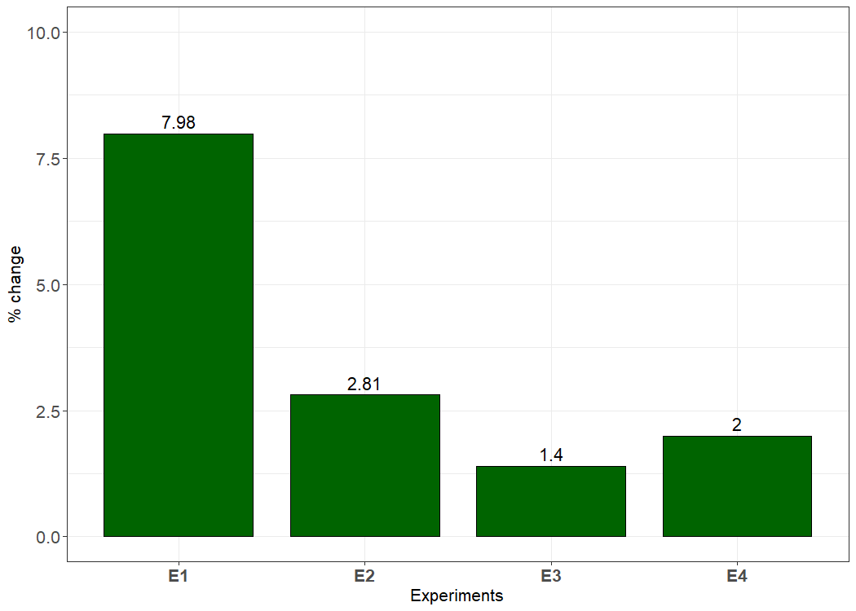
Food price impacts differ dramatically if climate impact is through TFP
Notes:
This map shows the percentage change in cropland area in each 5 min grid cell (5 min means < 20,000 acres)
1- Total growth in US cropland is projected to be <2% in this scenario which is much lower than production growth.
=> this is mainly due to productivity growth and higher intensification
2- the cropland expansion pattern is not uniform.
3- The map indicates faster growth in marginal land and small growth in current cropland
~transition:
This was about cropland, let’s look at water.

Slide 26

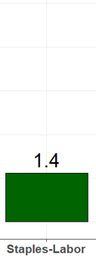
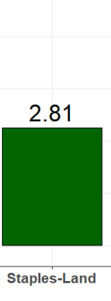
Agronomic yield shocks have greater impact on food prices than labor capacity reductions at +3C
Impact of climate change experiments on the composite price of staple grains and oilseeds
Greater capability to bring labor in from other sectors (labor is more elastically supplied than land in the long run). This moderates the food price impacts of heat stress on labor

Slide 27
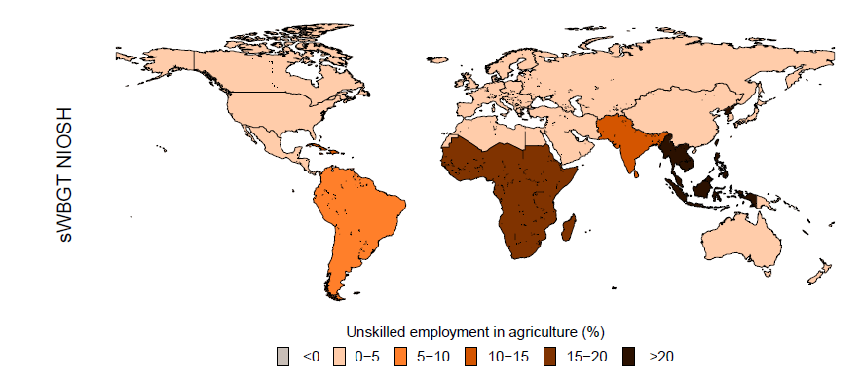
Increase in unskilled workers required in agricultural sector
The reduction in labor capacity of exposed workers in agriculture, coupled leads to reduced output and higher prices
More workers are demanded in crop production; increase is >30%, relative to baseline, in Southeast Asia
At current employment levels, this would amount to +69 million workers, worldwide
Change of unskilled employment in agriculture at +3C under heat stress on labor.
The values are percentage change in the number of agricultural workers (unskilled) relative to baseline for all GTAP crops.
Source: Lima et al., “Heat Stress on Agricultural Workers Exacerbates Crop Impacts of Climate Change”, in review

Slide 28

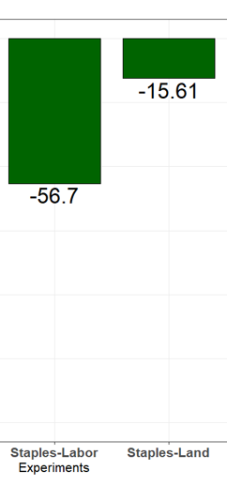
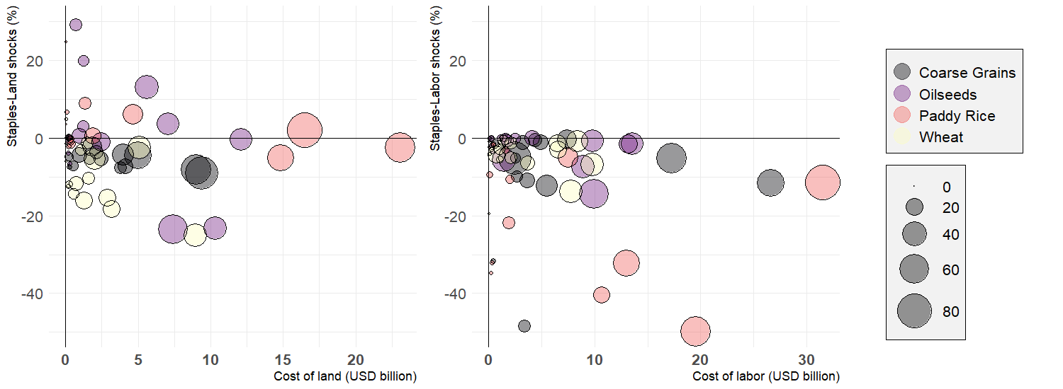
However, labor shocks from heat stress have a greater impact on global welfare due to coincidence of high heat stress and labor intensive farming
Rice plants do better than rice workers under high heat and humidity!
Heat stress tends to be correlated with regions where agriculture is extremely labor intensive.

Slide 29
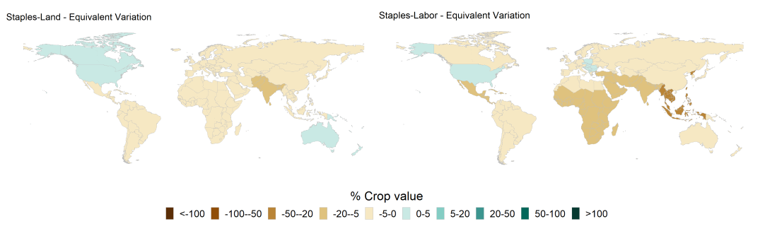
So labor losses are more concentrated in Africa and Asia
Impact of climate change experiments on regional welfare, % of staple crops output

Slide 30
Summary
Climate assessments have tended to focus on the low-hanging fruit; it is important, but we are missing the larger picture
Most researchers have ignored the impacts on humans working outdoors. Those impacts could be even more important and tend to be concentrated in low income countries in the tropics
None of the work to date has thought deeply about the consequences of climate change for the productivity of knowledge capital and the impacts of agricultural research on future TFP growth

Slide 31
