Slide 1

Will Greenhouse Gases Mitigation Policies Abroad affect the Domestic Economy? The Case of Taiwan
Presented by Y.-H. Henry Chen
23nd GTAP Conference
June 17–19, 2020
The study is published by Climate Change Economics and is coauthored by
Hui-Chih Chai, Wei-Hong Hong, John Reilly, Sergey Paltsev, and Y.-H. Henry Chen
http://globalchange.mit.edu/

Slide 2

Overview
Background
Questions
Approach
Findings
Conclusions
Notes:
Source: https://medium.com/@KKdayIntl/10-best-hotels-with-views-of-taipei-101-83bf0b09fa55
The study is now published by Climate Change Economics.

Slide 3
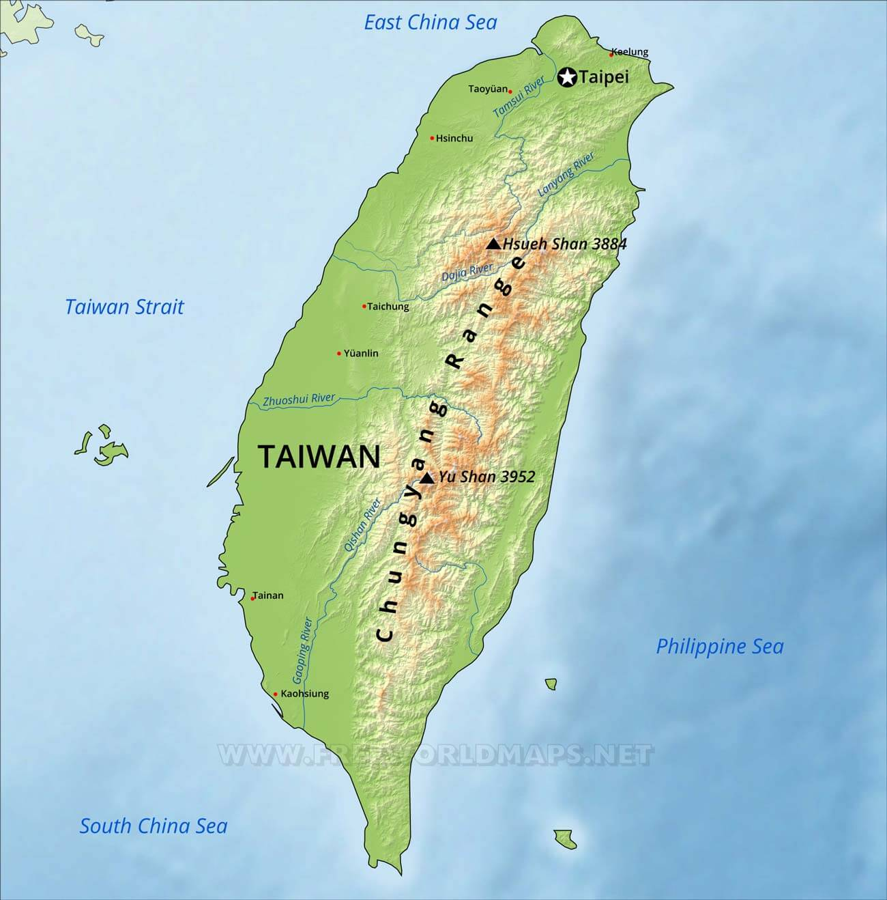
Background
Area: 36000 km² (14000 mi²)
394 km (245 mi) long
144 km (89.5 mi) wide
Capital city: Taipei
Population: 23.78 M (2018)
GDP per capita: $26160 (2019e)
US # 11 trade partners (2017)
Imports 98% of total energy supply
96% of imported energy: fossil fuels
4% of imported energy: nuclear
Exports: 62% of Taiwan’s GDP (2015)
Imports: 50% of Taiwan’s GDP (2015)
GHGs emissions: 288.0 MtCO₂e (2016)
Total CO₂ emissions: 274.3 MtCO₂ (2016)
Fossil CO₂ emissions: 257.8 MtCO₂ (2016)
Notes:
Sources:
1.https://www.freeworldmaps.net/asia/taiwan/map.html
2. https://en.wikipedia.org/wiki/Taiwan
3. U.S. #11 trader partners ranked by total exchange of goods (excluding services): https://fortune.com/2018/03/07/biggest-us-trade-partners/
4. Taiwan imports around 98% of its total energy supply (the sum of indigenous production and imports), and 95.5% of which are fossil fuels, with the remaining 4.5% being the nuclear energy (Bureau of Energy (BOE), 2018). This is equal to the sum of total primary energy supply, exports, international marine bunkers, international civil aviation, and stock changes. See Bureau of Energy (2018). (Chai et al., 2019)
5. Shaped roughly like a tobacco leaf, Taiwan is 394 kilometers (245 miles) long and 144 kilometers (89.5 miles) wide at its broadest point. The Central Mountain Range bisects Taiwan from north to south and about two-thirds of the island is covered with forested peaks. https://www.globalsecurity.org/military/ops/taiwan-geo.htm
6. exports and imports account for 62% and 50% of Taiwan’s GDP in 2015, respectively (National Development Council, 2016). (Chai et al., 2019)
7. Background info from Taiwan’s EPA: https://enews.epa.gov.tw/enews/fact_Newsdetail.asp?InputTime=1080923182946
8. Emissions:
GHGs emissions (288.0 MtCO2e; 2016): https://ghgrule.epa.gov.tw/qa/qa/3
CO2 emissions (95.26% of total GHGs: 2016): https://ghgrule.epa.gov.tw/qa/qa/3?fbclid=IwAR0XCV2GXBf8nx4chz2wXqEwvFCIq9KyEjs0y2E38GxCjmBYJBUawzhcJ3M
Fossil/combusted CO2 emissions (257.8 MtCO2; 2016): https://www.oecd-ilibrary.org/energy/co2-emissions-from-fuel-combustion_20783426

Slide 4
Background
(Total = 257.8 MtCO₂)
Source: IEA (2019)
Notes:
Sources:
1. Background info from Taiwan’s EPA:
https://enews.epa.gov.tw/enews/fact_Newsdetail.asp?InputTime=1080923182946
https://ghgrule.epa.gov.tw/qa/qa/3
2. IEA: CO2 emissions from fuel combustion 2019 ed. https://www.oecd-ilibrary.org/energy/co2-emissions-from-fuel-combustion_20783426

Slide 5
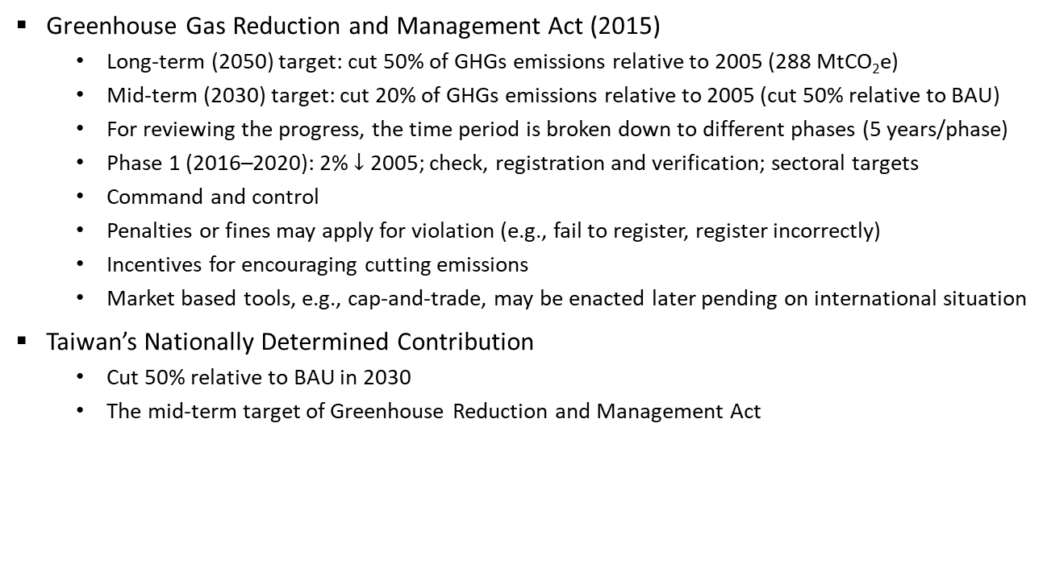
Background
Greenhouse Gas Reduction and Management Act (2015)
  Long-term (2050) target: cut 50% of GHGs emissions relative to 2005 (288 MtCO₂e)
  Mid-term (2030) target: cut 20% of GHGs emissions relative to 2005 (cut 50% relative to BAU)
  For reviewing the progress, the time period is broken down to different phases (5 years/phase)
  Phase 1 (2016–2020): 2% $↓$ 2005; check, registration and verification; sectoral targets
  Command and control
  Penalties or fines may apply for violation (e.g., fail to register, register incorrectly)
  Incentives for encouraging cutting emissions
  Market based tools, e.g., cap-and-trade, may be enacted later pending on international situation
Taiwan’s Nationally Determined Contribution
  Cut 50% relative to BAU in 2030
  The mid-term target of Greenhouse Reduction and Management Act
Notes:
Taiwan’s GHGs emissions in 2005: 288 MtCO2e: http://unfccc.saveoursky.org.tw/2017nir/uploads/02_content.pdf
Greenhouse Gas Reduction and Management Act (溫室氣體減量及管理法):
1) https://law.moj.gov.tw/ENG/LawClass/LawAll.aspx?pcode=O0020098
2) 「溫室氣體減量及管理法」第4條明定國家溫室氣體長期減量目標為139年（西元2050年）溫室氣體排放量降為94年（西元2005年）溫室氣體排放量50%以下。
而除了長期目標之外，我國減量之中程願景為119年溫室氣體排放量為BAU (business as usual)減量50% （214百萬公噸二氧化碳當量），此一減量目標相當於溫室氣體排放量降為94年溫室氣體排放量20%以下。
臺灣將以全國為範疇，涵蓋氣體包含：二氧化碳(CO2)、甲烷(CH4)、氧化亞氮(N2O)、氫氟碳化物(HFCs)、全氟碳化物(PFCs)、六氟化硫(SF6)、三氟化氮(NF3)，透過國內相關部門別減量的努力，達成國家溫室氣體減量之中、長程目標願景。
為達我國之中、長期減量目標，環保署106年3月28日發布之「溫室氣體階段管制目標及管制方式作業準則」中，明定階段管制目標規劃考量、訂定方式、達成情形檢視及調整機制等相關程序性規範，其中，第二條明定溫室氣體階段管制目標會以五年為一階段，第一階段係指自中華民國105年起至109年止，後續各階段以此類推，除第一階段外，應於下一階段排放期開始前二年提出。關於溫室氣體階段管制目標之詳細內容請見常見問答-「什麼是溫室氣體階段管制目標」。
https://ghgrule.epa.gov.tw/qa/qa/3?fbclid=IwAR0XCV2GXBf8nx4chz2wXqEwvFCIq9KyEjs0y2E38GxCjmBYJBUawzhcJ3M
3. Different phases for reviewing the progress: https://ghgrule.epa.gov.tw/qa/qa/3
4. Current progress and measures that have been taken: https://ghgrule.epa.gov.tw/greenhouse/greenhouse_page/23/100
Energy, manuf., trans., residential, agricultural, and environment sectors

Slide 6
Questions
Impacts on Taiwan’s economy when
  Taiwan’s NDC is enforced under a global policy vs. Taiwan’s NDC is enforced unilaterally
  mitigation efforts beyond current NDCs are pursued globally
  U.S. NDC is partially achieved vs. current NDCs are carried out worldwide
Notes:
How different are the policy impacts on Taiwan if its NDC targets are enforced in the context of a global effort, versus if they are undertaken unilaterally?
We also consider the scenario where the U.S. only partially achieves its NDC through the state-level efforts, while other countries including Taiwan fulfill their NDC goals as planned.
Can Taiwan still gain from the emissions cut abroad when mitigation efforts beyond the current NDCs are pursued worldwide?

Slide 7
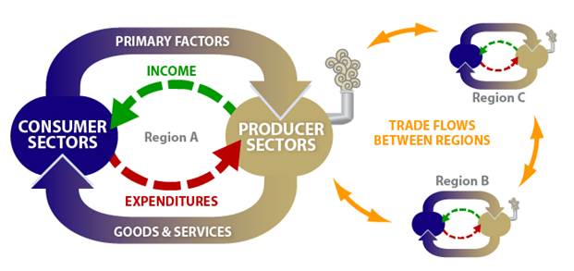
Approach
Global Computable General Equilibrium (CGE) model with regional and sectoral details
Consumers and producers interact through markets
Different regions are connected through trade linkages

Slide 8
Approach
Database: GTAP 9 with a base year of 2011
Calibrate the model so that it produces a BAU environment for the global economy in 2030
Represent each region’s NDC by cutting fossil (combusted) CO₂ emissions
The policy tool to achieve the NDC is CO₂ pricing—the most efficient tool
If emissions are cut through other approaches, the overall mitigation cost could be higher
Notes:
To explore the implications on Taiwan’s economy when it pursues its NDC to cut emissions, we calibrate the model so that it produces a business-as-usual (BAU) environment for the global economy in 2030—a strategy also known as “forward calibration.” To do this, for each region, we calculate the total factor productivity level such that the projected BAU GDP in 2030 is consistent to the assumed BAU GDP growth rate and the given levels of labor, capital and autonomous energy efficiency improvement (AEEI). The growth rates of BAU GDP, labor, capital, and AEEI are drawn from Jacoby et al. (2017).
For each region, when a mitigation policy is in place, an economy-wide carbon tax is used as an instrument for cutting emissions. Since this assumes that the most efficient policy to achieve the NDC is in place, if alternatively, a country decides to cut emissions through other approaches, such as adjusting the energy consumption portfolio of the power sector (e.g., more gas and less coal) via administrative or legislative measures, the overall mitigation cost (e.g., reduction in GDP) could be higher.

Slide 9
Findings

Slide 10
Findings

Slide 11
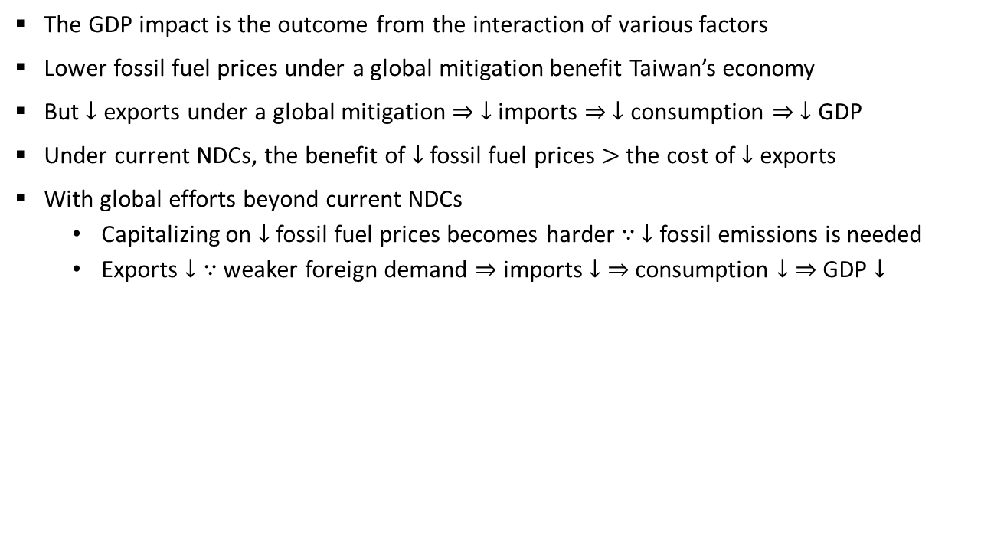
Findings
The GDP impact is the outcome from the interaction of various factors
Lower fossil fuel prices under a global mitigation benefit Taiwan’s economy
But $↓$ exports under a global mitigation $⇒$ $↓$ imports $⇒$ $↓$ consumption $⇒$ $↓$ GDP
Under current NDCs, the benefit of $↓$ fossil fuel prices $>$ the cost of $↓$ exports
With global efforts beyond current NDCs
  Capitalizing on $↓$ fossil fuel prices becomes harder $∵$ $↓$ fossil emissions is needed
  Exports $↓$ $∵$ weaker foreign demand $⇒$ imports $↓$ $⇒$ consumption $↓$ $⇒$ GDP $↓$
Notes:
We emphasize that the GDP impact is the outcome for the interaction of various factors. For instance, the decreased value of total exports (Figure 3) resulted from the suppressed foreign demand when worldwide mitigation efforts exist will have negative impacts on Taiwan’s economy, since it implies that for Taiwan, the value of total imports also has to decline, as our model closure suggests (see Section 2), and less imports eventually means the value of total consumption is diminished, a negative impact on GDP. On the other hand, the lower fossil fuel prices under the scenario with a global mitigation could benefit the economy (Figure 4), since it depends heavily on fossil fuel imports. Results in Figure 6 reveal that under the current NDCs of the Paris Agreement, for Taiwan, the benefit of lower fossil fuel prices outweighs the negative effects of diminished exports.
We gratefully acknowledge the comment from one reviewer in improving the GDP impact analysis.
We find that with further mitigation abroad, on the contrary, the negative GDP impact on Taiwan’s economy becomes higher than that under the unilateral policy (Figure 7). This is because although prices for fossil fuels decline further as mitigation levels increase (Figure 8), cutting fossil fuel consumption of Taiwan to meet more stringent emissions cut means that it becomes harder for Taiwan to capitalize on the lower prices of fossil fuels. At the same time, the total exports of Taiwan decrease when all countries carry out their NDCs and when the worldwide mitigation efforts increase, both of which lower the GDP level of Taiwan (Figure 9).
With further emissions cut globally beyond the current NDCs, foreign mitigation efforts could hurt Taiwan, as capitalizing on lower fossil fuel prices becomes harder for Taiwan when cutting Taiwan’s fossil fuel usage turns out indispensable, and as exports of Taiwan drop due to weaker foreign demand.

Slide 12
Conclusions
Taiwan can benefit from the Paris Agreement if current NDCs are carried out as planned
The U.S. withdrawal from the Agreement has negligible impacts on Taiwan’s economy
If more countries backtrack on their NDCs, it becomes costlier for Taiwan to cut emissions
With further mitigation beyond current NDCs, emissions cuts elsewhere can hurt Taiwan
Even with a country-specific focus, using a global model provides crucial insights
For a country that heavily depends on trade, the impacts of foreign policies matter
Notes:
If, however, more countries also follow the federal government of the U.S. and backtrack on their commitments in cutting emissions, it might become somewhat costlier for Taiwan to carry out its current NDC target, as prices for fossil fuels, which will remain crucial in Taiwan’s energy supply portfolio even with the fulfilment of Taiwan’s NDC, are likely to rise because of higher fossil fuel demand levels abroad due to weakened GHG mitigation efforts.
With further emissions cut beyond the current NDCs globally, foreign mitigation efforts could hurt Taiwan, as capitalizing on lower prices for fossil fuels becomes harder for Taiwan when cutting Taiwan’s consumption of fossil fuels is indispensable in meeting more stringent policies, and as exports of Taiwan drop due to weaker foreign demand. The finding suggests that for a small country that depends heavily on trade, it should consider the policies of other countries as well as its own, as policies abroad can affect the domestic economy.

Slide 13
Thanks for your attention!
Questions?
Contact: chenyh@mit.edu
Notes:
Source: https://medium.com/@KKdayIntl/10-best-hotels-with-views-of-taipei-101-83bf0b09fa55

