Slide 1
Modeling the Impacts of Agricultural Support Policies
on Emissions from Agriculture
2020 GTAP Conference
David Laborde, Abdullah Mamun, Will Martin, Valeria Piñeiro & Rob Vos
International Food Policy Research Institute
16 May 2020

Slide 2
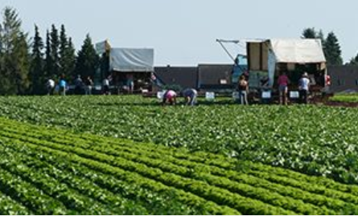

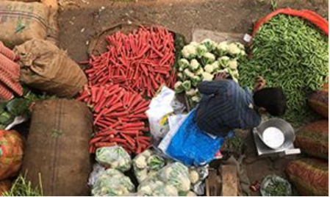
Research question
How might the vast amount of agricultural support be repurposed to better serve environmental, economic and resilience goals?

Slide 3
Agriculture matters for GHG emissions
Sources of global emissions (2010) in percentage
Source FAO

Slide 4

Changing interventions in OECD countries
non-OECD countries covered by OECD
Source: OECD
Notes:
Nominal rate of assistance
Agricultural protection falling in rich countries, rising in developing
Nominal rate of assistance

Slide 5
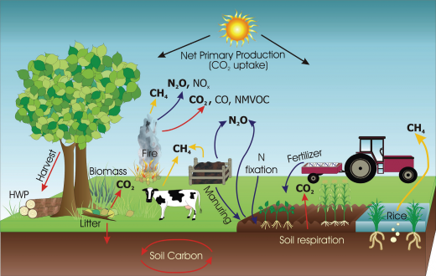
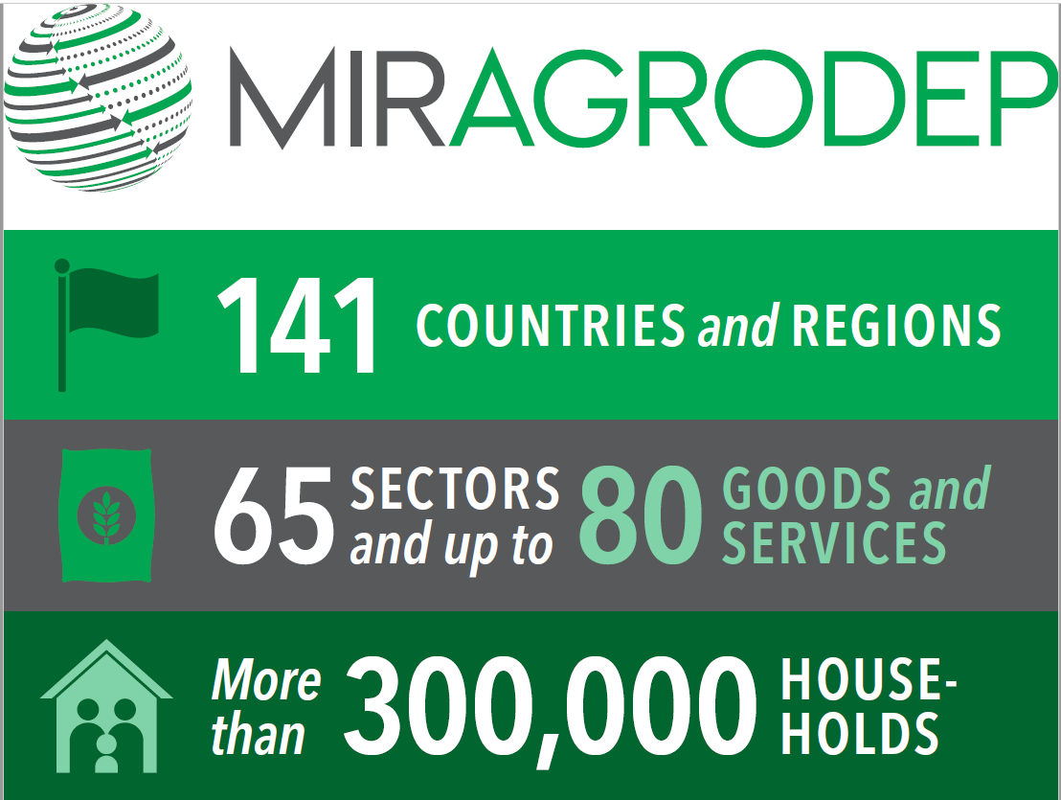

Extended set of instruments
Data
Model
GHG database
Based on FAOSTAT (Tubiello and al.)
Extended for energy and fertilizers
+ GTAP 10 database
+ Extensions / adaptation
2019 release
+ Extensions for domestic support policies
With reclassification of payments
Notes:
141 country/regions.
Sectors 65

Slide 6
A proper dataset

Slide 7
GHG Database: Reconstruct with bottom-up approach
Source of emission
(12 sources identified)
decompose into
Scale of production (Source: FAO)
Area
Quantity
Head
Technical coefficients
Emission per unit
N extraction per head
N content in residue
Leaching and volatilization rate
Share let on soil etc.
Apply technical coefficients- Tier I* (Source: IPCC Guidelines)
Direct emission
Indirect emission
Aggregate CO2eq
by country, source, sector and year
Allocate emission by commodities across sources**
Apply conversion coefficients
(N to N2O, to CO2eq; CH4 to CO2eq)
* Tier I: Default emission factors from IPCC guidelines
** Using disaggregation space and linkage matrix

Slide 8
Emissions by commodity & source 2015
% of total Ag. Production emissions
 | Rice | Other Cereals | Milk | Beef | Pigmeat | Poultry | Total
Crop residues | 1.5 | 3.6 | 0 | 0 | 0 | 0 | 5.1
Enteric fermentation | 0 | 0 | 11 | 30.5 | 0.6 | 0 | 42.1
Manure | 0 | 0 | 6.2 | 16.8 | 3.7 | 2.9 | 29.6
Pesticides | 0.2 | 0.8 | 0 | 0.1 | 0 | 0 | 1.1
Rice cultivation | 12.6 | 0 | 0 | 0 | 0 | 0 | 12.6
Synthetic Fertilizers | 2.4 | 6.5 | 0 | 0.7 | 0 | 0 | 9.6
Total | 16.7 | 10.9 | 17.2 | 48.1 | 4.3 | 2.9 | 100

Slide 9
Producer Assistance, $bn, 2014-16
Domestic support policies dataset
Annual coupled subsidies and GSSE, 2014-16 (US$ billion)
 | Narrow | Broader |  | All
 | Environmental | Environmental | Fertilizer | Coupled | Decoupled | GSSE
 | Conditionality | Conditionality | Subsidies | Subsidies | Subsidies
Australia | 0.2 | 0.1 | 0.0 | 0.5 | 0.4 | 1.0
Brazil | 0.0 | 2.9 | 0.0 | 4.5 | 0.0 | 2.7
Canada | 0.0 | 0.0 | 0.0 | 1.7 | 0.0 | 1.8
Switzerland | 0.8 | 2.6 | 0.0 | 1.4 | 1.1 | 0.8
Chile | 0.0 | 0.1 | 0.0 | 0.4 | 0.0 | 0.4
China | 0.0 | 7.2 | 0.0 | 53.7 | 5.9 | 39.9
Colombia | 0.0 | 0.0 | 0.0 | 0.9 | 0.0 | 0.6
Costa Rica | 0.0 | 0.0 | 0.0 | 0.0 | 0.0 | 0.0
EU28 | 8.8 | 65.0 | 0.0 | 36.2 | 44.4 | 12.9
Indonesia | 0.0 | 0.0 | 1.4 | 1.9 | 0.0 | 1.2
India | 0.0 | 0.0 | 11.0 | 28.0 | 0.0 | 12.2
Iceland | 0.0 | 0.0 | 0.0 | 0.1 | 0.0 | 0.0
Israel | 0.0 | 0.0 | 0.0 | 0.2 | 0.0 | 0.2
Japan | 2.4 | 5.8 | 0.0 | 4.8 | 3.0 | 8.4
Kazakhstan | 0.0 | 0.0 | 0.0 | 1.1 | 0.0 | 0.5
Korea | 0.8 | 0.9 | 0.1 | 1.0 | 0.8 | 2.9
Mexico | 1.1 | 1.1 | 0.0 | 3.7 | 0.0 | 0.8
Norway | 0.1 | 0.1 | 0.0 | 1.4 | 0.0 | 0.2
New Zealand | 0.0 | 0.0 | 0.0 | 0.0 | 0.0 | 0.4
Philippines | 0.0 | 0.0 | 0.0 | 0.0 | 0.0 | 0.0
Russia | 0.0 | 0.0 | 0.0 | 0.0 | 0.0 | 0.0
Turkey | 0.1 | 0.1 | 0.3 | 3.1 | 0.0 | 2.9
Ukraine | 0.0 | 0.0 | 0.0 | 1.1 | 0.0 | 0.2
USA | 5.1 | 24.9 | 0.0 | 16.8 | 11.2 | 8.7
Vietnam | 0.0 | 0.0 | 0.0 | 0.5 | 0.0 | 0.7
South Africa | 0.0 | 0.0 | 0.0 | 0.2 | 0.0 | 0.3
Total | 19.4 | 110.8 | 12.8 | 163.3 | 66.8 | 99.7
Source: OECD

Slide 10
Method on domestic support
PSE
Coupled
A. Support based on commodity outputs
Decoupled
C. Payments based on non-current A/An/R/I production required
B. Payments based on input use
D. Payments based on non-current A/An/R/I, production required
E. Payments based on non-current A/An/R/I, production not required
F. Payments based on non-commodity criteria
G. Miscellaneous payments
GSSE
Policy type
Policy coverage
Instrument
Conditionality
Notes:
Classification of policies
PSE

Slide 11
Nominal rate of protection (NRP), 2016
(as a percent of world price)
 | GLOBAL | High Income Countries | Middle Income Countries | Low Income Countries
Oilseeds and products | -1.78 | -0.26 | -2.71 | -6.66
Fruits and vegetables | -1.03 | 12.33 | -2.28 | 28.46
Sugar | 15.84 | 15.66 | 17.63 | -38.28
Bovine Meat | 11.12 | 8.70 | 13.75 | 13.95
Maize | 9.15 | -0.54 | 26.00 | -47.78
Milk | 8.21 | 15.87 | 1.09 | -55.96
Poultry meat | 13.22 | 10.88 | 14.88
Rice | 30.36 | 109.31 | 22.96 | 17.98
Wheat | 19.67 | 4.58 | 34.48 | -25.86
TOTAL | 7.00 | 9.50 | 7.20 | -41.18

Slide 12
Measuring (international) market access distortions
Two potential approaches:
  Direct measures of border protection for imports Bouet and al. 2008, RIE) and exports Laborde and al., 2013, World Economy)
  Indirect approach through price gaps: OECD (PSE manual, 2016)
First approach well suited for trade policy reforms but could omit other distortions e.g. NTBs
We select the second approach building on the Ag-Incentives Consortium data → Nominal Rate of Protection, both positive and negative
But, NRP are not bilateral!
  Issue of preferences and relevance for the “where it comes from”
“Bilateralisation” of NRPs
  Split of NRP into
  [more by david]
Notes:
To be finished

Slide 13
A Global Model

Slide 14
What is the impact of current farm policies on GHG emissions?
Decisions | Why it matters for GHG?
Which commodity to produce? “Wheat or Rice?” | Different commodities are associated with different levels of emissions of different GHGs (CO₂CH₄, N₂O)
Where to produce? “Brazil or Switzerland?” | Different biophysical conditions and different technologies lead to different level of emissions for the same commodity in different countries
How much to produce? “10 million tons or 100 million tons?” | The more we produce, the more we emit
How to produce? “How much fertilizers should we use?” | Input and output prices change the way we adopt technology and produce farm goods, using more intensive or extensive technologies
Notes:
Farm & trade policies impact production decisions by changing prices and economic incentives faced by farmers.
In particular, they change production decisions.

Slide 15
The specific role of trade policies
Decisions | Effect of trade policies
Which commodity to produce | Tariffs vary from one product to another
Where to produce | Tariffs have strong impacts in shifting production around the world
How much to produce | Tariffs increase the price of agricultural products and therefore will deter consumption
How to produce | Tariffs can change the cost of adopting technologies and inputs

Slide 16

Modelling Framework
MIRAGRODEP:
  a Computable General Equilibrium (CGE) model,
  built upon the MIRAGE model.
  It is a multi-region, multi-sector model, dynamically recursive CGE model;
  Government explicitly represented;
  Main source of data: GTAP 10 (base year 2014).
Assumptions:
  Static version of the model
  Public purchases held constant and a variable consumption tax used to hold the deficit to GDP ratio constant,
  Land use held constant to focus on emissions from agriculture
  A constant level of employment.
Key closures:
  Savings defined investments;
  Current account surplus/deficit [net foreign savings] constant in terms of global GDP:
    Real exchange rate endogenous
    Foreign capital flows stable
  Net Public savings (government surplus/deficit): constant in terms of domestic GDP
    Endogenous tax reform
    No change in public investment

Slide 17
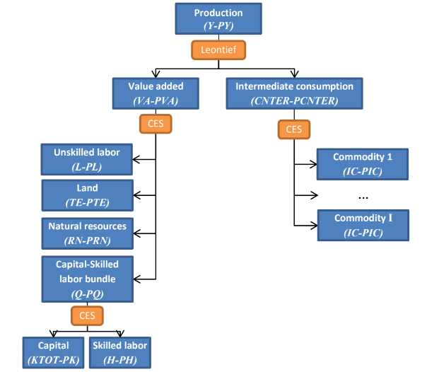
How do we produce things?
Production emissions from:
- Fertilizers
Chemical pesticides
Fossil fuel
Role of dedicated subsidies
Production emissions from
Soils use ( crop specific as Rice-Methane)
Production emissions from
Animal heads enteric fermentation

Slide 18


Where does it come from?
The role of properly capturing trade deviation effects
Demand(i,s)
Local (i,s)
Imports (i,s)
Trade(i,r,s)
Trade(i,r,s)
Trade(i,r,s)
$$σ_{ARM}(i,s)$$
Fruits & Vegetables (F&V)
$$σ_{EXP}(i,s)$$
EU: F&V = “Apples”
Same substitution?
Chile: F&V = “Apples”
Cameroon: F&V = “Banana”
Notes:
Improved substitution tree in the Armington Structure
Controlling for HS6 contents of aggregates
Reminder of the differences in emissions per unit of output per location (do we have a slide about this)
<< Innovation >>
New Armington structure in MIRAGRODEP to better capture specific substitution

Slide 19
Where does it come from?
Each tree is built for each sector and each importer based on cluster analysis made at the HS6 level and done for the specific aggregation of the model
Demand(i,s)
Local (i,s)
Imports (i,s)
Trade(i,r,s)
Trade(i,r,s)
Trade(i,r,s)
Demand(i,s)
Local (i,s)
Imports (i,s)
Trade(i,Z1,s)
Trade(i,Z2,s)
Trade(i,r,s)
Trade(i,r,s)
$$σ_{ARM}(i,s)$$
$$σ_{EXP}(i,s)$$
Notes:
Add one level to the substitution tree
Nesting become country and sector specific
E.g. EU and Chile similar for F&V but not for Minerals

Slide 20
How much do we produce and which products?
CES-LES demand system, with a sub CES nest for food products
The goal is to capture proper income elasticity
And improved price elasticity and substitution
With income and price elasticities based on USDA 2012 data.
Low demand elasticity strengthen the role of “where it comes from”

Slide 21
Results

Slide 22
Key scenarios
Market Access
S3+increase of Multi Factor Productivity
Full policy removal
S3+productivity changes that reduces emissions
Domestic support
S1
S2
S3
S4
S5

Slide 23
Removing coupled subsidies:
Total Impact
-34mt CO₂ equivalent
-0.6% of Ag. Production emissions
Source of reduction

Slide 24
Removing border measures
Total Impact
+128 mt CO₂ equivalent
+2.1% of Ag. Production emissions
Notes:
Some sectors still achieve emission gains through relocation of production

Slide 25
Removing coupled subsidies and border measures
Output changes, %
Total Impact
+102 mt CO₂ equivalent
+1.7% of Ag. Production emissions
Notes:
Some sectors still achieve emission gains through relocation of production

Slide 26
Is it surprising that current trade policies are limiting GHG emissions?
Answer: No
High prices limit consumption, and therefore reduce the scale of production
Overall, they shift production from developing countries to more advanced, and protectionist economies. The latter have better technologies and lower emissions per unit of output for many products (but not all!)
Free trade maximize economic efficiency in a system without externalities. With the lack of market for GHG emissions, free trade could not deliver an optimal environmental solution
What should be done: address the externalities at the source
Develop technologies that directly reduce emissions per unit of output
Favor technological adoption, especially in developing countries to realign economic and environmental efficiency
Address the issue of pricing of the GHG emissions

Slide 27
30% reduction in emissions per unit
Global Emission Change, %
Rebound effect

Slide 28
Next steps
Broaden coverage of measures
More about impacts on production methods
Incorporate land use change
Consider broader range of repurposing reforms

Slide 29
Conclusions & next steps
Agricultural support is very substantial-- subsidies, trade barriers, public goods
  Policy reform needs to be guided by implications for key policy outcomes
Agricultural & land use emissions close to a quarter of global emissions
  Agricultural emissions strongly concentrated in beef, dairy & rice
Subsidies to emitting commodities increase global emissions
  Trade barriers reduce emissions by reducing global demand
  Productivity enhancement cuts emissions
Building towards a better understanding of impacts of policy redesign

Slide 30
References
Christophe Gouel & David Laborde, 2018. "The Crucial Role of International Trade in Adaptation to Climate Change," NBER Working Papers 25221, National Bureau of Economic Research, Inc.
Laborde, David & Valin, Hugo, 2010. "Modelling Indirect Land Use Effects Of Biofuels:," 14th ICABR Conference, June 16-18, 2010, Ravello, Italy 188100, International Consortium on Applied Bioeconomy Research (ICABR).
Piñeiro et al, forthcoming. A scoping review on incentives for sustainable agricultural practices: from adoption to outcomes. Nature.

