Slide 1
U.S. Trade Policies and their Impact on Domestic Vegetables, Fruits and Nuts Sector: a detailed tariff line analysis
Maksym Chepeliev,* Alla Golub,* Thomas Hertel,*
Wajiha Saeed,* and Jayson Beckman†
*Center for Global Trade Analysis, Purdue University
†Economic Research Service, US Department of Agriculture
Financial support is provided by the Economic Research Service, United States Department of Agriculture

Slide 2
Recent trade policies in play
Our goal is to analyze the potential impacts of recent US trade policies, with a focus on vegetables and fruits
The Trump administration reversed the long-held consensus on trade liberalization as one of it’s first acts
Imposed import tariffs on steel (25%) and aluminum (10%) on most countries
NAFTA is being re-negotiated
These acts have caused retaliatory tariffs on US goods including US agricultural products from several US trade partners
Vegetables, fruits and nuts (VFN) is among the targeted sectors, which represents 21% of total US agricultural exports

Slide 3
Retaliatory tariffs on U.S. Veg, Fruit & Nut (VFN) have been highly varied and went as high as 100% for some commodities…

Slide 4
Assessing trade policies
Tariff/trade policies are typically assessed using CGE models, GTAP
Governments implement tariffs at HS 6 level (or even higher level of disaggregation)
But in the models, these must be aggregated up to the models’ sectors
In the standard GTAP model, vegetables, fruits and nuts are represented under a single aggregate sector, which covers over a hundred HS6 codes
  Simplistic aggregation rules means variation at the HS6 level is lost
  This causes loss of precision and potential inaccuracies due to false competition
  Countries that do not compete in a third market at the disaggregate level can appear to be competitors at the aggregated level
    E.g. two countries where one produces apples and the other oranges are not competitors; but at the aggregate VFN level they can appear to be

Slide 5
Assessing trade policies (contd.)
The alternative to CGE models is partial equilibrium (PE) models that focus on individual commodities instead
However, this approach does not provide an economy-wide perspective or overall impacts of broad-based policies (welfare, employment)
To overcome these limitations, hybrid frameworks have been adopted
These have included several past applications where GTAP has been paired with a sub-sector PE model where the sector of interest is disaggregated
We refer to these hybrid models as GTAP-HS:
  The HS stand for “Harmonized System”, and denotes modeling at or close to the actual tariff line level

Slide 6
Underlying data in the GTAP-HS approach
The GTAP-HS approach must be supported by disaggregated input data including bilateral trade flows, protection rates, domestic production and demand
Past studies use different approaches to construct these data:
  Grant et. al (2007) use constrained optimization to minimize deviations at the aggregate level given disaggregate trade data
  Narayanan et. al. (2010) and Aguiar et. al. (2019) assume a uniform ration of domestic consumption to imports within the disaggregate sector
In this paper, we are able construct an underlying database for 79 disaggregated vegetable, fruits and nuts using explicit estimates of output and domestic absorption
We also capture heterogeneity in substitution possibilities among different import supplies with newly available elasticity estimates at the HS6 level

Slide 7
This paper therefore offers several contributions:
An explicit underlying GTAP-HS database of 79 VFN commodities
An assessment of the on-going trade frictions between the US and its trading partners focusing on the VFN
  Including sensitivity analysis with respect to trade substitution elasticities
An assessment of the GTAP and GTAP-HS frameworks relative to each other
A comparison of GTAP-HS when an explicit underlying database is available, and GTAP-HS without knowledge of output and domestic absorption at the disaggregate commodity level

Slide 8
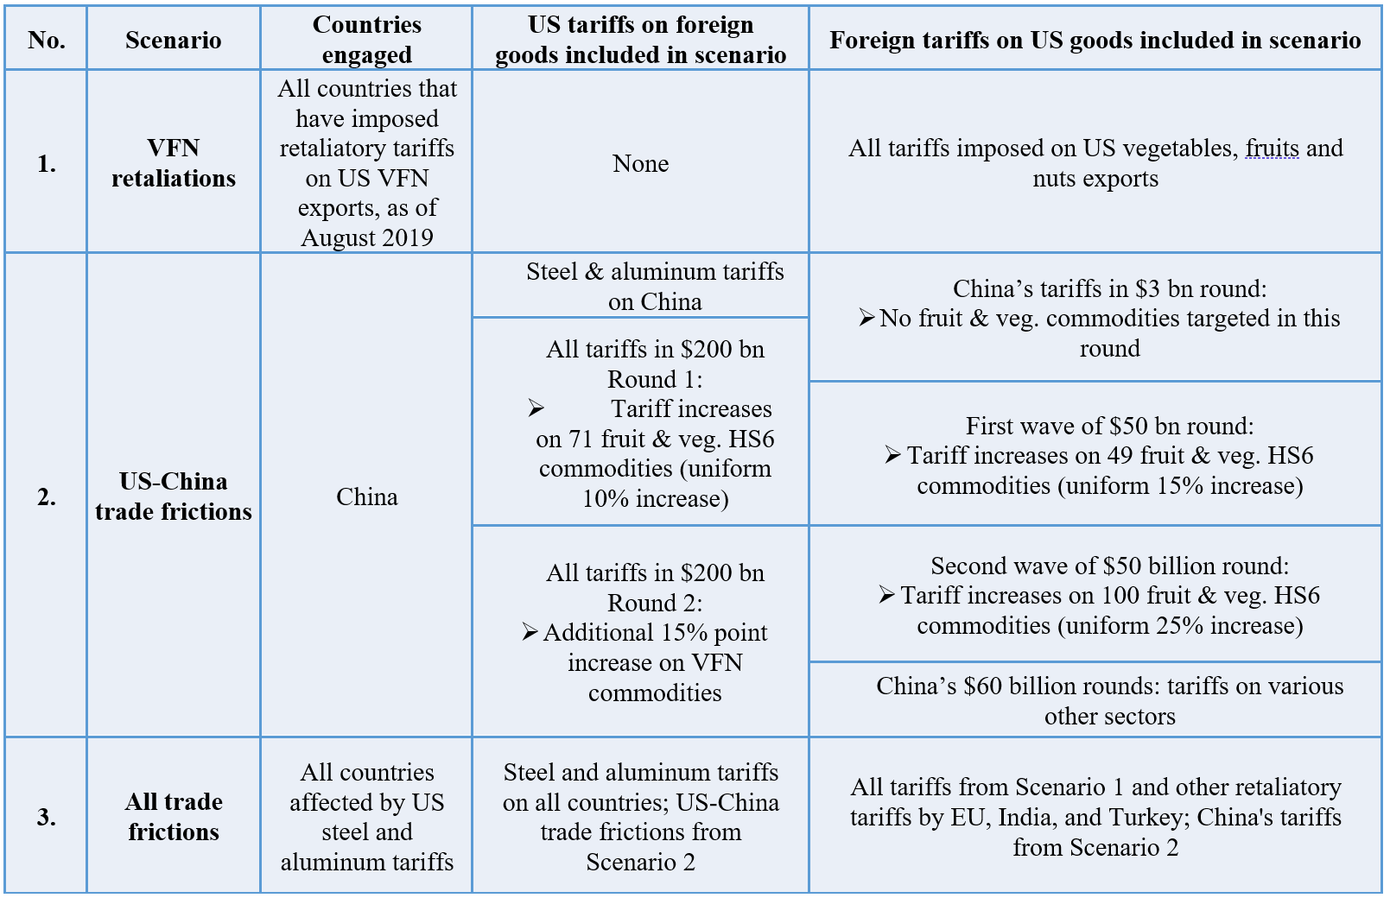
Scenarios used in the analysis

Slide 9
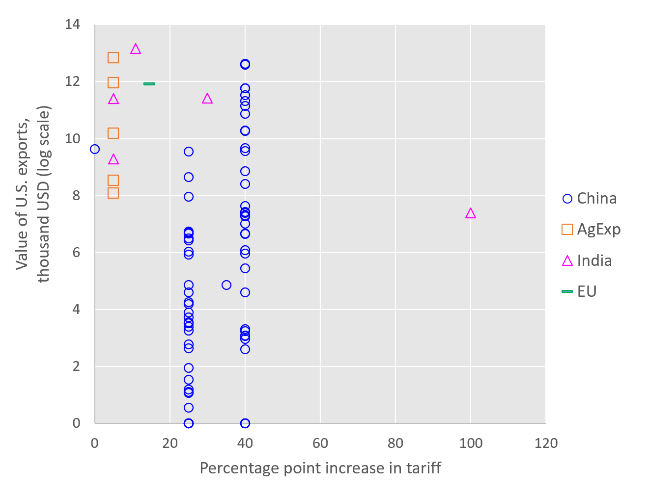
Export values vs. retaliatory tariffs imposed on U.S. vegetables, fruit and nuts (scenario 1)
India on walnuts
Note: Each point corresponds to a commodity at the HS6 level.
Source: Developed using Li (2018), UN (2018).

Slide 10
Structure of 2014 US VFN Output, before tariffs
Total output 46 billion USD
80/20 rule: of 79, 17 (20%)
commodities represent
80% of output by value

Slide 11
Structure of 2014 US VFN Exports, before tariffs
Total exports $16 billion
17 (20%) commodities
represent 80% of exports

Slide 12
U.S. exports of vegetables, fruit and nuts by commodity and destination
Notes:
EU, Canada, China, Mexico and India are important trading partners for US for many v_f commodities.
Large share of these 17 commodities were shipped to countries/regions that undertake increase in tariffs on U.S. vegetables, fruit and nuts. For example, 2879 of 3815 mn (75%) of almonds exported by US were traded with EU, Canada, China, Mexico, India and Agricultural Exporters. However, with exception of China, these partners target only specific commodities. EU target dry kidney beans. India target almonds, walnuts and apples. Turkey walnuts and almonds, Mexico apples.
It is worthwhile to note that before the trade war, US V_F were imported with zero tariff by Canada and Mexico. With the introduction of retaliatory tariffs, this changes only for apples, which are now imported by Mexico with new 20% tariff.
India had been imposing almost uniform across all 79 V_F commodities 30% tariff before the trade war. Only few of the VFN commodities are subject to retaliatory tariffs in India, with walnuts tariff being increased by very large amount.
EU and China had been imposing some tariffs on many vegetables, fruits and nuts before the trade war. Most of these tariffs were much smaller than those imposed by India. EU retaliates by imposing tariffs on dry beans originated from US. China retaliates with large increase in tariffs on all VFN imported from US. In summary, the retaliatory tariffs are likely to have noticeable impact on U.S. almond and apple sectors, and all other sectors that export a lot to China (almonds and pistachios).

Slide 13
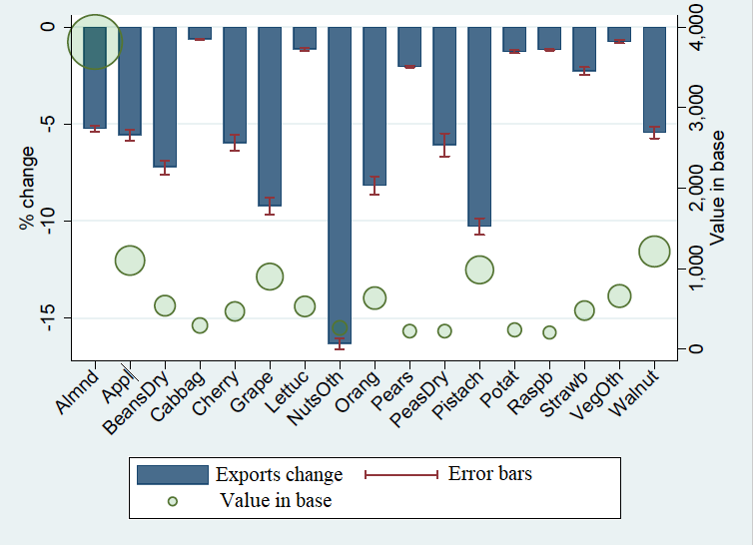
US exports of top 17 VFN commodities by value
% change due to retaliatory tariffs (Scenario 1)
Notes:
Note: Error bars show uncertainty in simulated changes in exports and represent +/- two standard deviations from the mean. The uncertainty is measured using the systematic sensitivity analysis (SSA) (Arndt and Pearson, 1998). Each trade elasticity is varied independently in the range of +/- two standard errors reported in Fontagné et al., 2019. , assuming a symmetric triangular distribution over that range.

Slide 14
Top 10 contributors to change in total US VFN exports
% change due to retaliatory tariffs (Scenario 1)
Notes:
Note: Error bars show uncertainty in simulated changes in exports and represent +/- two standard deviations from the mean. The uncertainty is measured using the systematic sensitivity analysis (SSA) (Arndt and Pearson, 1998). Each trade elasticity is varied independently in the range of +/- two standard errors reported in Fontagné et al., 2019. , assuming a symmetric triangular distribution over that range.

Slide 15
US exports of top 17 VFN commodities by value
% ch. under different elasticity assumptions (Scenario 1)
Notes:
(top 17 commodities by value)

Slide 16
US exports of top 17 VFN commodities by value
% ch. under different database construction methods (Scenario 1)
Notes:
(top 17 commodities by value)

Slide 17
Total US VFN exports, by Region
Change under different elasticity assumptions (Scenario 1)
Notes:
(top 17 commodities by value)

Slide 18
Total US VFN exports, by Region
Change under different database construction (Scenario 1)
Notes:
(top 17 commodities by value)

Slide 19
Total US VFN exports, by Region
Change under different scenarios

Slide 20
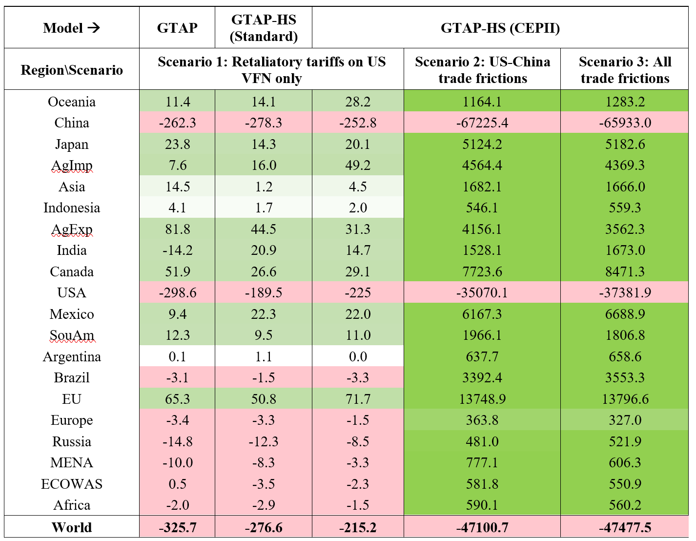
Regional Welfare
Change (Mil. USD) under different scenarios
Notes:
Note: For the GTAP-HS (CEPII) model, mean EV estimates of the SSA runs are reported.

Slide 21
Conclusions
Developed GTAP-HS data base for vegetables, fruit and nuts
Complemented with trade elasticities at the HS6 level
Quantified impacts of the recently introduced trade frictions between U.S. and trading partners
  On aggregate level, U.S. and China suffer the most, while other regions gain
When comparing with standard GTAP results, we find that standard GTAP overstates impacts on aggregate sector output and trade
  Magnitude of these differences depends critically on the specified trade elasticities
While aggregate U.S. exports of VFN under scenario 1 decrease by 6.8% under standard GTAP; under GTAP-HS with standard GTAP trade elasticities they decrease by 4.0%; and under GTAP-HS with heterogenous trade elasticities, they decrease by 5.0%
Impacts are highly heterogeneous across individual commodities
  U.S. exports of some of the VFN commodities are reduced by more than 10%
  For many of the VFN commodities, U.S. exports to China are reduced by more than 50%

Slide 22
Thank you!

Slide 23
GTAP-HS data base
GTAP 10p2 data base, reference year 2014
Bilateral imports, protection rates, domestic production and demand for domestically produced commodities at the HS6 level within GTAP vegetables, fruit and nuts (v_f)
  FAOSTAT data on production, total country exports and imports (quantities, prices and values) of 93 vegetables, fruits, nuts and 23 dairy commodities at the country level
    Other data sets to fill gaps in FAO data (Euromonitor , OECD-FAO Agricultural Outlook)
    Gap filling techniques
  MACMAP data on HS6 bilateral trade values (CIF prices) and import tariff rates
  MACMAP trade data and FAO production data use different classification systems (HS 2012 and CPC 2.1) => use intersection
  MACMAP and FAO data are reconciled to match the GTAP data at the sectoral level
In the final GTAP-HS data base
  GE part: 20 regions and 28 sectors, including v_f and mil
  PE part: trade and domestic use of 79 commodities within GTAP sector “vegetables, fruit and nuts” and 9 commodities within GTAP sector “dairy products”

Slide 24
Quantity linkages in the GTAP-HS model
Domestic supply of GTAP
commodity v_f in region s
Domestic supply of HS6
commodity k within v_f
in region s
Supply of HS6 commodity k from region s to export market d
Supply of HS6 commodity k for the domestic market in region s
Demand for imported HS6 commodity k by source s in region d
Demand for domestic HS6 commodity k in region d
Demand for imported HS6 commodity k aggregated across sources s
Domestic absorption of HS6 commodity k in region d
Domestic absorption of GTAP commodity v_f in region d

Slide 25
Price linkages in the GTAP-HS model
Basic price of domestically supplied GTAP commodity v_f in region s
Basic price of domestically supplied HS6 commodity k within v_f in region s
Aggregate
Destination-generic and destination specific export taxes in region s
FOB price of HS6 commodity k exported from region s to region d
Cost of international transport of the HS6 commodity k imported from s to d
Price including cost of insurance and freight of HS6 commodity k imported from s to d
Source-generic and source-specific import taxes in region d
Basic price of HS6 commodity k imported from region s in domestic market in region d
Basic price of the imported HS6 commodity k in domestic market in region d, aggregated across all sources s
Aggregate
Basic price of the imported GTAP commodity v_f in region d
Aggregate

