Slide 1




Impacts of EU Agricultural and Trade Policies on West Africa: The Cases of Poultry and Dairy
Omid Zamani Janine Pelikan
Thünen Institute of Market Analysis, Bundesallee 63, 38116 Braunschweig, Germany.
Email: omid.zamani@thuenen.de, Janine.pelikan@thuenen.de
GTAP Conference
June 2020

Slide 2
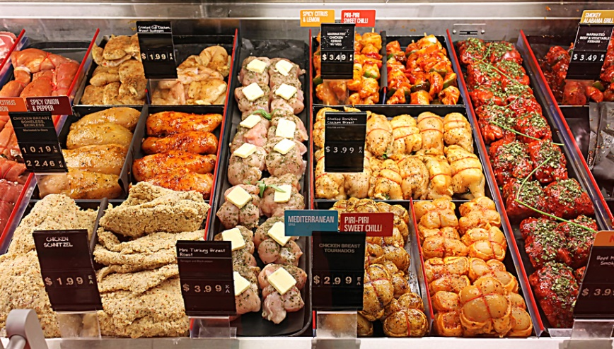
Introduction
80 % of the chicken meat in German supermarkets is chicken breast
  Wings, necks, feet, bones and offal are mainly exported
Benin, Ghana and Liberia are the top three export destinations in West Africa for German poultry exports
© niloo - Fotolia
  EU-export practices are strongly criticized
Notes:
Alles in 16. Juni 2016 umbenennen

Slide 3
Introduction – Project Aim
Repeated criticism of German/EU export policies to African countries.
Examine the effects of these exports on selected African countries.
Develop and evaluate measures to avoid or reduce undesirable effects of these exports.
Product focus: Poultry meat and milk products
Country focus: Ghana and Senegal

Slide 4




IMMPEX: an overview
Trade
Consumer
IMMPEX
Production

Slide 5







The Project
Trade Flows
Consumers
Poultry
Consumers
Dairy
Policies
Impact Analysis
Producers
Value Chain

Slide 6
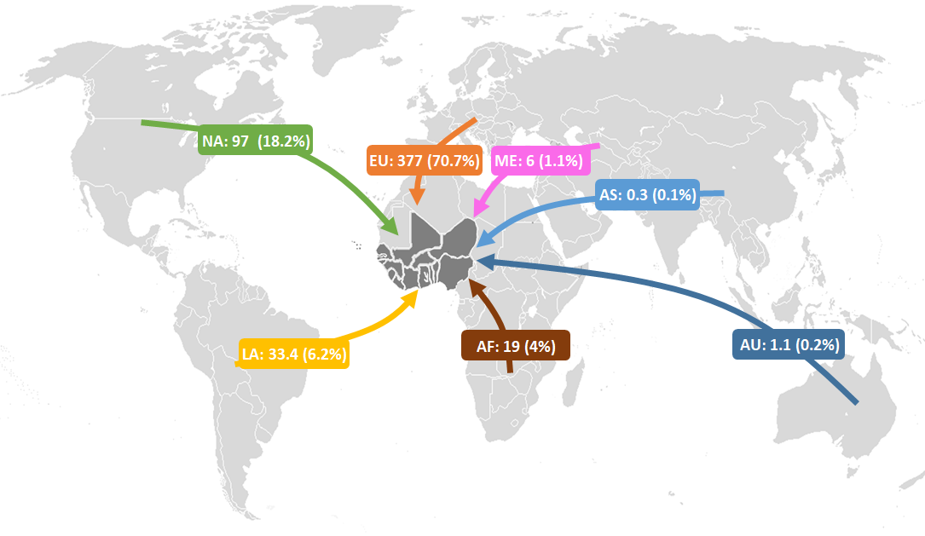
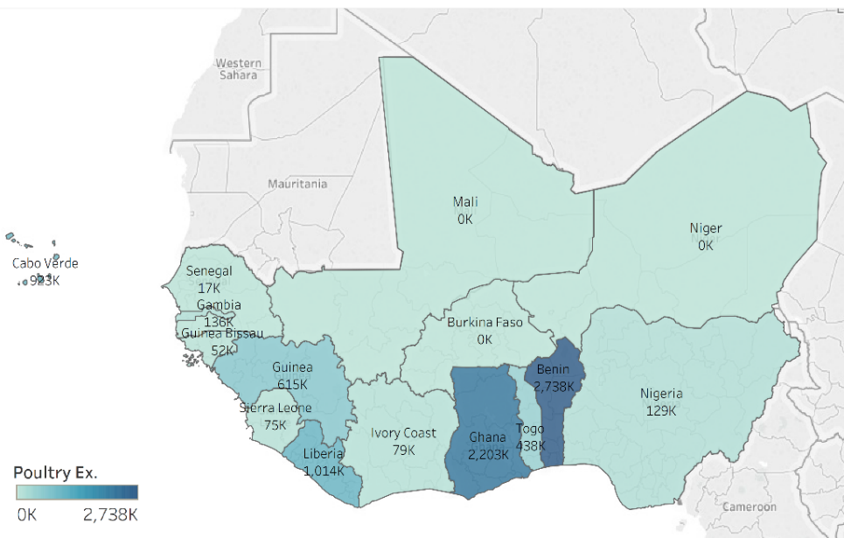
Global Trade Flows of Poultry Meat to West Africa (in 1000 ton)
Source: Own elaboration based on UN Comtrade. HS code: 0207, 0105, 020990, 150190, 160231, 160232, 160239

Slide 7
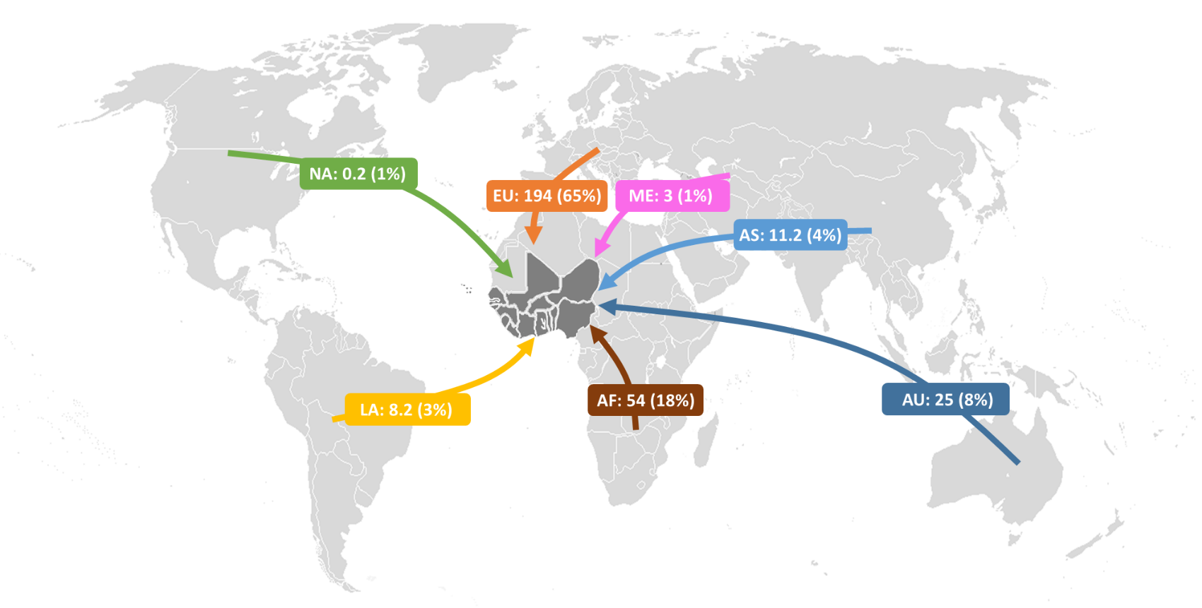
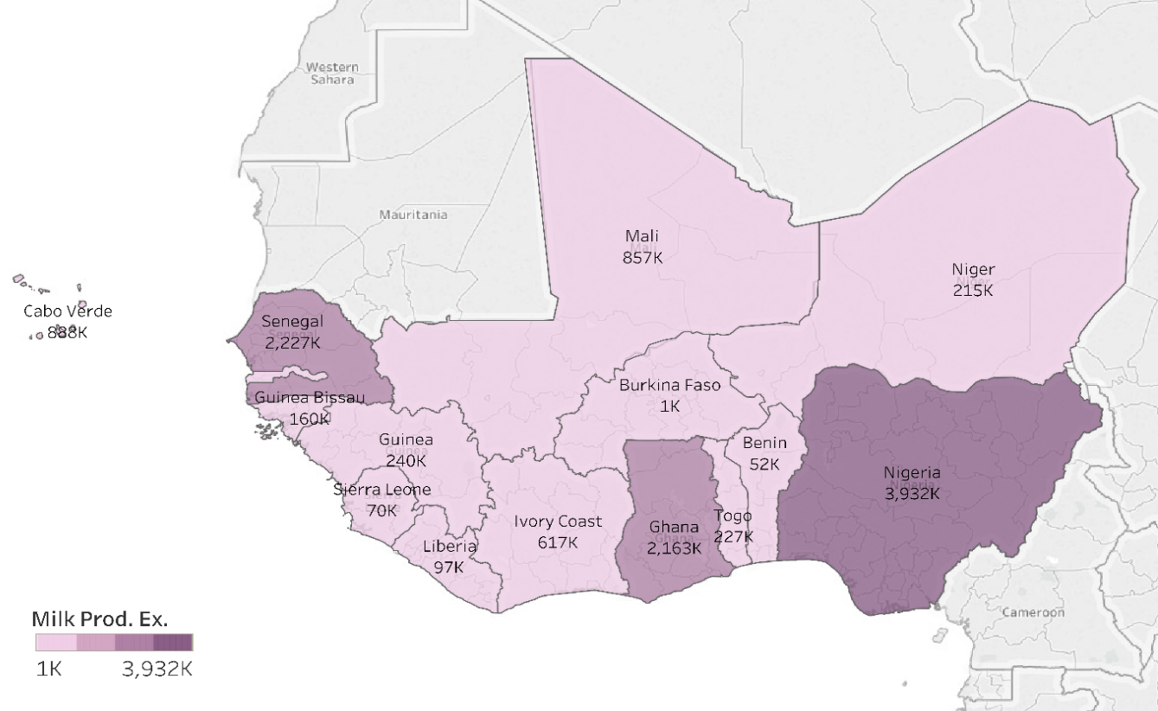
Global Trade Flows of Milk to West Africa (in million USD)
Source: Own elaboration based on UN Comtrade. HS code: 0401--, 040291, 040299, 0403--, 040490, 0405--, 0406--, 170211, 170219, 2105--, 350110.

Slide 8
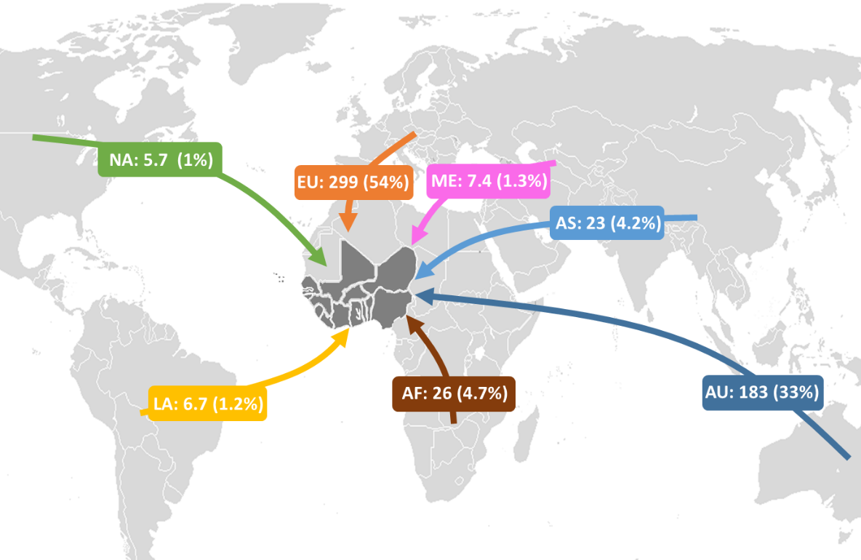
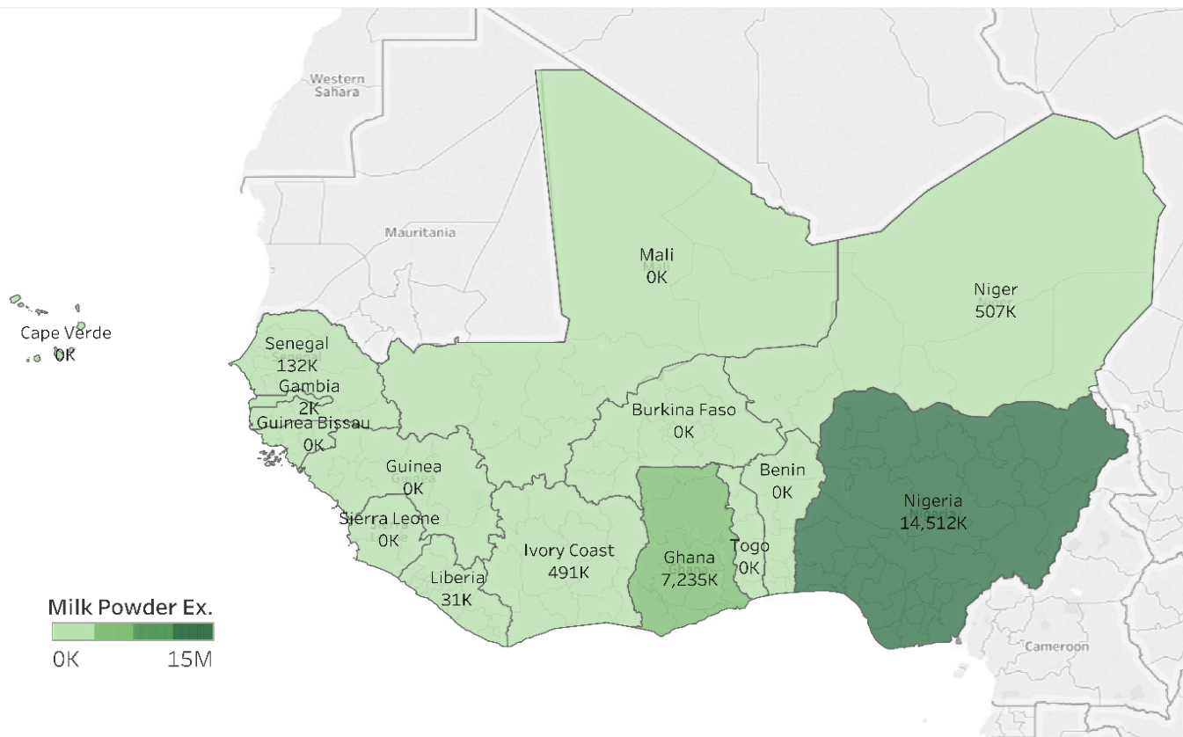
Global Trade Flows of Milk Powder to West Africa (in million USD)
Own elaboration based on the UN Comtrade database, 2017. HS product code: 040221, 040210, 040410, 040229.

Slide 9

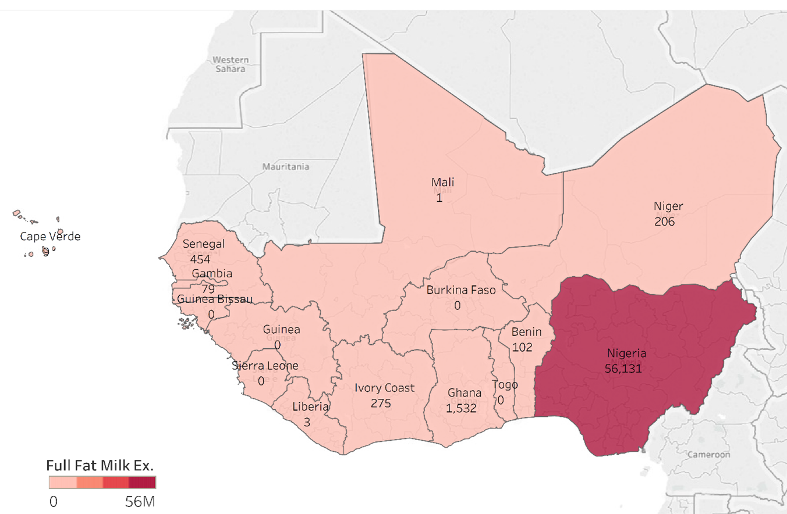
Global Trade Flows of Full-Fat Milk to West Africa (in million USD)
Source: Own elaboration based on UN Comtrade. Unit: Million USD. HS code: 190190

Slide 10
Focus Regions
  Ghana and Senegal
  Imports are criticised by the media
  Share of total import volume and/or market share is particularly high
  Policy measures
  Other criteria: Feasibility, existing contacts, data availability and accuracy

Slide 11
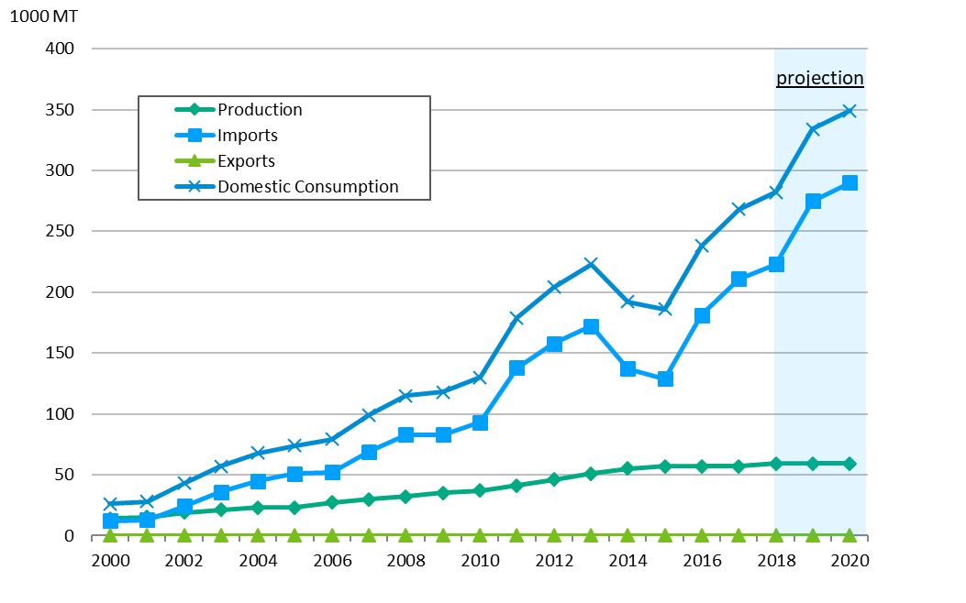
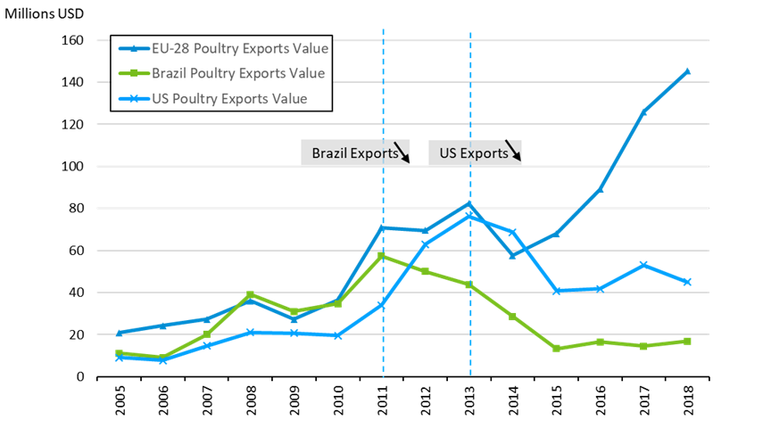
Poultry Meat Production, Consumption and Imports of Ghana
Source : UN Comtrade. HS code: 0207, 0105.USDA.

Slide 12
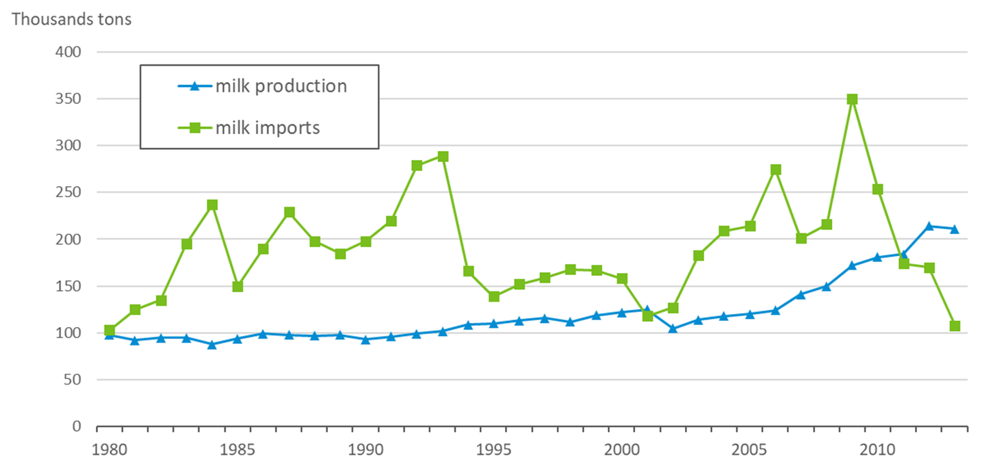
Total Dairy imports and Domestic Production in Senegal (1000 tons)
Source: FAOSTAT (2018).

Slide 13
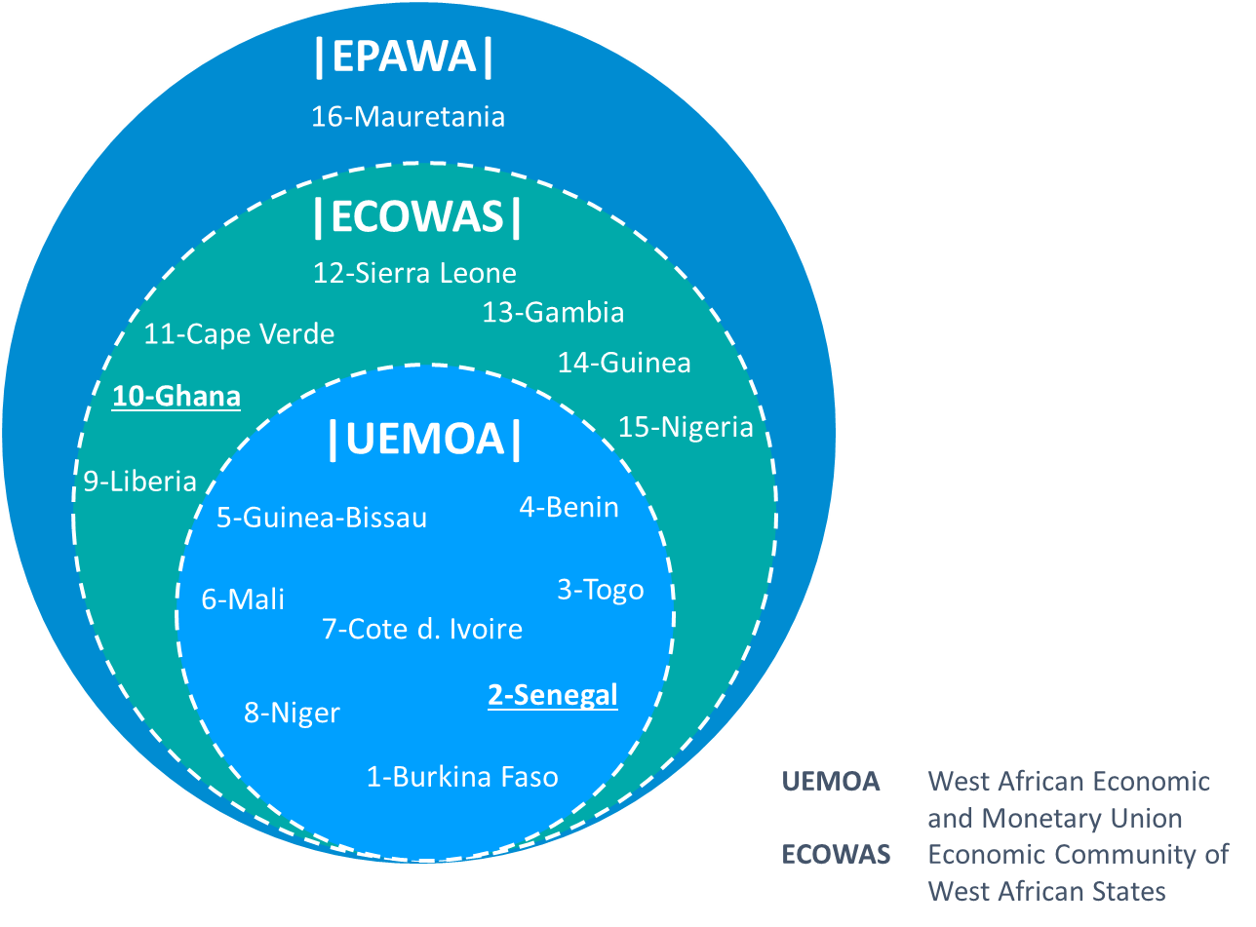


EU-WA Economic Partnership Agreement
African Continental Free Trade Area
Import duties
Import Liberalization

Slide 14
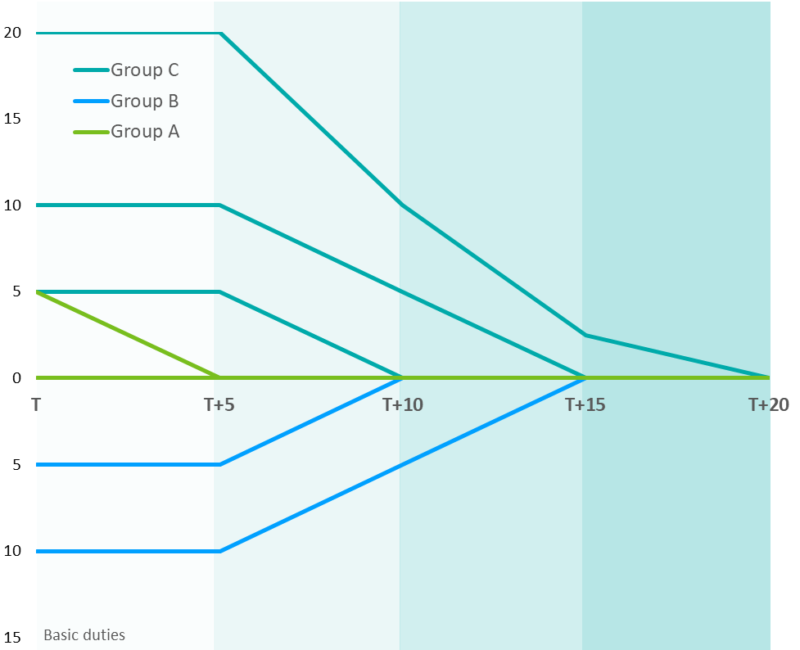
Tariff Dismantling in EPA
Originality and sensitivity definitions?

Slide 15
Import Tariffs on EU28 Poultry Exports (HS 0207)
 | Applied tariff | Common External Tariff (ECOWAS) | Bound tariff
Ghana | 20% | 35% | 100%
Senegal | 20% | 35% | 30%
South Africa | 1.3% |  | 74%
Sub Saharan Africa | 6.7% |  | 80%
LDC | 15% |  | 63%
Source: ITC tariff data (2019), EPA-Agreement (2014)
Trade weighted aggregated import tariffs for tariff line HS 0207 (meat and edible offal of poultry, fresh, chilled or frozen).
Notes:
Farben anpassen, Schrift vergrößern etc.

Slide 16
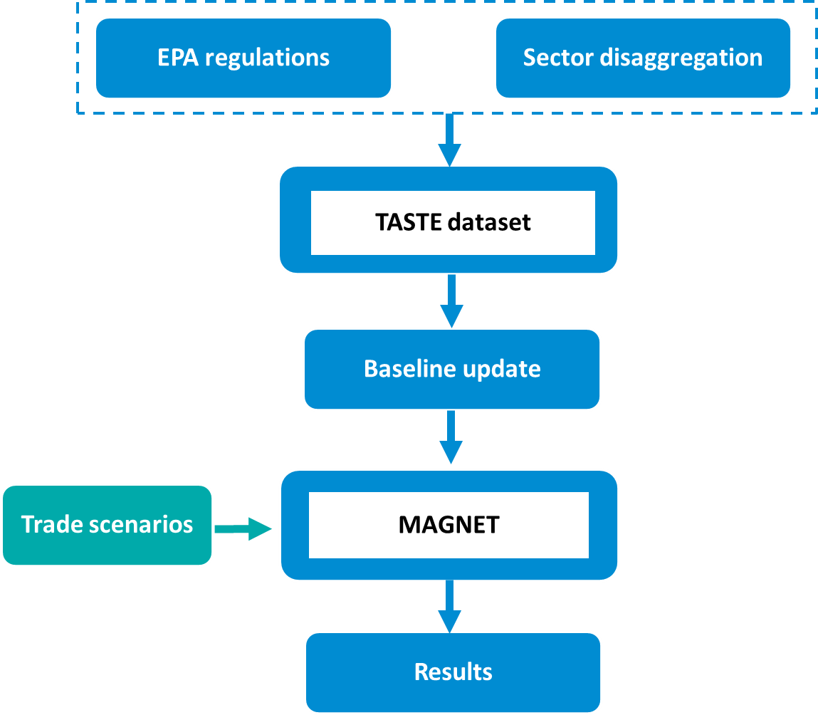
Method Flowchart

Slide 17
Results

Slide 18
Summary and Policy Implications

Slide 19


Thank you for your attentions!
www.linkedin.com/immpex
janine,pelikan@thuenen.de

