Slide 1

23th Annual Conference on Global Economic Analysis
Measuring the UK Economy’s Armington Elasticities
Elliot E. Delahaye
Catherine A. Milot
Department for International Trade, United Kingdom

Slide 2

Introduction – Parameters and AGE
AGE models have measured economic effects of changes to trade policy, resource allocations within countries, custom union and trade negotiation issues, as well as environmental impacts from trade.
Results of AGE models are largely determined by the choice of the behavioural parameters, which reflect the sensitivity of consumers and firms to changes in relative prices.
However, the measures of these elasticities are generally not identified with precision and very little is known about what determines their value.
These elasticities are often assume to be the same for each country
Ideally, elasticities should be generated by statistical or econometric methods based on the historical behaviour of prices and quantities and then examined for consistency with economic theory and analysts’ intuition.

Slide 3
Introduction (cont’d) – Armington for the UK?
No set of Armington elasticities (macro or micro) of substitution have previously been measured for the United Kingdom
Calculations for the European Union countries (of which some included the UK) or for certain UK sectors.
Why measure elasticities for the UK:
  Majority of existing studies provide results only for the United States (US)
  The few studies available for other countries find considerably different results (Olekseyuk & Schurenberg, 2014).
  Armington elasticity estimates can be sensitive to the choice of estimation strategy (Feenstra et al., 2014)
  Need to match the sectors level and time horizon of the AGE (Ossa, 2015).
We follow Blonigen and Wilson (1999), Kapuscinski & Warr (1999) and Gallaway, McDaniel & Rivera (2003)
We use historic data from the ONS, HMT and DEFRA.
We estimate elasticities for UK agricultural, manufacturing and services industries at the GTAP10 sectors level.

Slide 4
Literature review- The Armington assumption
Standard trade theory focuses on inter-industry trade: if a country either exports or imports a good.
Paul Armington: firms in each region produce a unique variety of a good.
  Armington Assumption: behavioural relationship between the demand for the foreign and domestic goods considering their relative prices.
  Goods produced in different countries are imperfect substitutes in demand.
Substitution elasticities: the macro and the micro.
  Macro: substitution between goods produced domestically and imported goods.
  Micro: substitution for the same imported goods provided by different foreign suppliers.
Goods with a high macro elasticity: consumers will substitute relatively easily between domestic and foreign varieties: homogenous agricultural (rice, wheat, meat) or mining products (oil, gas)
Goods with a low macro elasticity: consumers strongly distinguish goods according to their origin : manufactured goods (beer, wearing apparel).

Slide 5
Literature review (cont’d)- The size of the Armington elasticities
The extent to which a policy change will affect a country’s trade balance, production, GDP and welfare all depend on the measured size of the Armington elasticity used in modelling thus rendering essential the estimation of these parameters (Feenstra et al., 2010).
The earlier estimations of trade elasticities go back to 1976 with Stern et al. where the authors provide the first set of import-demand elasticities for 28 industries.
According to McDaniel & Balistreri (2003), three subsequent studies have attempted to capture Armington elasticities for the US imports of various goods using linear regression methods: Shiells et al (1986), Reiner & Roland-Holst (1992) and Shiells & Reinert (1993).
These earlier sets of elasticities were assumed to be too low (domestic and imported goods are believed to be more substitutable than the estimates would suggest) as they generated unrealistically large terms of trade.
  Shiells et al (1986): 0.45 to 6.5. (USA)
  Lachler (1985): 0.8 to 4.9 (Germany)
  Shiells & Reinert (1993) :0.14 to 1.98. (USA)

Slide 6
Literature review (cont’d)- The size of the Armington elasticities
Studies with more complex estimation models such as Hummels (1999) and Gallaway, McDaniel & Rivera (2003) find values that are significantly higher than those found in older studies.
These results highlight the important fact that the Armington elasticities used in AGE models generally differ substantially from the ones measured empirically.
  The average GTAP macro elasticities are set at 3.1, greater than the empirical macro Armington elasticities (around 1).
Gallaway, McDaniel & Rivera (2000) infer that AGE modellers are aware of the empirical results but that they believe them to be too low thus generating unrealistically low levels of trade and prefer to neglect them.
Differences in Armington could stem from the variations in model specifications between AGE modelling practices and the econometric approaches to estimate. McDaniel & Balistreri (2003)

Slide 7
Methodology
McDaniel & Balistreri (2003)’s literature review provides an interesting starting point to customise our methodology.
1) Obtain both long-run and short-run estimates:
  Firstly, given that most trade policy analysis focuses on a long-term horizon for modelling, these long-run estimates will be most useful. However, estimating short-run estimates is useful by enabling us to additionally assess the sensitivity of this impact in the near-term horizon.
  Secondly, this allows us to compare our findings with those of McDaniel & Balistreri (2003) on the relative size of both types of estimate.
2) A level of sectors/industries aggregation which matches the number of sectors in our AGE model.
  Empirically, it is found that the more disaggregate the sample, the greater the estimated substitution elasticity.
  But we question the practice of applying aggregate estimates of the Armington elasticities to individual sectors that are the focus of study or applying the average elasticity from disaggregate estimates to an aggregated commodity.
  We obtain empirically grounded estimates for the 65 sectors breakdown in the GTAP 10 AGE model.
3) Estimation model specification which matches the entirely independent AGE models that they are exogenous inputs into.
  Our estimation models are consistent with the economic theory of Armington models and present a range of econometric

Slide 8
Estimation procedure
Conceptually, Armington models are derived from the solution to the consumer’s optimisation problem using a CES utility function to describe the choice between domestic goods and foreign goods.
Due to data availability, we assume that all domestic purchasers of a certain good are identical in their demands and in their assessment of the substitutability
  The categories of domestic demand include final consumers, intermediate good purchasers, investment good purchasers and the government.
We solve this consumer’s optimisation problem to derive an equation which links relative market shares of domestic/foreign goods to their associated relative prices via an elasticity of substitution. This allows theoretically consistent estimation of the Armington elasticities.
We follow the econometric approaches of Blonigen & Wilson (1999), Kapuscinski & Warr (1999) and Gallaway, McDaniel & Rivera (2003) and estimate the elasticities using three models: Ordinary Least Squares (OLS), Partial Adjustment Model (PAM) and the Error Correction Model (ECM).

Slide 9
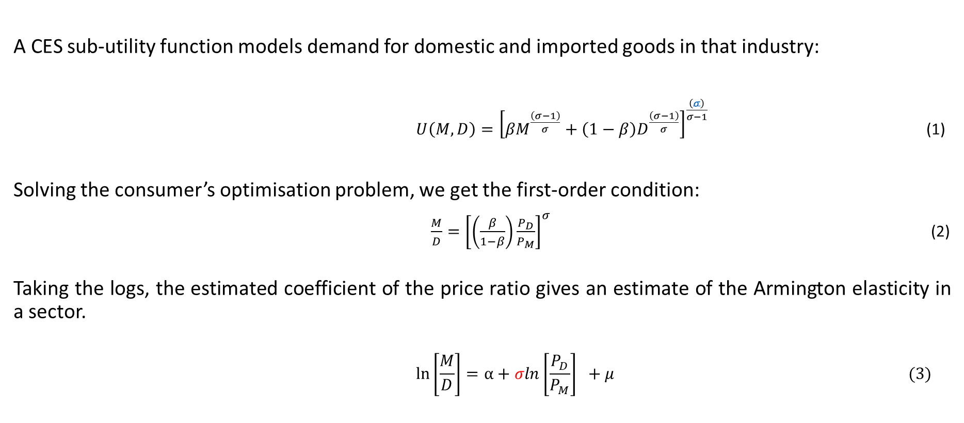
Estimation procedure (Cont’d) - Deriving a Theoretically Consistent Form for the Estimation Equation
A CES sub-utility function models demand for domestic and imported goods in that industry:
$U\left(M,D\right)={\left[{βM}^{\frac{\left(σ−1\right)}{σ}}+\left(1−β\right)D^{\frac{\left(σ−1\right)}{σ}}\right]}^{\frac{\left(σ\right)}{σ−1}}$ (1)
Solving the consumer’s optimisation problem, we get the first-order condition:
$\frac{M}{D}={\left[\left(\frac{β}{1−β}\right)\frac{P_{D}}{P_{M}}\right]}^{σ}$(2)
Taking the logs, the estimated coefficient of the price ratio gives an estimate of the Armington elasticity in a sector.
$$\ln\left[\frac{M}{D}\right]=α+σln\left[\frac{P_{D}}{P_{M}}\right] +μ (3)$$

Slide 10
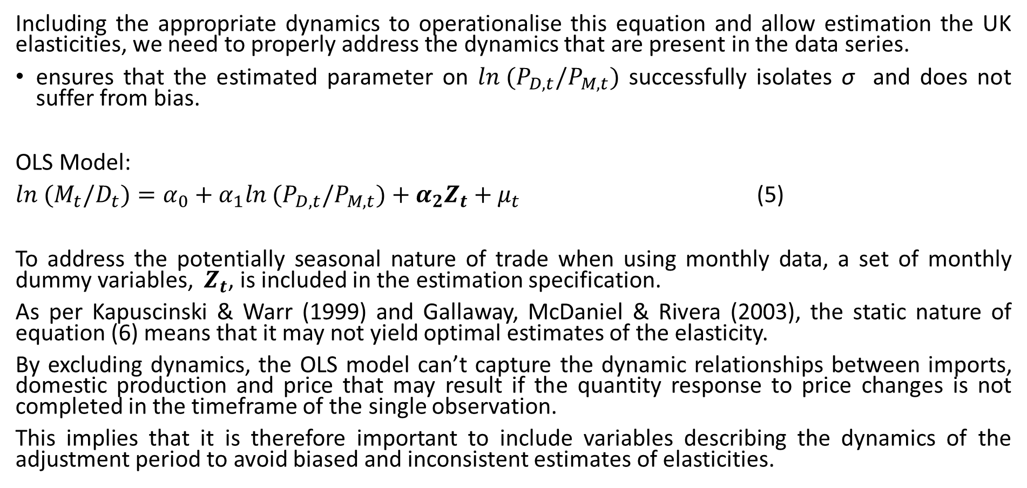
Estimation procedure (Cont’d) - (OLS) model
Including the appropriate dynamics to operationalise this equation and allow estimation the UK elasticities, we need to properly address the dynamics that are present in the data series.
ensures that the estimated parameter on $ln (P_{D,t}/P_{M,t})$ successfully isolates σ and does not suffer from bias.
OLS Model:
$ln (M_{t}/D_{t})=α_{0}+α_{1}ln (P_{D,t}/P_{M,t})+α_{2}Z_{t}+μ_{t}$ (5)
To address the potentially seasonal nature of trade when using monthly data, a set of monthly dummy variables, $Z_{t}$, is included in the estimation specification.
As per Kapuscinski & Warr (1999) and Gallaway, McDaniel & Rivera (2003), the static nature of equation (6) means that it may not yield optimal estimates of the elasticity.
By excluding dynamics, the OLS model can’t capture the dynamic relationships between imports, domestic production and price that may result if the quantity response to price changes is not completed in the timeframe of the single observation.
This implies that it is therefore important to include variables describing the dynamics of the adjustment period to avoid biased and inconsistent estimates of elasticities.

Slide 11
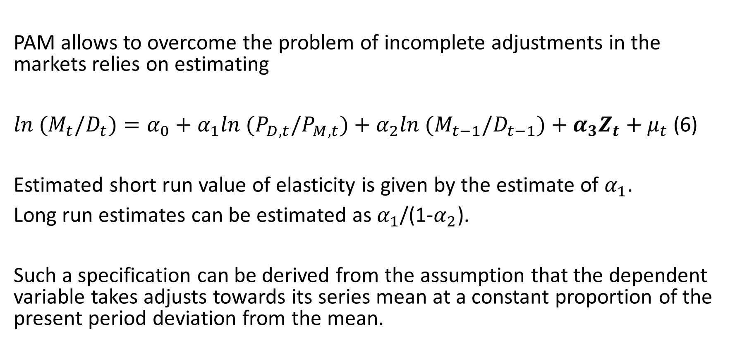
Estimation procedure (Cont’d) - PAM
PAM allows to overcome the problem of incomplete adjustments in the markets relies on estimating
$ln (M_{t}/D_{t})=α_{0}+α_{1}ln (P_{D,t}/P_{M,t})+α_{2}ln (M_{t−1}/D_{t−1})+α_{3}Z_{t}+μ_{t}$ (6)
Estimated short run value of elasticity is given by the estimate of $α_{1}$.
Long run estimates can be estimated as $α_{1}$/(1-$α_{2}$).
Such a specification can be derived from the assumption that the dependent variable takes adjusts towards its series mean at a constant proportion of the present period deviation from the mean.

Slide 12
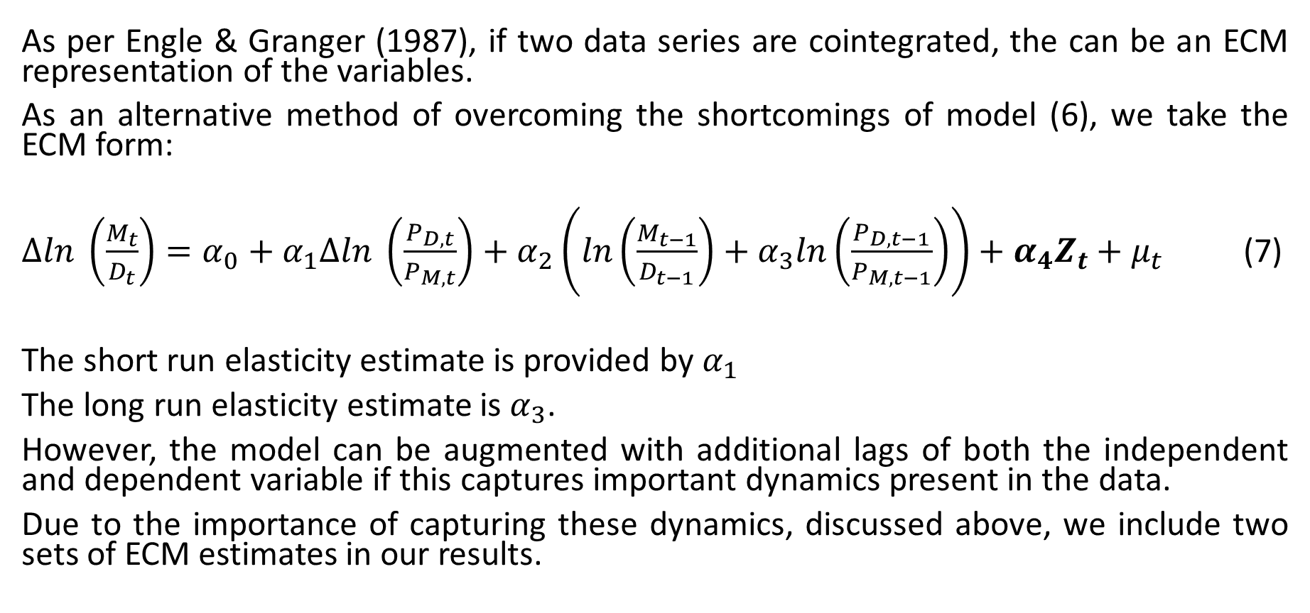
Estimation procedure (Cont’d) – ECM
As per Engle & Granger (1987), if two data series are cointegrated, the can be an ECM representation of the variables.
As an alternative method of overcoming the shortcomings of model (6), we take the ECM form:
$∆ln \left(\frac{M_{t}}{D_{t}}\right)=α_{0}+α_{1}∆ln \left(\frac{P_{D,t}}{P_{M,t}}\right)+α_{2}\left(ln\left(\frac{M_{t−1}}{D_{t−1}}\right)+α_{3}ln\left(\frac{P_{D,t−1}}{P_{M,t−1}}\right)\right)+α_{4}Z_{t}+μ_{t}$ (7)
The short run elasticity estimate is provided by $α_{1}$
The long run elasticity estimate is $α_{3}$.
However, the model can be augmented with additional lags of both the independent and dependent variable if this captures important dynamics present in the data.
Due to the importance of capturing these dynamics, discussed above, we include two sets of ECM estimates in our results.

Slide 13
Data – Domestic Sales and Domestic Prices
Agriculture
Data on the sales of UK agricultural industries are created by DEFRA and are available at a breakdown in line with the EAA.
  Data is not broken down by domestic and foreign sales.
  DEFRA produces APIs to reflect the price of UK agricultural goods on a comparable sector basis to its sales data.
Purdue University’s GSC3 sector classification does not contain a mapping for agricultural sectors to the ISIC sectors.
Not all products included in a sector will be available in both import and domestic form.
In extreme cases however, the UK does not produce any notable output in certain GTAP sectors such that estimates cannot be obtained for these sectors.
Annual data is available for sales and prices from 1995 onwards.

Slide 14
Data – Domestic Sales and Domestic Prices
Manufacturing
Data on the sales of UK manufacturing industries are created by the UK’s ONS and are available as turnover by SIC industry.
  The ONS splits turnover into domestic sales and sales abroad.
  The Armington model reflects the choice of UK consumers buying UK or foreign goods, we use domestic sales only.
To measure the price of these domestic sales, the ONS creates Producer Price Indices (PPIs) on the same SIC sector basis.
These are concorded to GTAP sectors using Purdue University’s GSC3-ISIC Rev.4 concordance.
Both sales and price data are available on a monthly basis for the period since 1999.

Slide 15
Data (Cont’d) - Import Sales and Import Prices
As the ONS does not produce comprehensive import price indices by sector, we instead used unit value indices from data on the UK’s imports.
Data for elementary value indices are extracted on a HS 6-digit basis from HMRC data on monthly UK imports.
Data is available for the same period as domestic prices and sales.
  However, in cases where mapping 6-digit series to the pre-2002 HS nomenclature or post-2017 HS presents issues that would require greater aggregation of the elementary series, a judgement is made as to whether the granularity of the price data takes is more desirable to additional observations.

Slide 16
Results
Estimates were obtained from three model specifications: OLS, PAM and ECM and are presented in Table 1.
Of the 109 ECM estimates, 44 short-run elasticities were statistically significant and of the right sign, and of the long-run elasticities, 22 were statistically significant and of the right sign.
An interesting point about our results is that they appear to meet all the robust findings of the McDaniel & Balistreri (2003)’s review of the literature as presented in our section 3 on methodology.
  First, long-run estimates are higher than short-run except for textiles, fabricated metal products and electronic products.
  Second, the level of aggregation is important, with the more disaggregate the sample, the greater the estimated substitution elasticity. Most of our results have a value of less than one, which corresponds to what might be expected with such a high aggregation level which comes with the GTAP sectors.
  Third, recent cross-sectional studies find higher substitution rates than the central values obtained in the time-series studies. This seems to explain again the lower estimations .
Results of trade-policy analysis using static computable models are generally interpreted as the long-run effects of policy changes; we discuss the ECM long-run results, when possible. The short run estimates are provided as sensitivity.
Looking at the ECM results, we can see that the average long run elasticity estimates is 0.808, with a range between 0.001 and 2.69.
  According to our results, some of the most import sensitive sectors are wheat (wht), oil seeds (osd), raw milk (rmk), lumber (lum), wearing apparels (wap) and transport equipment (otn).
  The less import sensitive sectors would be textiles (tex), other food products(ofd), vegetables & fruits (v_f), meat products (omt & cmt) and rubber & plastics products (rpp).

Slide 17
Results (Cont’d) – Table 1 – Agricultural Sectors
 |  | OLS (with Monthly Dummies) | PAM (with Monthly Dummies) | ECM |  | ECM with Optimal Spec |  | GTAP model
 |  |  |  | Short-Run | Long-Run | Short-Run | Long-Run
Wheat (wht) | Elasticity | 1.0776 | 1.1739 | 0.9393 | 1.0142 |  | 1.6898 | 4.45
 | Significance |  |  |  |  |  | ***
 | SE | 0.5697 | 0.5938 | 0.8385 | 0.8225 |  | 0.4643
 | t-stat | 1.8900 | 1.9800 | 1.1200 | 1.2300 |  | 3.6400
 | R2 | 0.1399 | 0.2130 | 0.4832 |  | 0.6187
Other Grains (gro) | Elasticity | 0.9024 | 0.9105 | 0.7102 | 0.7453 | 1.0486 | -0.4656 | 1.30
 | Significance | *** | *** | ** | * | **
 | SE | 0.1386 | 0.1848 | 0.2099 | 0.3482 | 0.2757 | 0.7260
 | t-stat | 6.5100 | 4.9300 | 3.3800 | 2.1400 | 3.8000 | -0.6400
 | R2 | 0.6583 | 0.6037 | 0.8120 |  | 0.8794
Vegetables & fruits (v_f) | Elasticity | 0.7077 | 0.2302 | 0.3981 | -2.8799 | 0.5279 | 0.1267 | 1.85
 | Significance |  |  | *
 | SE | 0.4949 | 0.2542 | 0.1814 | 7.4199 | 0.2736 | 3.0753
 | t-stat | 1.4300 | 0.9100 | 2.1900 | -0.3900 | 1.9300 | 0.0400
 | R2 | 0.0850 | 0.8658 | 0.2692 |  | 0.4415
Oil Seeds (osd) | Elasticity | 1.2868 | 0.4932 | 0.1463 | 1.5831 |  | 1.2284 | 2.45
 | Significance | *
 | SE | 0.5236 | 0.3487 | 0.3583 | 1.8915 |  | 1.2996
 | t-stat | 2.4600 | 1.4100 | 0.4100 | 0.8400 |  | 0.9500
 | R2 | 0.2154 | 0.7224 | 0.2162 |  | 0.2665
Cane & Beets sugar crops (c_b) | Elasticity | 0.6026 | 0.6183 | 0.8496 | -0.3681 | 0.9438 | -0.2827 | 2.70
 | Significance | * | * | *** |  | ***
 | SE | 0.2286 | 0.2221 | 0.1473 | 0.8980 | 0.1647 | 0.7767
 | t-stat | 2.6400 | 2.7800 | 5.7700 | -0.4100 | 5.7300 | -0.3600
 | R2 | 0.2401 | 0.4474 | 0.8034 |  | 0.9007
Other crops (ocr) | Elasticity | 1.0472 | 0.5633 | 0.0550 | 0.9204 |  | 0.8795 | 3.25
 | Significance | *** | * |  | **
 | SE | 0.1580 | 0.2154 | 0.2624 | 0.3125 |  | 0.4511
 | t-stat | 6.6300 | 2.6200 | 0.2100 | 2.9500 |  | 1.9500
 | R2 | 0.6665 | 0.7089 | 0.3967 |  | 0.3571
Cattle (ctl) | Elasticity | 0.9199 | 0.8932 | 0.8084 | 1.2256 | 0.8144 | 1.1092 | 2.00
 | Significance | *** | *** | *** | *** | *** | **
 | SE | 0.0345 | 0.0516 | 0.1092 | 0.2872 | 0.1154 | 0.3005
 | t-stat | 26.6700 | 17.3000 | 7.4100 | 4.2700 | 7.0600 | 3.6900
 | R2 | 0.9700 | 0.9713 | 0.9871 |  | 0.9900
Other Animal Products (oap) | Elasticity | 1.0771 | 1.0801 | 0.4456 | 1.1078 |  | 1.2102 | 1.30
 | Significance | *** | *** |  | *** |  | ***
 | SE | 0.0325 | 0.0323 | 0.2264 | 0.0781 |  | 0.0567
 | t-stat | 33.1300 | 33.4200 | 1.9700 | 14.1800 |  | 21.3500
 | R2 | 0.9804 | 0.9824 | 0.9924 |  | 0.9948
Raw Milk (rmk) | Elasticity | 1.4177 | 0.6634 | 0.2981 | 1.1180 |  | 1.6170 | 3.65
 | Significance | *
 | SE | 0.6147 | 0.5836 | 0.6146 | 2.1788 |  | 1.6150
 | t-stat | 2.3100 | 1.1400 | 0.4900 | 0.5100 |  | 1.0000
 | R2 | 0.1947 | 0.4675 | 0.1609 |  | 0.1244

Slide 18
Results (Cont’d) – Table 1 – Manufacturing Sectors
 |  | OLS (with Monthly Dummies) | PAM (with Monthly Dummies) | ECM |  | ECM with Optimal Spec |  | GTAP model |  |  | OLS (with Monthly Dummies) | PAM (with Monthly Dummies) | ECM |  | ECM with Optimal Spec |  | GTAP model
 |  |  |  | Short-Run | Long-Run | Short-Run | Long-Run |  |  |  |  |  | Short-Run | Long-Run | Short-Run | Long-Run
Cattle & Other meat (cmt & omt) | Elasticity | 0.3183 | 0.0339 | 0.3897 | 0.0010 |  | -0.1154 | 3.85 & 4.40 | Basic Pharmaceuticals Products (bph) | Elasticity | 0.1118 | 0.2484 | 0.8404 | -0.1067 | 0.8813 | -0.7122 | 3.30
 | Significance | ** |  | * |  |  |  |  |  | Significance |  | *** | *** |  | ***
 | SE | 0.1051 | 0.1003 | 0.1592 | 0.1663 |  | 0.3025 |  |  | SE | 0.0739 | 0.0563 | 0.0393 | 0.3899 | 0.0412 | 1.5688
 | t-stat | 3.0300 | 0.3400 | 2.4500 | 0.0100 |  | -0.3800 |  |  | t-stat | 1.5100 | 4.4100 | 21.3800 | -0.2700 | 21.3900 | -0.4500
 | R2 | 0.3663 | 0.4434 | 0.7045 |  | 0.6928 |  |  |  | R2 | 0.0701 | 0.4929 | 0.8423 |  | 0.8786
Dairy products (mil) | Elasticity | 0.2130 | -0.0362 | 0.6605 | -0.2155 | 0.5564 | -0.1855 | 3.65 | Rubber & Plastic Products (rpp) | Elasticity | -0.5021 | 0.0173 | 0.9969 | -0.3173 | 1.0065 | 0.0713 | 3.30
 | Significance |  |  | ** |  | * |  |  |  | Significance | *** |  | *** |  | ***
 | SE | 0.1411 | 0.1138 | 0.1930 | 0.2921 | 0.2617 | 0.4428 |  |  | SE | 0.0674 | 0.0590 | 0.0637 | 0.3154 | 0.0716 | 0.8550
 | t-stat | 1.5100 | -0.3200 | 3.4200 | -0.7400 | 2.1300 | -0.4200 |  |  | t-stat | -7.4500 | 0.2900 | 15.6500 | -1.0100 | 14.0500 | 0.0800
 | R2 | 0.4102 | 0.6724 | 0.6459 |  | 0.6433 |  |  |  | R2 | 0.3043 | 0.6820 | 0.7285 |  | 0.7643
Other food products (ofd) | Elasticity | 0.7856 | 0.1914 | 0.7896 | -0.0523 | 0.8636 | 0.0023 | 2.00 | Non Metallic Mineral products (nmm) | Elasticity | 0.9150 | 0.8719 | 0.9506 | 1.0741 | 0.9932 | 0.6213 | 2.90
 | Significance | *** |  | *** |  | *** |  |  |  | Significance | *** | *** | *** |  | ***
 | SE | 0.0713 | 0.1025 | 0.1346 | 0.3159 | 0.2051 | 0.1521 |  |  | SE | 0.0788 | 0.0602 | 0.0362 | 0.5651 | 0.0473 | 1.2896
 | t-stat | 11.0100 | 1.8700 | 5.8700 | -0.1700 | 4.2100 | 0.0200 |  |  | t-stat | 11.6100 | 14.4800 | 26.2600 | 1.9000 | 21.0000 | 0.4800
 | R2 | 0.8490 | 0.5826 | 0.9776 |  | 0.9563 |  |  |  | R2 | 0.4973 | 0.7137 | 0.9444 |  | 0.9545
Beverage & tobacco (b_t) | Elasticity | 0.9360 | 0.6418 | 0.0780 | 0.9704 |  | 0.9849 | 1.15 | fabricated metal products (fmp) | Elasticity | 0.6736 | 0.5789 | 0.8235 | 0.5580 | 0.8997 | 0.4422 | 3.75
 | Significance | *** | *** |  | *** |  | *** |  |  | Significance | *** | *** | *** | *** | ***
 | SE | 0.0365 | 0.0669 | 0.1519 | 0.0532 |  | 0.0539 |  |  | SE | 0.0401 | 0.0430 | 0.0452 | 0.1229 | 0.0477 | 0.2244
 | t-stat | 25.6700 | 9.6000 | 0.5100 | 18.2500 |  | 18.2800 |  |  | t-stat | 16.8100 | 13.4500 | 18.2100 | 4.5400 | 18.8700 | 1.9700
 | R2 | 0.9188 | 0.9404 | 0.8547 |  | 0.8746 |  |  |  | R2 | 0.6605 | 0.7045 | 0.8972 |  | 0.9081
Textiles (tex) | Elasticity | 0.8574 | 0.8614 | 0.9294 | 0.6323 | 0.9593 | 0.5594 | 3.75 | electronic products (ele) | Elasticity | 0.5901 | 0.5667 | 0.9166 | 0.5973 | 0.9402 | 0.5859 | 4.40
 | Significance | *** | *** | *** | *** | *** |  |  |  | Significance | *** | *** | *** | *** | *** | ***
 | SE | 0.0288 | 0.0287 | 0.0229 | 0.1763 | 0.0217 | 0.3709 |  |  | SE | 0.0205 | 0.0294 | 0.0360 | 0.0813 | 0.0360 | 0.0901
 | t-stat | 29.7900 | 29.9900 | 40.5500 | 3.5900 | 44.2000 | 1.5100 |  |  | t-stat | 28.7600 | 19.2600 | 25.4800 | 7.3500 | 26.0800 | 6.5000
 | R2 | 0.8166 | 0.8199 | 0.9897 |  | 0.9920 |  |  |  | R2 | 0.8422 | 0.8440 | 0.9556 |  | 0.9598
Wearing Apparels (wap) | Elasticity | -1.0748 | 0.1542 | 0.7986 | 0.0888 | 0.7141 | 2.6918 | 3.70 | electrical equipment (eeq) | Elasticity | -0.5991 | 0.1455 | 0.7958 | -1.5243 | 0.7842 | -1.9336 | 4.05
 | Significance | ** |  | *** |  | *** |  |  |  | Significance | *** |  | *** |  | ***
 | SE | 0.3962 | 0.0760 | 0.1148 | 3.9889 | 0.1143 | 4.8255 |  |  | SE | 0.1598 | 0.0947 | 0.0597 | 1.0557 | 0.0899 | 2.6203
 | t-stat | -2.7100 | 2.0300 | 6.9500 | 0.0200 | 6.2500 | 0.5600 |  |  | t-stat | -3.7500 | 1.5400 | 13.3300 | -1.4400 | 8.7200 | -0.7400
 | R2 | 0.0533 | 0.9665 | 0.5146 |  | 0.5619 |  |  |  | R2 | 0.1431 | 0.8383 | 0.7354 |  | 0.7508
Leather Products (lea) | Elasticity | 0.6409 | 0.6755 | 0.9430 | 0.7831 | 0.9316 | 0.7982 | 4.05 | machinery & equip (ome) | Elasticity | 0.9949 | 0.9890 | 0.7626 | 1.0394 | 0.8730 | 1.1146 | 4.05
 | Significance | *** | *** | *** |  | *** |  |  |  | Significance | *** | *** | *** | *** | *** | ***
 | SE | 0.1116 | 0.0723 | 0.0466 | 0.6209 | 0.0473 | 0.5416 |  |  | SE | 0.0161 | 0.0163 | 0.0506 | 0.0587 | 0.0545 | 0.1542
 | t-stat | 5.7400 | 9.3400 | 20.2500 | 1.2600 | 19.7100 | 1.4700 |  |  | t-stat | 61.8300 | 60.7500 | 15.0800 | 17.7100 | 16.0100 | 7.2300
 | R2 | 0.1975 | 0.6618 | 0.8522 |  | 0.8552 |  |  |  | R2 | 0.9605 | 0.9619 | 0.9895 |  | 0.9911
Lumber (lum) | Elasticity | 1.2984 | 0.4942 | 0.7761 | 1.4124 | 0.8141 | 1.6854 | 3.40 | Motor Vehicles (mvh) | Elasticity | -0.2171 | -0.1166 | 1.1705 | -0.2656 | 1.2735 | -0.3852 | 3.75
 | Significance | *** | *** | *** | *** | *** | ** |  |  | Significance | *** |  | *** | ** | ***
 | SE | 0.1270 | 0.1024 | 0.1831 | 0.3764 | 0.1786 | 0.5095 |  |  | SE | 0.0591 | 0.0612 | 0.1562 | 0.0922 | 0.1560 | 0.1668
 | t-stat | 10.2300 | 4.8300 | 4.2400 | 3.7500 | 4.5600 | 3.3100 |  |  | t-stat | -3.6700 | -1.9000 | 7.4900 | -2.8800 | 8.1700 | -2.3100
 | R2 | 0.4316 | 0.7444 | 0.4905 |  | 0.5337 |  |  |  | R2 | 0.3189 | 0.3780 | 0.6650 |  | 0.7701
Paper & Paper Products (ppp) | Elasticity | 0.9641 | 0.9704 | 0.9192 | 0.9269 | 0.9437 | 0.9119 | 2.95 | Other Transport Equipment (otn) | Elasticity | 0.9854 | 0.9838 | 0.4809 | 1.0136 | 0.4668 | 1.0118 | 3.75
 | Significance | *** | *** | *** | *** | *** | *** |  |  | Significance | *** | *** | *** | *** | *** | ***
 | SE | 0.0078 | 0.0081 | 0.0279 | 0.0401 | 0.0265 | 0.0589 |  |  | SE | 0.0109 | 0.0108 | 0.0672 | 0.0264 | 0.0679 | 0.0255
 | t-stat | 124.0200 | 120.2600 | 32.9600 | 23.1200 | 35.6000 | 15.4900 |  |  | t-stat | 90.6500 | 90.9200 | 7.1500 | 38.4200 | 6.8800 | 39.6100
 | R2 | 0.9900 | 0.9905 | 0.9991 |  | 0.9993 |  |  |  | R2 | 0.9814 | 0.9819 | 0.9924 |  | 0.9926
chemical Products (chm) | Elasticity | 0.8740 | 0.8509 | 0.9227 | 0.4129 | 0.9574 | -0.0960 | 3.30 | Other manufacturing (omf) | Elasticity | 0.0995 | 0.3384 | 0.7305 | 0.2910 | 0.7501 | 0.3165 | 3.75
 | Significance | *** | *** | *** |  | *** |  |  |  | Significance |  | *** | *** |  | ***
 | SE | 0.0446 | 0.0421 | 0.0279 | 0.3514 | 0.0290 | 0.6626 |  |  | SE | 0.0839 | 0.0609 | 0.0404 | 0.5642 | 0.0466 | 0.9581
 | t-stat | 19.5900 | 20.1900 | 33.0900 | 1.1700 | 33.0300 | -0.1400 |  |  | t-stat | 1.1900 | 5.5600 | 18.1000 | 0.5200 | 16.0900 | 0.3300
 | R2 | 0.7112 | 0.7521 | 0.9769 |  | 0.9796 |  |  |  | R2 | 0.1414 | 0.5902 | 0.8200 |  | 0.8663

Slide 19
Results (Cont’d) – Agricultural sectors
We estimate Armington elasticities for all 12 GTAP agricultural commodities but 2.
Due to data availability, we are not able to estimate paddy rice (pdr) since the UK does not produce any, and data for plant-based fibres (pfb) was not complete.
  The range of the long run: 0.13 to 1.69, with an average of 1.12.
The sectors with the most responsiveness to a change in prices are wheat (wht), raw milk (rmk) and oil seeds (osd) whereas vegetables & fruits (v_f), are less responsive.
Our agricultural results are consistent with Donnelly et al (2004) and Kapuscinski & Warr (2015): 0.02 to 5.0
Estimates for the agricultural sector display a lower degree of statistical significance than estimates for the manufacturing sector do.
  This reflects the smaller number of observations available for each agricultural sector meaning that estimates likely contain a larger amount of noise.
  However, in the absence of more frequent data series on agricultural sales, these estimates still give a good indication of the elasticity.

Slide 20
Results (Cont’d) - Manufacturing sectors
We measure elasticities for the 20 manufacturing GTAP sectors out of the 27 sectors forming the manufacturing group.
Due to data availability, we could not estimate processed rice, sugar vegetable oil, petroleum products, iron & steel and non-ferrous metals.
The range of long run elasticities goes from 0.001 to 2.69, with an average of 0.82.
The sectors with the most imports responsiveness to a change in prices are wearing apparels (wap), lumber (lum) and transport equipment (otn) whereas other food products (ofd), meat products (omt & cmt) and rubber & plastics products (rpp) are estimated as less responsive.

Slide 21
Conclusion
Armington elasticities are central behavioural parameters in any AGE models to determine quantitative and qualitative results that informs policy making.
However, the economic literature highlights that there are gaps between the values found in econometric studies and the values used by AGE modellers.
As a result, many AGE models simply assume these elasticities to be the same for each country.
This study fills some of these gaps by measuring the short and long run macro Armington elasticities representative of the UK economy as per the GTAP sectors.
Overall, our econometrics results suggest that the ECM specification provides an adequate characterisation of the process of substitution between imports and domestic production.
  Its estimation yields statistically significant estimates of the Armington elasticities, suitable for use in further applied work such as AGE modelling with a GTAP model.

Slide 22
Conclusion (Cont’d)
Using data that matches the level of aggregation contained in the GTAP dataset we obtain long-run estimates to match the timeframe of AGE models.
With elasticities in the range of 0.001 to 2.69, the results of this paper suggest that the GTAP parameters of Armington elasticities are too high for an economy such as the United Kingdom.
  Thus, leading us to conclude that the GTAP model, with its current parameters, may inflate the gains from trade resulting from trade liberalisation.
Our work, to best capture the Armington elasticities for the UK economy, is therefore essential to ensuring the value of any analysis of trade measures in the UK.

Slide 23


